Slide 1

Overview of IEC 61850 – GOOSE Vibrosmart
presented by Samuel Delabays
Technical Support
March 2022

Slide 2
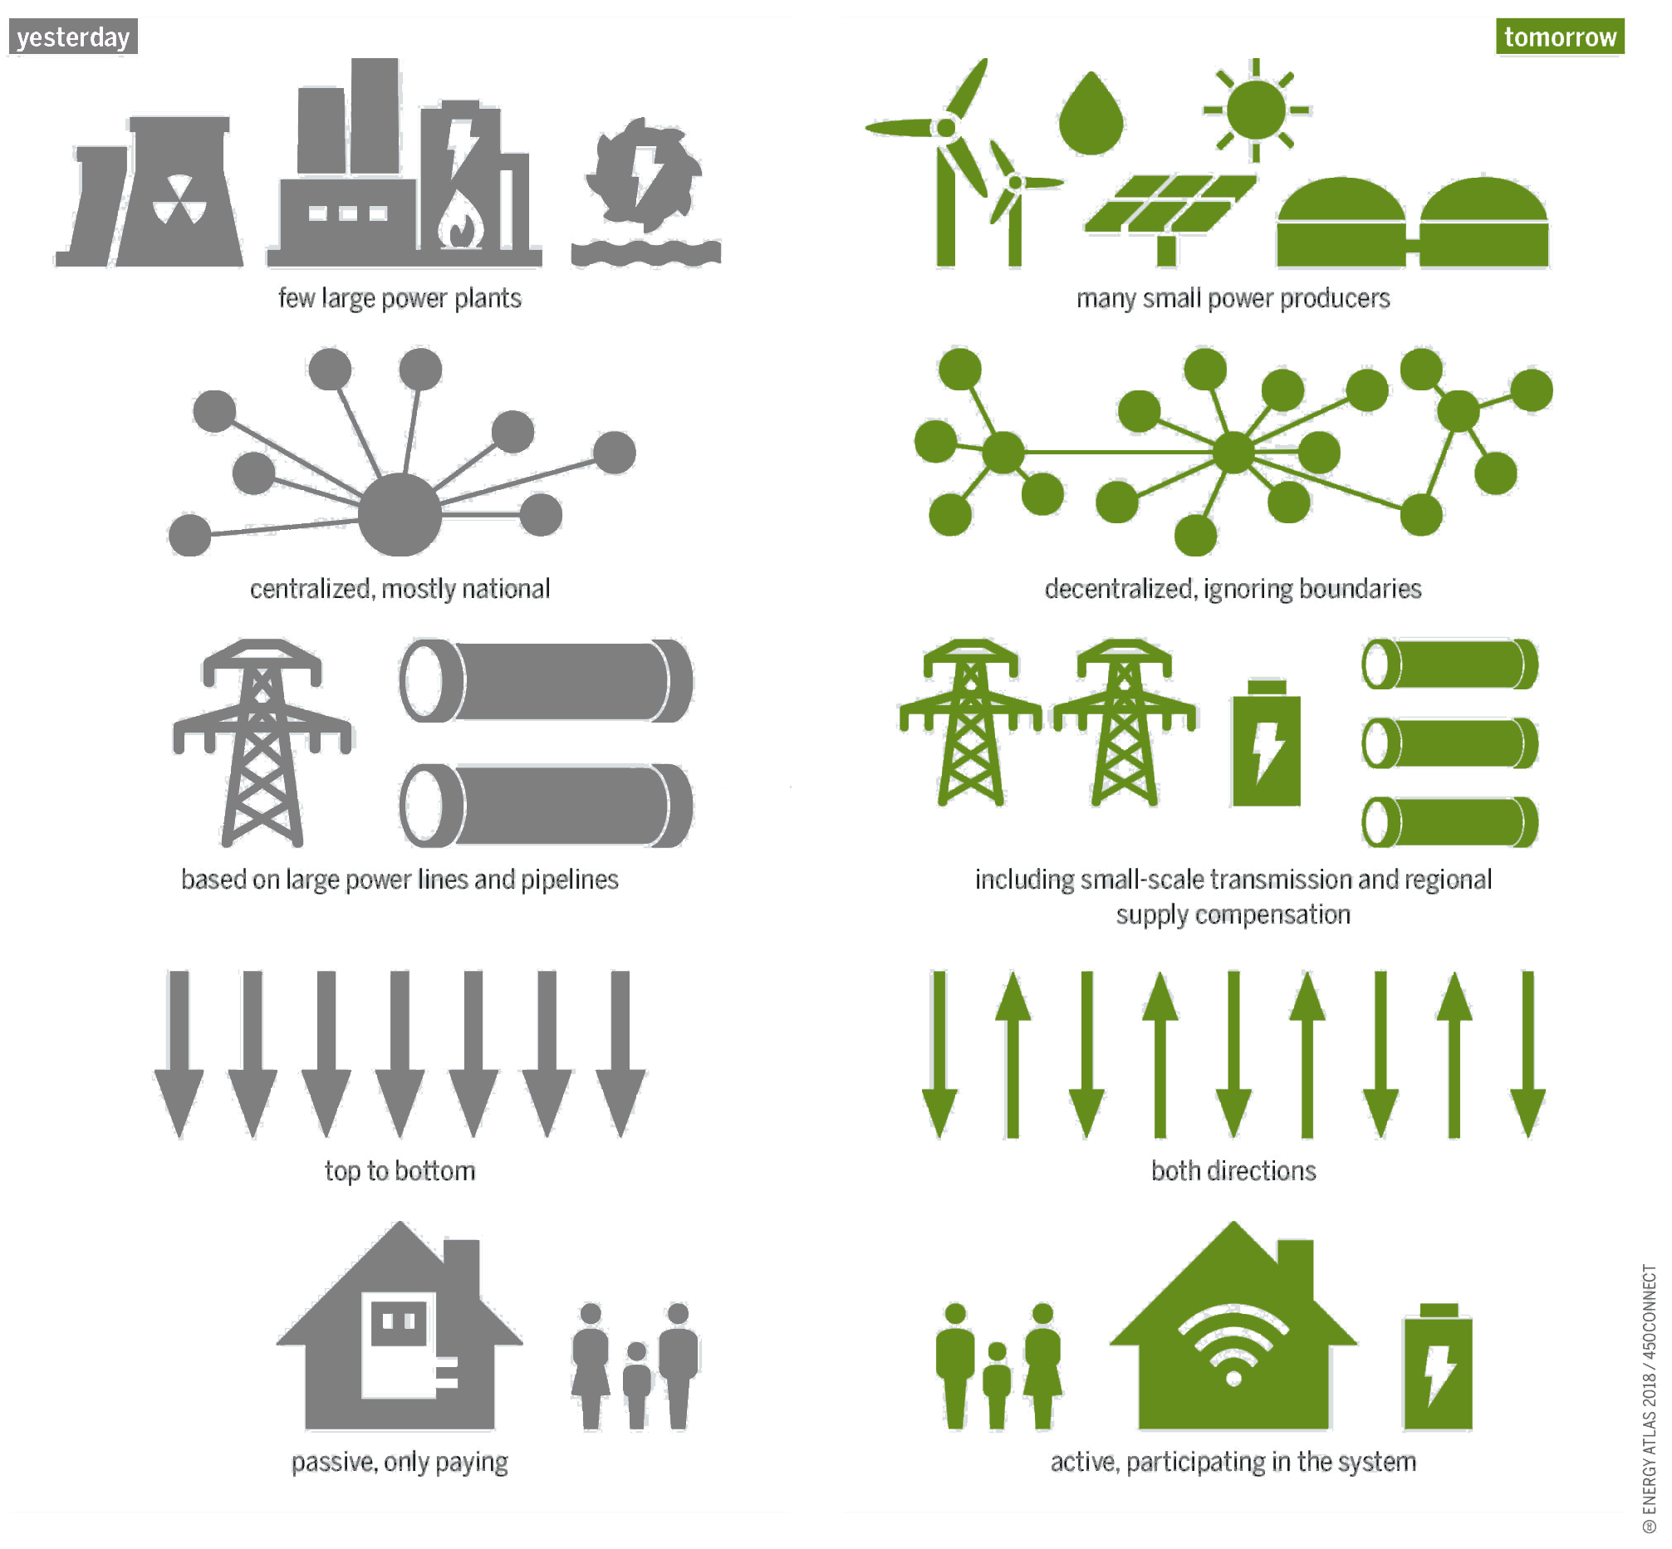
Smart Grid
Transformation of the industry → digital transformation of the infrastructure
generation
few, large power plants
many, small power producers
market
centralized, mostly national
decentralized, ignoring boundaries
transmission
based on power lines and pipelines
including small-scale transmission
and regional supply compensation
distribution
top to bottom
both directions
consumer
passive, only paying
active, participating in the system

Slide 3



Main issues with modern power grid
Fast growth and unpredictability (wind, solar, etc)
Cybersecurity risks
Aging infrastructure
No common standards

Slide 4
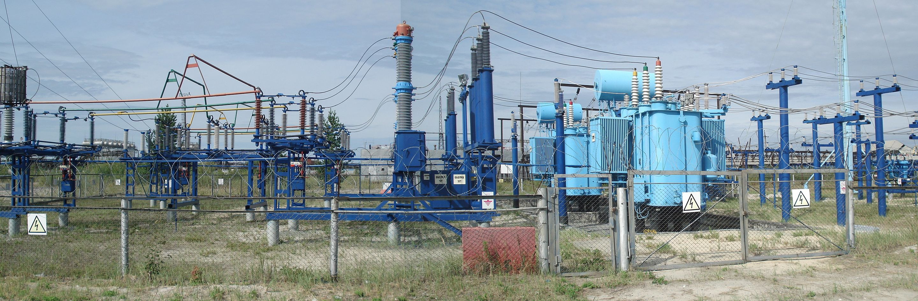
IEC 61850
Focused on improving the automation of electrical substations*
Interoperability: avoidance of proprietary protocols and easier integration of equipment from different manufacturers.
Economy: technologies that can reduce the amount of wiring and engineering time.
Maintainability: improvements in the commissioning and maintenance tasks.
*WHAT IS AN ELECTRICAL SUBSTATION?
Substations transform voltage from high to low (or vice-versa) and perform several other critical functions. Before power reaches the consumer from the generating station, it is likely to flow through several substations at different voltage levels.

Slide 5


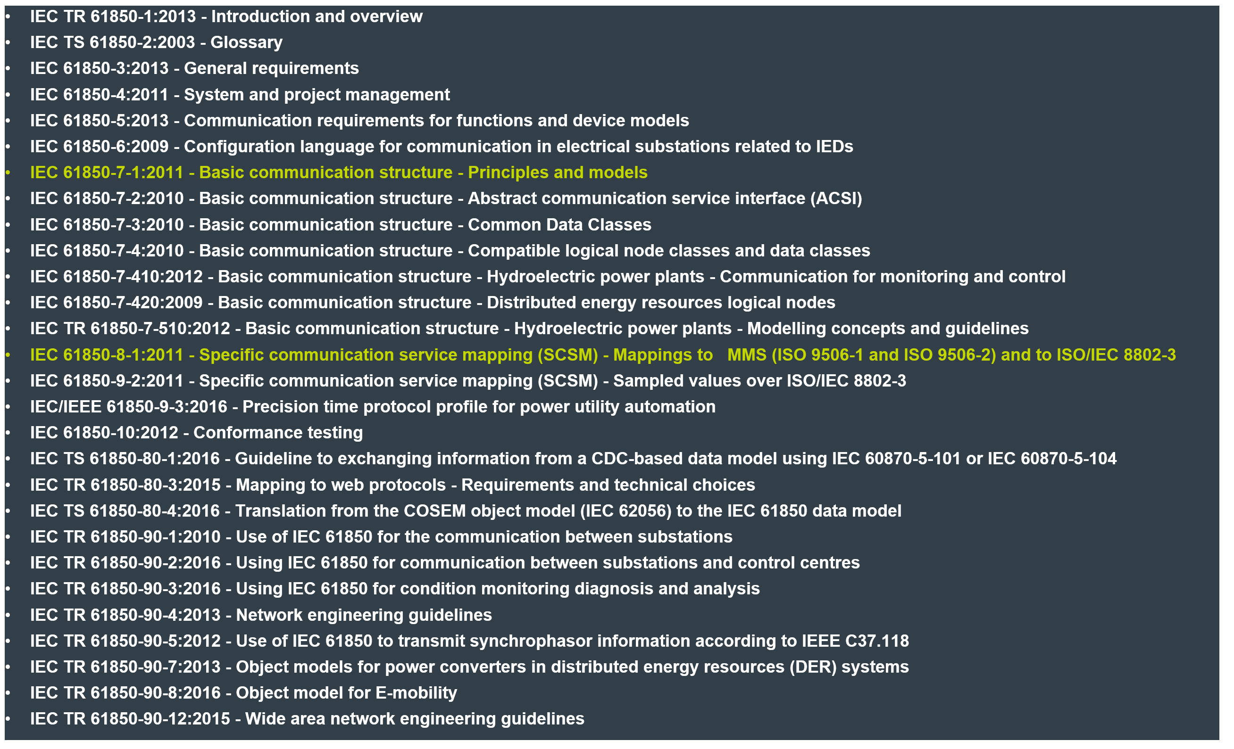
GOOSE
Generic Object-Oriented Substation Event
Generic Object-Oriented Substation Event
GOOSE is a communication model defined in IEC 61850
It features ultra-high messaging speed and improved reliability needed for sequence-of-event reconstruction where events may be separated by milliseconds.
IEC 61850 is a family of standards; GOOSE is only a small part of the standard’s content
Part 7-1
Part 8-1

Slide 6

GOOSE - Generic Object-Oriented Substation Event
Other competing protocols:
DNP3
EIP
Profibus
Profinet
Modbus
UCA2
IEC 608070-5-X
Why are we implementing it?
Owners of both Power Generation and power transmission/distribution show clear interest in IEC-61850 approach for remote control and data collection from grids and power plants.
GOOSE is often preferred over other protocols for substation automation and control because of its advanced features and capabilities, robustness, and reliability in harsh industrial environments, and ability to support real-time communication and advanced diagnostic information.
Hydro-Québec VibroSmart pilot project:
Joint work on integration of IEC 61850 VibroSmart solution into existing HQ
remote monitoring and control system for the whole fleet of HQ facilities
GOOSE protocol implementation
Limited support of SCL configuration features

Slide 7

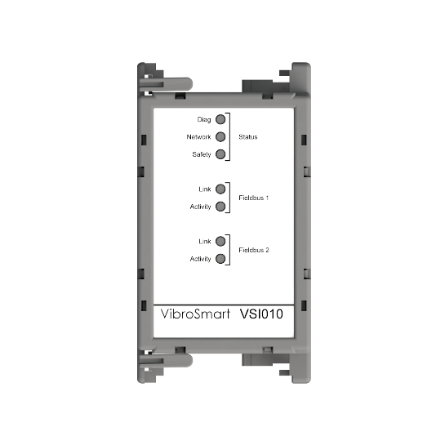
What is our IED?
Intelligent Electronic Device
In the context of GOOSE communication protocol, an IED (Intelligent Electronic Device) is a device that is used to monitor and control various electrical and automation systems. An IED typically contains digital inputs and outputs, and communication interfaces, and is capable of processing and exchanging information with other devices and systems in real-time.
The VSI010 is a IED

Slide 8
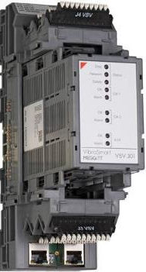
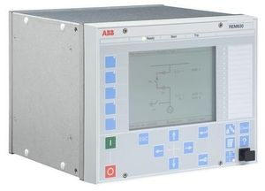
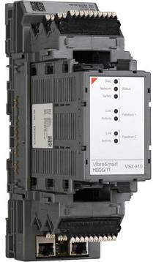
VibroSmart implementation – Block diagram Concept implemented at Hydro Québec
VSV30x
VSV30x
SMART RELAY
VSI010
VSV30x
IEC61850
GOOSE protocol
IEC61850
GOOSE protocol
NETWORK
VSV30x
GOOSE Subscriber
GOOSE Publisher
IEC 61850 – GOOSE
8
16 February 2023

Slide 9
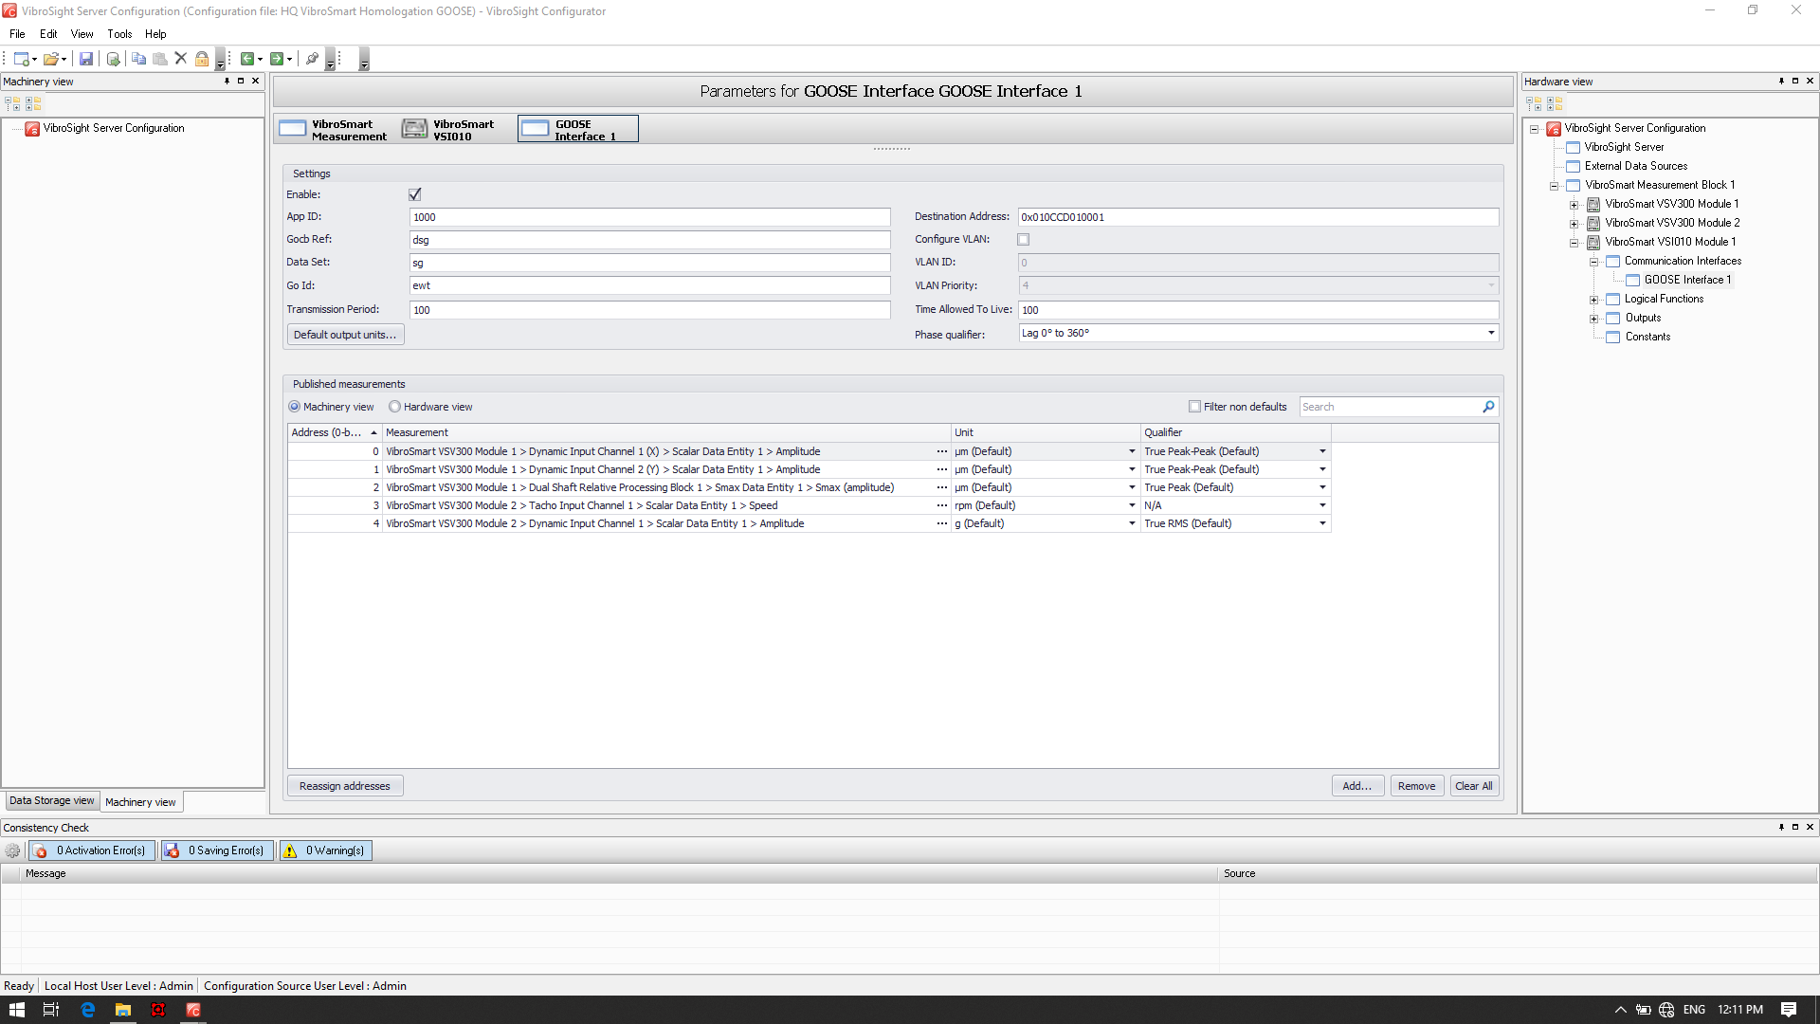
VibroSmart implementation – Configurator – VSI GOOSE interface
9
IEC 61850 – GOOSE
16 February 2023

Slide 10
PTP synchronization Vibrosmart
GSM – Abu Dhabi
presented by Samuel Delabays,
Technical Support
March 2022

Slide 11

The Precision Time Protocol (PTP) is used to synchronize clocks throughout a network. Allow accurate event correlation
Both NTP (Network Time Protocol) and PTP (Precision Time Protocol) use network to serve time to other devices and achieve time synchronization.
Firmware release prior 642-001-000-019 only provided NTP synchronization between the VibroSmart devices and other systems. The PTP synchronisation was only performed between VSV30x modules. With FW -020 and newer, it is now possible to sync the VSV30X modules to either a NTP or a PTP server.
With NTP, the VSV30x were able to achieve time synchronisation between 2 – 10ms and in some cases up to 50ms.
With PTP, the VSV30x can synchronise waveform measurement to sub-millisecond in order to correlate events from VibroSmart system with other systems such as circuit breakers or electrical events and allow accurate analysis (chain of events etc). Also the PTP synchronisation between module has been improved and the display sync has been redesigned in VibroSight vision enabling the “Elapsed Time” view for the waveform plot.

Slide 12


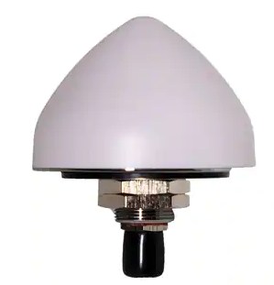
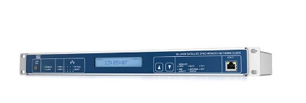
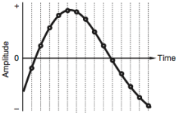
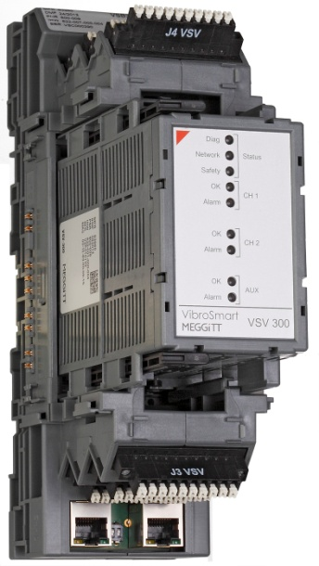
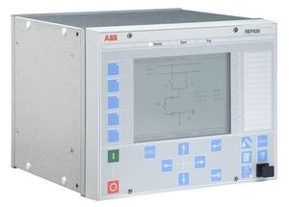

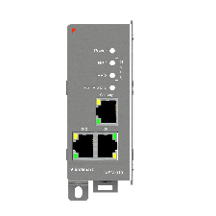
VibroSmart® PTP synchronization - Concept
Addition of PTP protocol with VSV30x. Tests showed that millisecond sync is achieved for waveform measurements between modules.
GPS SAT
PTP server
VSV #2
3rd party devices
Δ ≤1ms
The VSN010 runs the PTP deamon and acts as a bridge between PTP and PTCP
VSV #1
VSN010
PTP Layer 2 (or layer 3)
PTCP protocol definition within the Profinet context
12
DIGITAL PLANT - PTP
16 February 2023

Slide 13
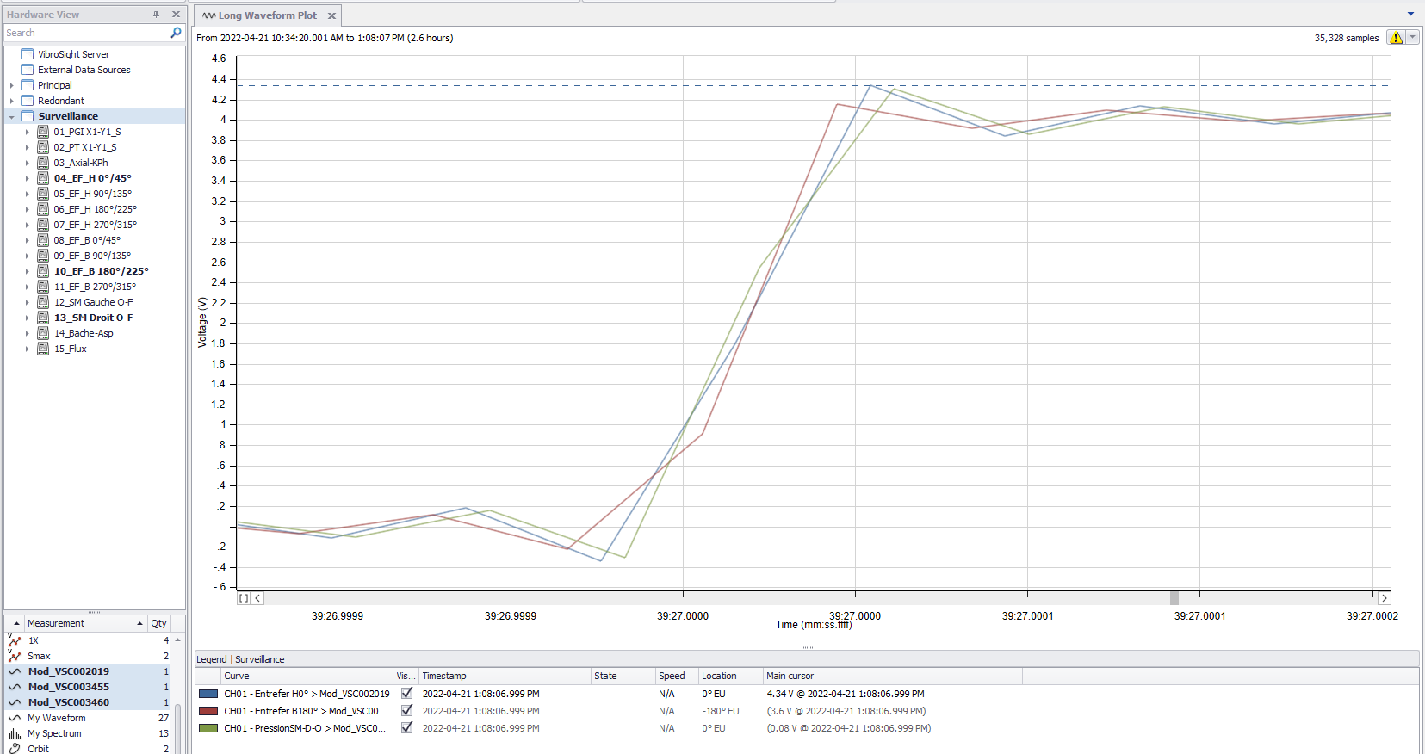

PTP – Test results
13
DIGITAL PLANT - PTP
16 February 2023

