Slide 1
DISTRIBUTED VS CENTRALIZED
SOLUTION
GRÉGORY ZURBRIGGEN, REGIONAL SALES MGR (Canada)
Notes:
complete, but make certain that time is spent discussing WHY in adequate detail. A key point is that if wire has already been pulled, the distributed system will not really save any money because its primary benefit is that it reduces the amount of wire and associated labor. Thus, if upgrading an existing system, the distributed option might not make sense. Distributed probably makes more sense if selling to OEMs doing small packages where everything is preinstalled and pre-wired (micro-hydro) or if installing something on a completely naked machine where no wiring has been run and you are starting with a blank sheet of paper.

Slide 2

Definitions
Monitoring system
Usually a standalone system
Usually monitors critical and complex parameters such as machine vibration and generator air gap
Typically interfaces with a plant’s distributed control system (DCS) via industry standard fieldbus communication protocols such as Modbus or OPC

Slide 3


Definitions
Monitoring system goals
Machinery protection system (MPS) | Condition monitoring system (CMS)
Very short-term view | Long-term view
Emergency shutdown (ESD): Relays used to initiate a shutdown | Trends: Diagnostics and prognostics for condition-based maintenance
Insurance against breakdown and injury | Insurance against unexpected failure

Slide 4
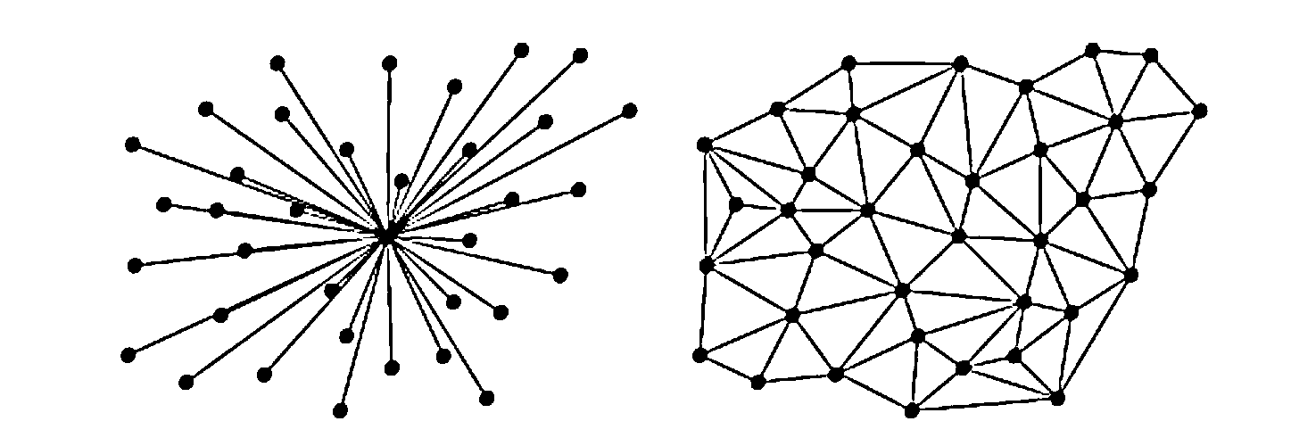
Definitions
Centralized vs distributed
Centralized
Distributed

Slide 5
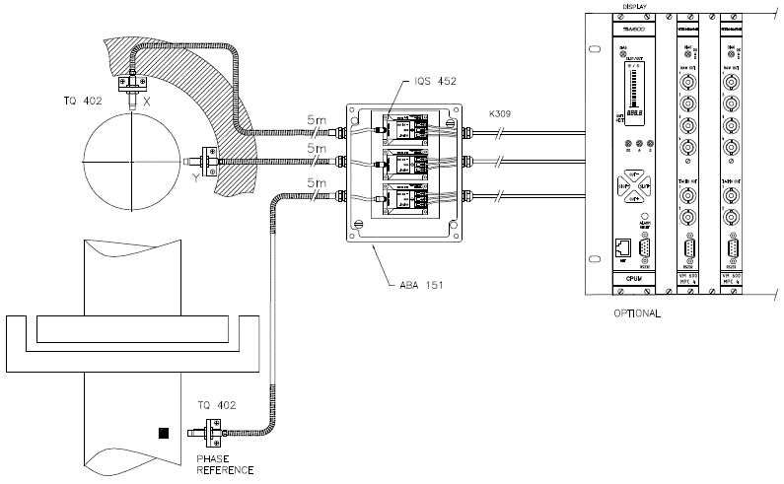
Centralized monitoring system
Components (1 of 2)
Sensors with high-quality analog cables
Signal conditioners installed in junction boxes
Field cables (analog) in conduits to machinery monitoring system in control room

Slide 6
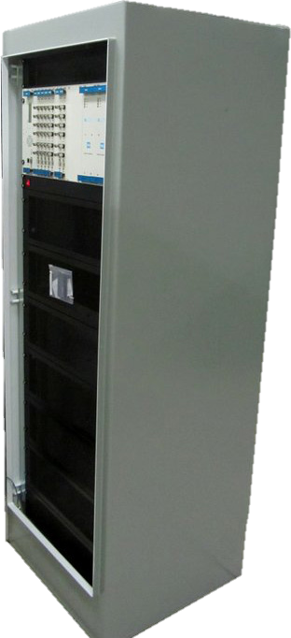
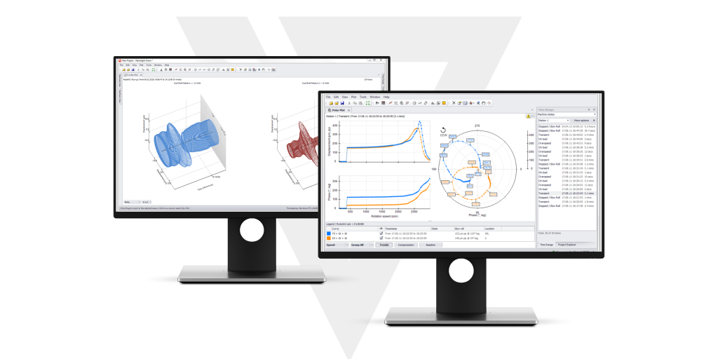
Centralized monitoring system
Components (2 of 2)
Centralized machinery monitoring system such as a 19” rack installed in a cabinet in a control room
Computer running data analysis and diagnostics software

Slide 7
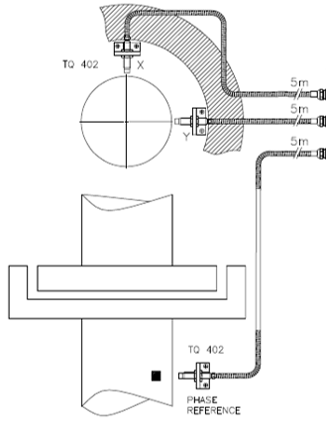
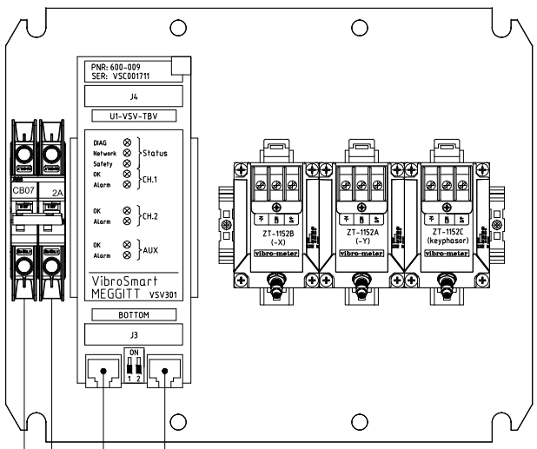
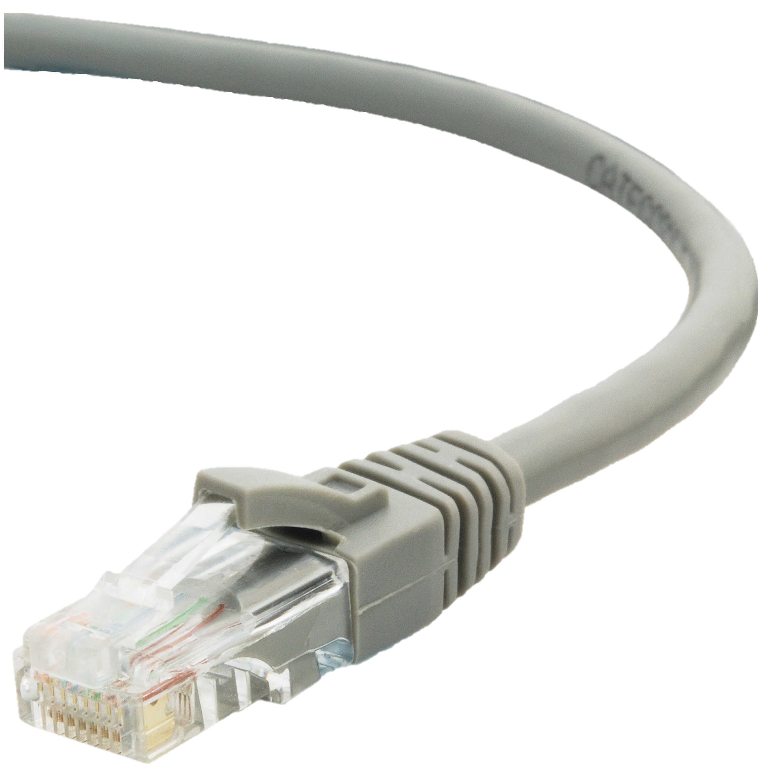
Distributed monitoring system
Components (1 of 2)
Sensors with high-quality analog cables
Signal conditioners and machinery monitoring modules installed in junction boxes
Ethernet cable (digital) to control room

Slide 8
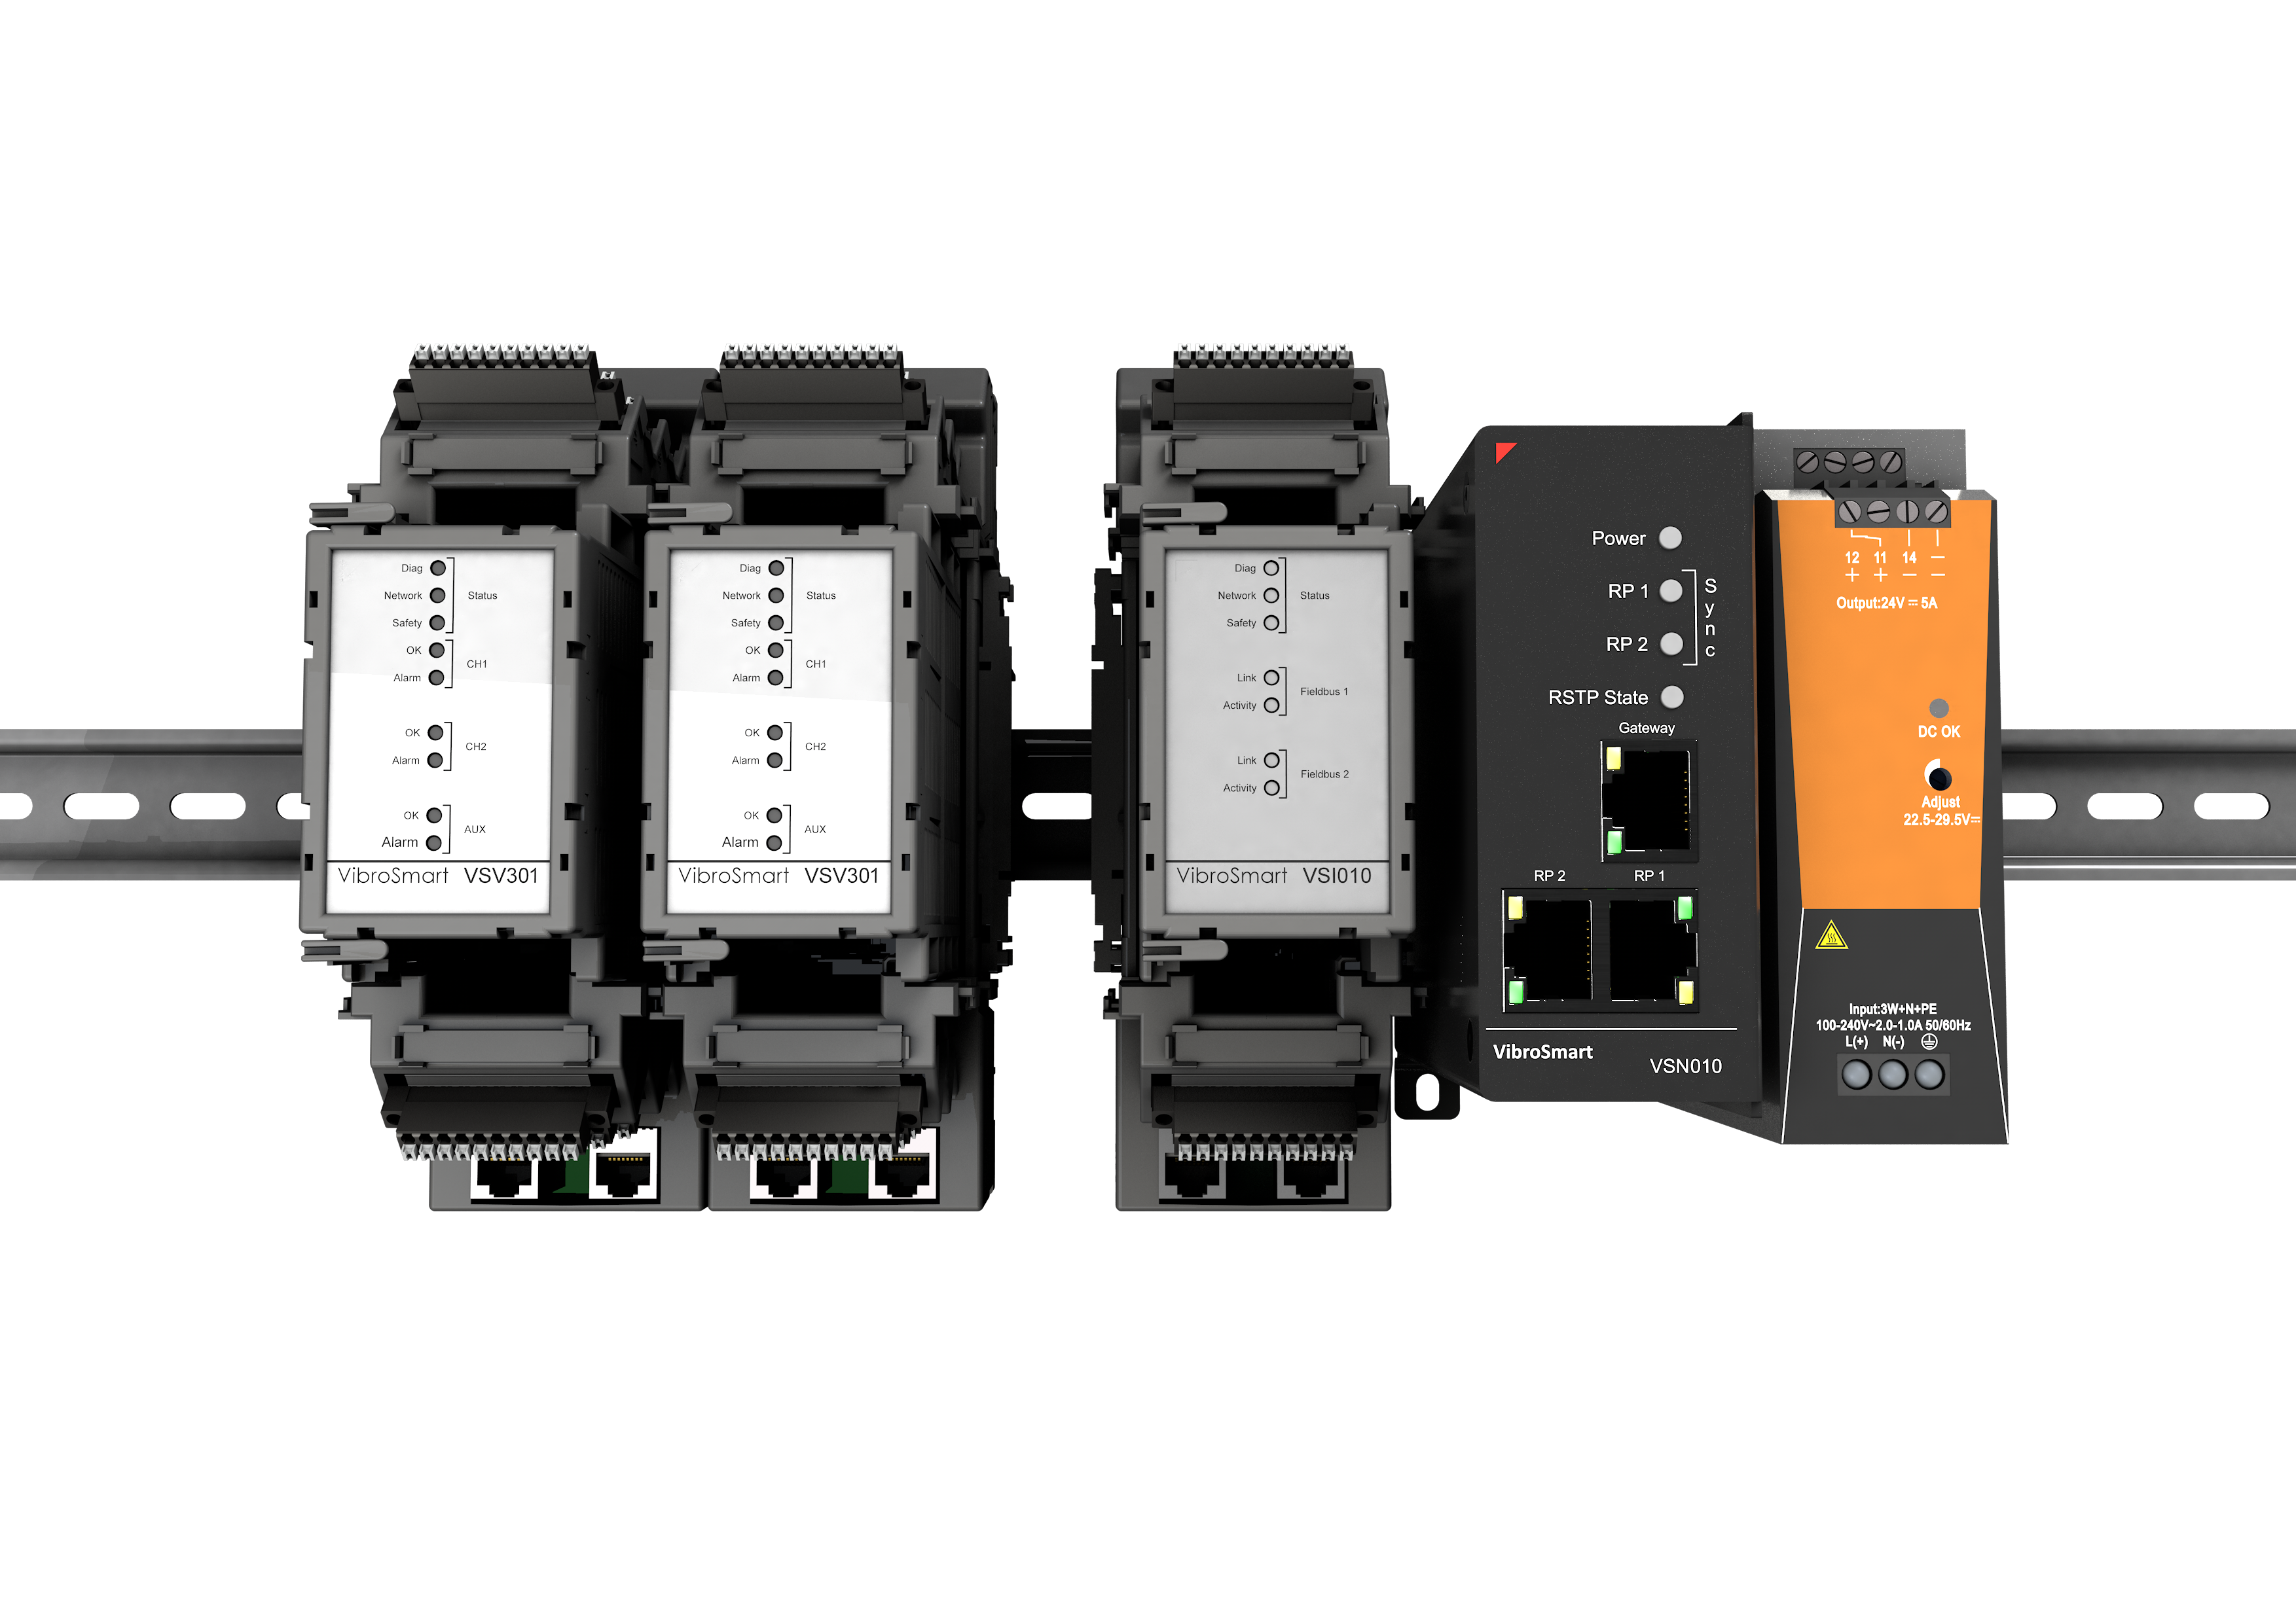
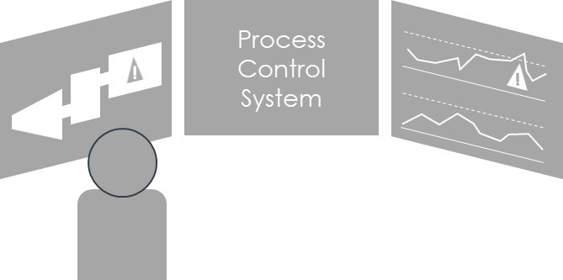
Distributed monitoring system
Components (2 of 2)
Ethernet cabling to connect the machinery monitoring modules together
Computer running data analysis and diagnostics software
1x Ethernet cable from the machinery monitoring modules to the control room

Slide 9
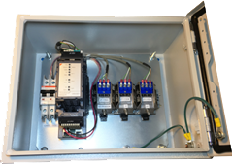
Distributed monitoring system
Benefits
Simpler infrastructure

Slide 10
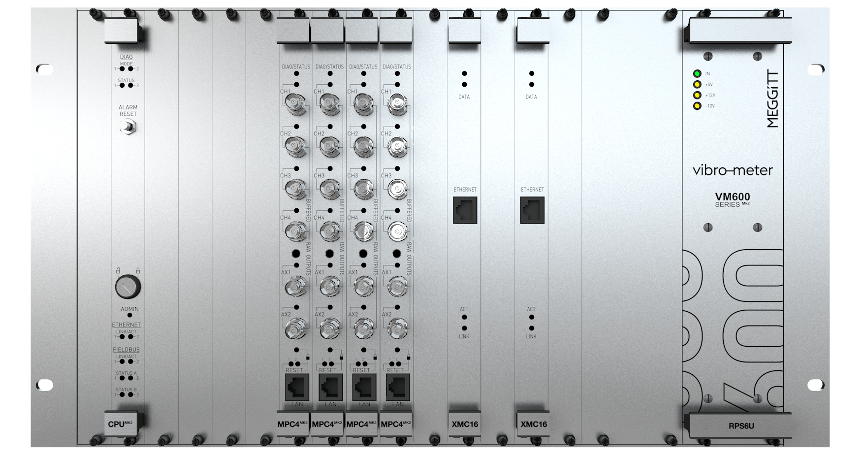
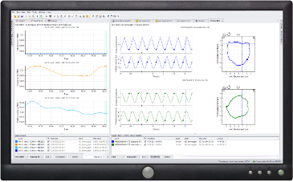
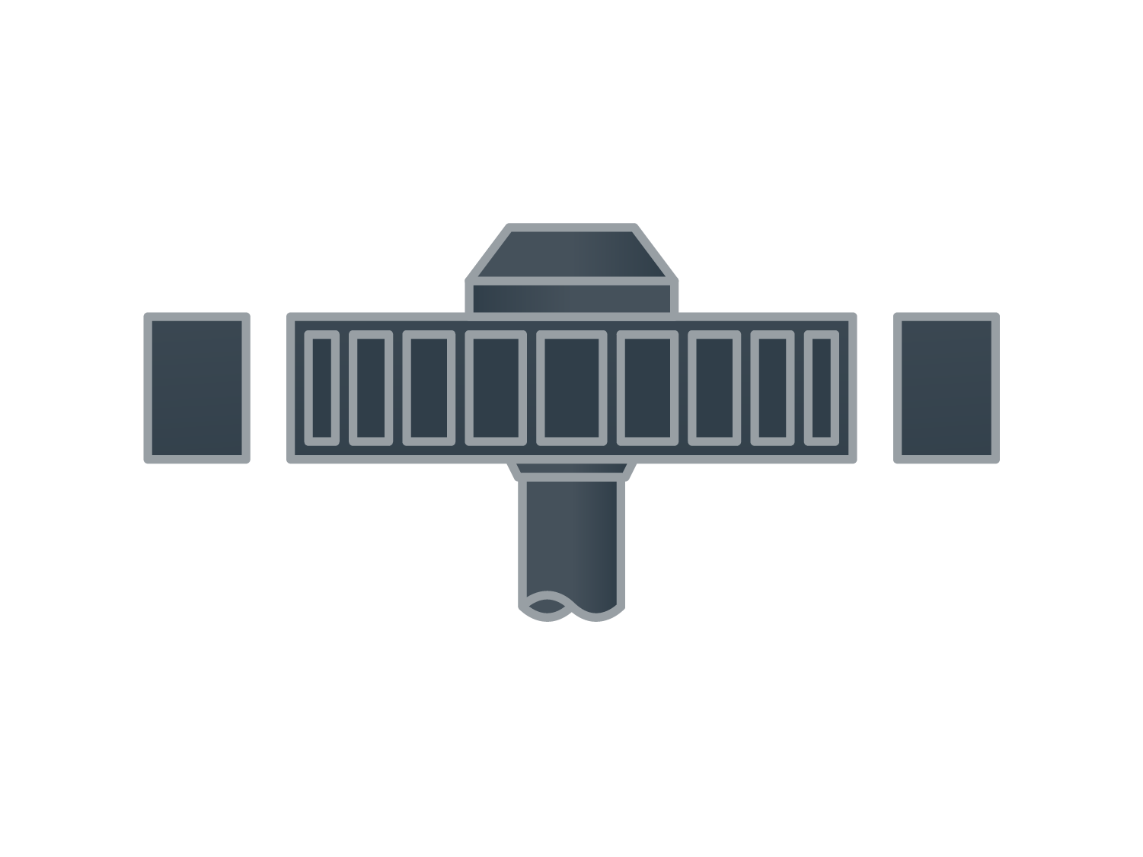
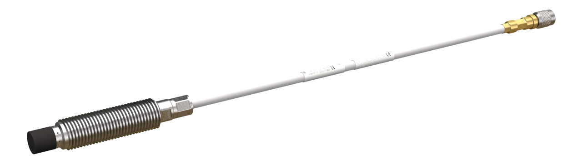
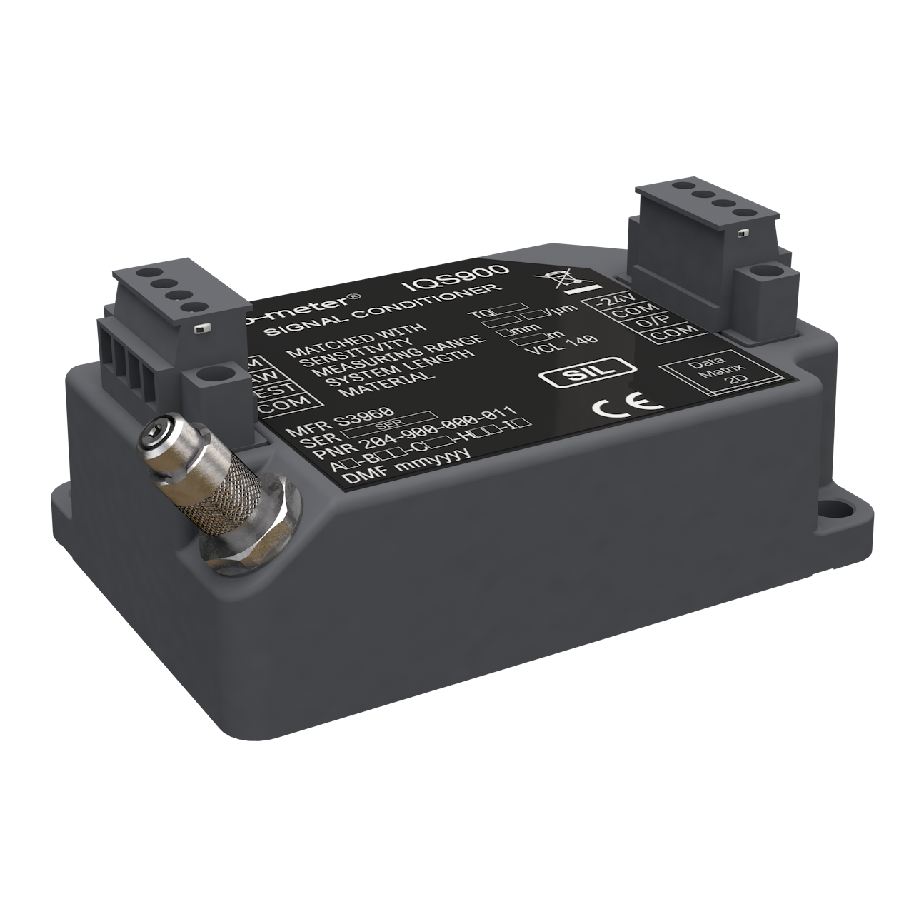

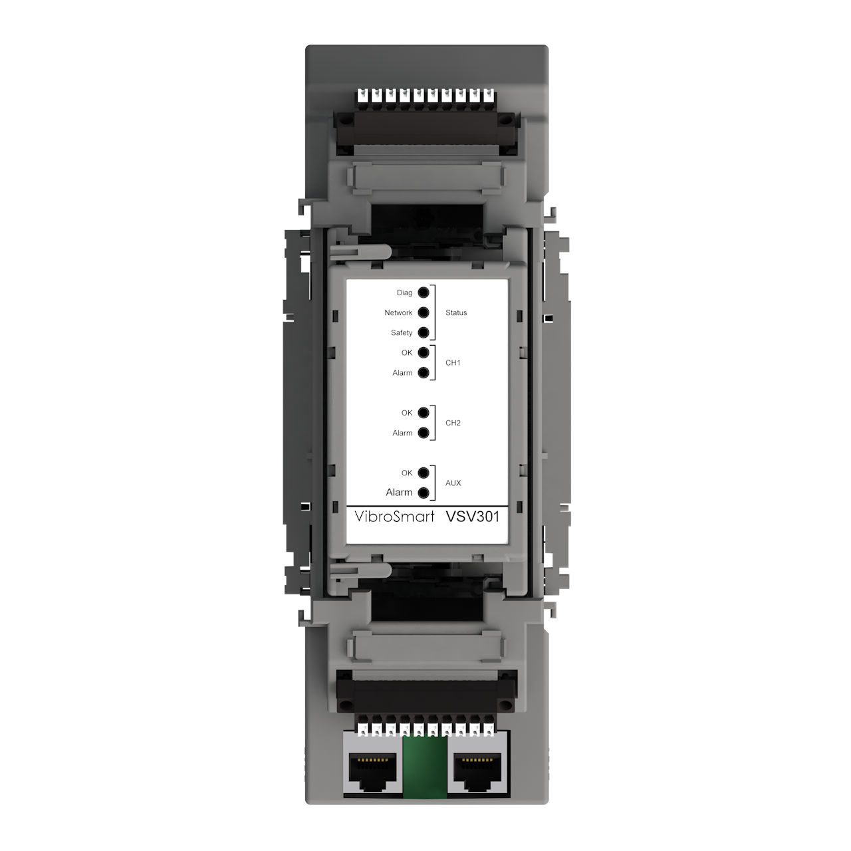
Distributed monitoring system
Benefits – less cabling and reduced installation labor
n x sensors
n x transmission cables
1 x network cable (CAT6 or fiber)
LONG @ € € € per meter
Variable cable length at € per meter
n x sensors
n x transmission cables
n÷2 modules
(in field JBs)
SHORT @ € € € per meter
Variable cable length at € per meter
MACHINE DECK
CTRL ROOM
CM ROOM

Slide 11
Comparison
Centralized vs. distributed
Feature/benefit | Centralized | Distributed
Installation costs reduced by up to 30% | no | yes
Digitization close to the sensor | no | yes
Smaller real-estate requirement for large channel count | yes | no
Secure IEC61850 communication | future | yes
MPS/CMS functionality segregation | yes | future
Compatible with any type or brand of sensor | yes | yes
Support for industry standard communication(Modbus/OPC) | yes | yes
Advanced data analysis capabilities | yes | yes
Remote access for troubleshooting and basic training | yes | yes

Slide 12
Comparison
Centralized vs. distributed
Installation Requirements | Centralized | Distributed
Retrofit of an existing centralized monitoring system | + | –
Retrofit of an existing distributed monitoring system | – | +
Installation of a new monitoring system | ≈* | ≈*
Add new measurement points to an existing monitoring system | ≈* | ≈*
* multi-factor considerations

