Slide 1

Energy presentation
Presenter:
Title:
Date:

Slide 2





OUR VALUES
TEAMWORK
We support each other and recognise outstanding contributions. We build highly skilled teams passionate about what we do and how we do it.
INTEGRITY
We conduct ourselves with integrity and the highest standards of ethical behaviour across the business.
EXCELLENCE
We enable the extraordinary at Meggitt. We deliver the most ambitious technologies, products and services safely, efficiently and cost-effectively.
CUSTOMER FOCUS
We always strive to understand our customer needs and will go the extra mile to deliver the best solution.
ENTREPRENEURSHIP
We take initiative and measurable risk to find innovative and market leading solutions.

Slide 3
Meggitt global footprint
Over 10,000 employees worldwide
UK
Employees: 2,623
Locations: 9
Europe
Employees: 1,060
Locations: 5
Denmark, France, Switzerland
United States
Employees: 5,115
Sites: 18
Rest of World
Employees: 1,216
Locations: 7
China, Mexico, Singapore, Vietnam
As at 1 July 2020

Slide 4
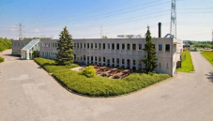
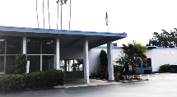
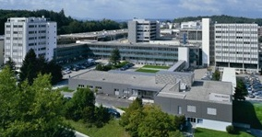
Energy Sensing & Controls footprint
MEGGITT
Piezoceramics
Kvistgaard (DK)
MEGGITT
Valves & Actuators
San Diego (USA)
Integrators / Distributors
MEGGITT
Condition Monitoring
Fribourg (CH)
Meggitt offices
Meggitt Energy factories

Slide 5
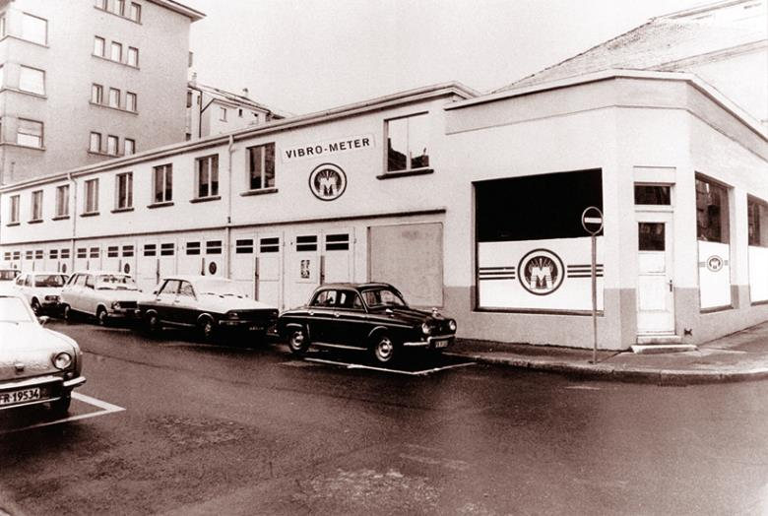

Legacy – Innovation – success story

Slide 6
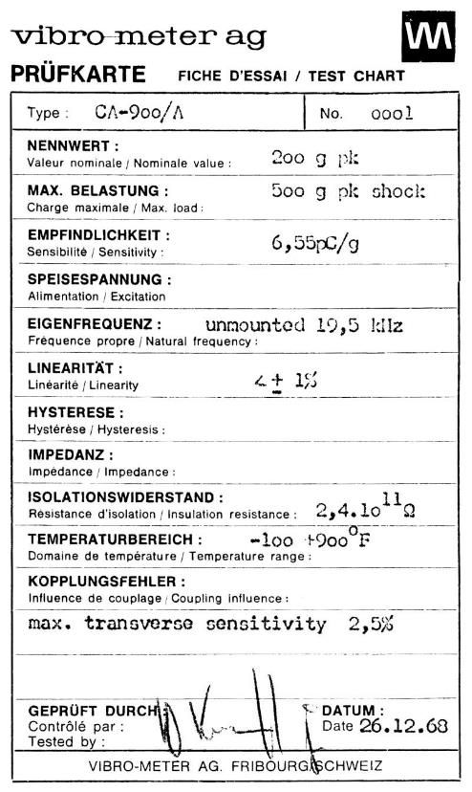
Legacy
100% predictability from sensors to decisions
In December 1968, vibro-meter launched the CA-900/A accelerometer and changed the world of vibration monitoring by reaching unprecedented temperature ranges (−196 to 700 °C).
54 years later we have sold thousands of piezoelectric accelerometers for gas turbine protection and monitoring worldwide.

Slide 7

Continuous Innovation
100% predictability from sensors to decisions
First high-temperature optical pressure sensor for turbines >500 °C, Fabry-Pérot interferometer for extreme environments
Extended measurement capability Full pressure measurement, extended bandwidth, improved stability and multiplexing
Improved sensitivity and accuracy Positioning as close as possible to the measurement point
Intrinsic reliability Insensitivity to electromagnetic interference and inherent compatibility with explosive atmospheres

Slide 8

Impactful Success story
100% predictability from sensors to decisions
20 % of all worldwide power turbines
Have our protection systems custom designed and installed
80 % of all medium and large gas turbines worldwide
Use our combustion monitoring solutions to monitor and protect
Helping to ensure power for millions of people
Our protection and monitoring systems are installed on the majority of Switzerland’s and Canada’s hydropower plants

Slide 9




OUR VISION
100 % predictability from sensors to decisions – creating value to our customer beyond products
How we achieve it:
High-performance culture (HPC)
Competitive solutions
Customer focus
OUR KEY SEGMENTS
Power generation
Gas turbines and steam turbines
Hydro turbines
Nuclear power
Adjacent markets
High-value asset monitoring
Selected projects
OUR VISON
OUR KEY SEGMENTS
OEM
Partnering on specific solutions with long-term revenue, global account management
End users
Increasing visibility and trust to deliver high-margin projects based on our existing hardware and software
OUR CUSTOMERS
New solutions Derived from existing products

Slide 10



Portfolio overview
3 Product Lines
Technical
Center of Excellence
4 Regional
Field Service Centers
Product portfolio performance, development and maintenance
Offers fully integrated solutions and value to our customers
Delivers and supports our product and solutions portfolio, including services
Our products, solutions and services enable our customers to reliably operate critical infrastructure without disruption
Notes:
Customer centric, small and agile,
We offer tailored made and competitive products, solutions and services to our customers,
We deliver differentiated protection and condition monitoring solutions with highly demanding requirements to the power generation industry and other adjacent markets

Slide 11

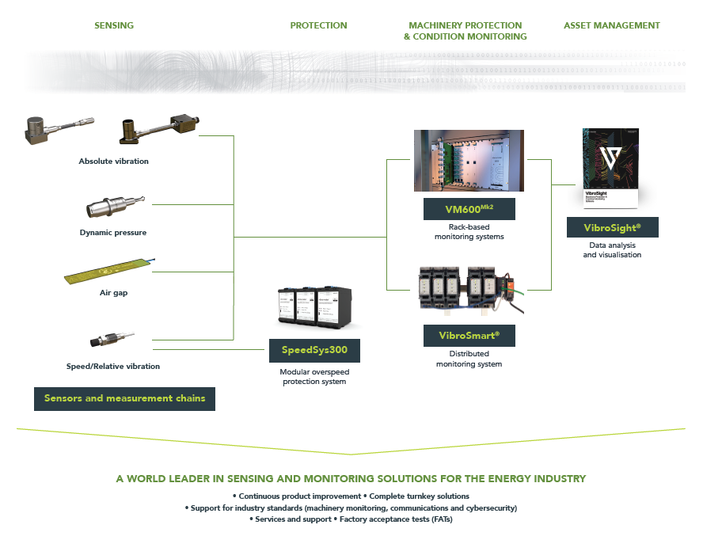

Slide 12
Sensors & measurement chains
Sensors / measurement chains to monitor critical plant and equipment

Slide 13
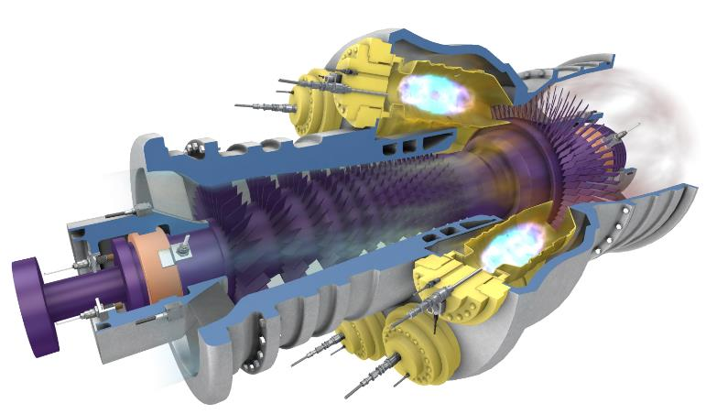
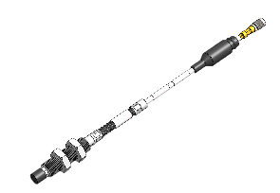
Sensing solutions for harsh environments
Gas turbines
Absolute vibration
(accelerometers)
Displacement - Position - Speed
(proximity sensors)
Combustion
(dynamic pressure sensors)

Slide 14
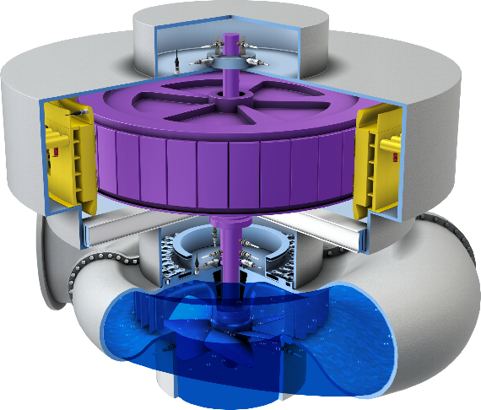


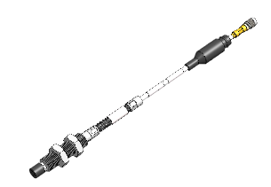
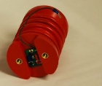
Sensing solutions
Hydro turbines
Absolute vibration
(accelerometers)
Rotor-stator gap
(air-gap sensors)
Vibration as velocity
(velocity sensors)
Displacement - Position - Speed
(proximity sensors)
Winding current
(partial discharge)

Slide 15
Protection & monitoring systems
Protection and monitoring systems for critical rotating machinery

Slide 16
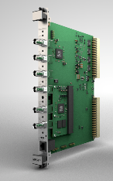
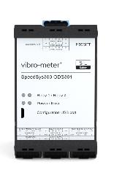
PORTFOLIO OVERVIEW Advanced machinery protection, condition and performance monitoring for high-value rotating machinery
VM600^{Mk2} Centralized rack-based advanced machinery protection and condition monitoring system.
* Standard rack heights of 6U and 1U.
Protection and/or condition monitoring
VibroSmart® Distributed module-based scalable system suitable for both smaller and larger rotating machinery.
SpeedSys300 Scalable, robust and independent layer of protection to deliver fast and reliable protection against overspeed.
Overspeed detection and protection

Slide 17
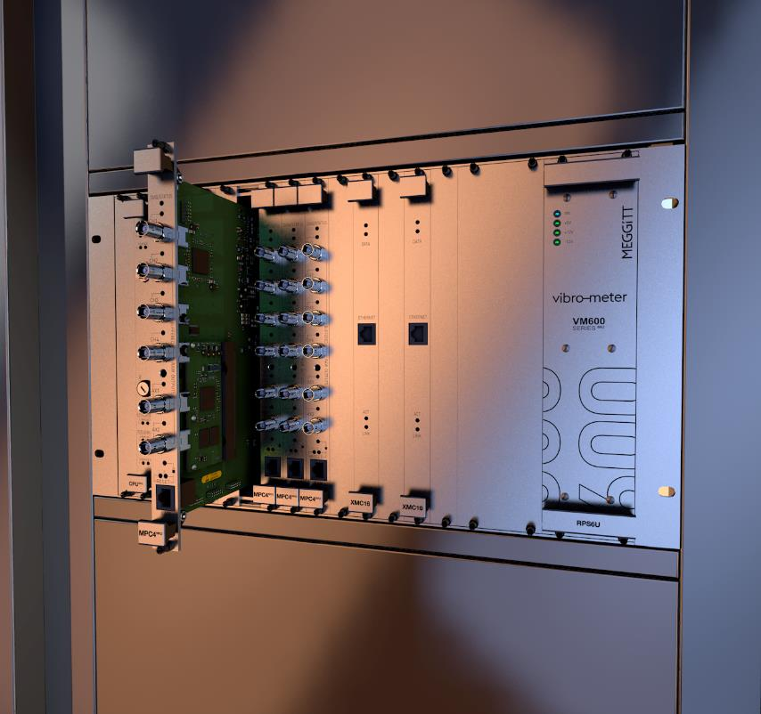
DESIGN CONCEPT
VM600^{Mk2}
Centralized system – designed to centrally process a wide range of different input signals coming from a variety of critical assets.
All measurements in one module – enables complex systems to be built with a minimum number of modules (modular structure with smart function combination).
MPC4^{Mk2} module supports machinery protection and condition monitoring
Flexible network architecture – easy integration with VibroSmart® distributed monitoring system for optimal and flexible network architecture in a condition monitoring system platform.
Industry standards
API 670 compliant.
Cybersecurity in accordance with IEC 62443.
SIL 2 in accordance with IEC 61508.

Slide 18


Our Legacy
VM600 success story
20+ years of machinery monitoring success
VM600 was introduced to the market in 2001
Over 8,000 VM600 racks installed worldwide with:
40,000 machinery protection modules (MPC4)
5,500 condition monitoring modules (/XMV16/XMC16/CMC16)
Innovation drive: VM600^{Mk2} is our latest rack-based system for protection and condition monitoring (replacing the VM600)

Slide 19
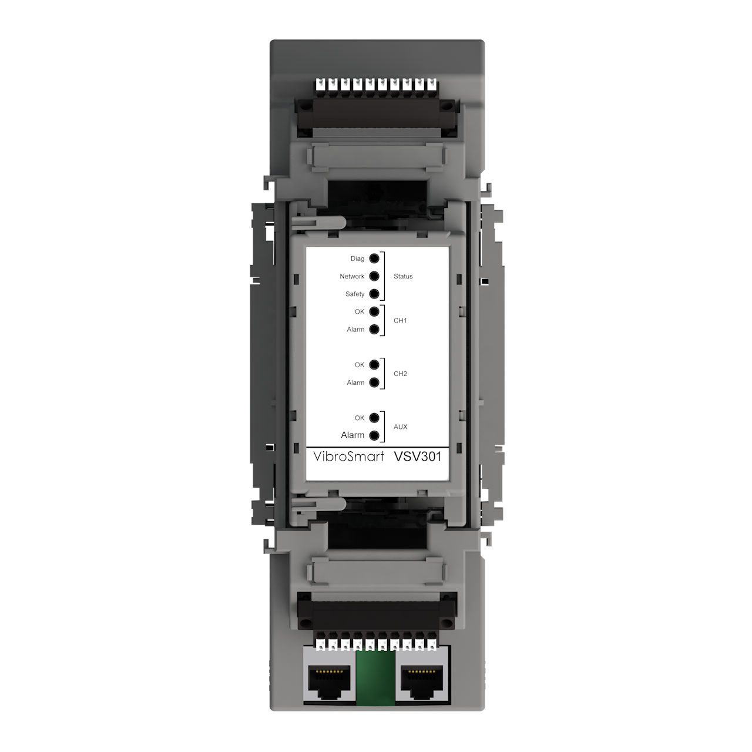
DESIGN CONCEPT
Distributed system
Modular and scalable system designed for condition monitoring and machinery protection applications of critical assets.
Flexible Highly scalable and easy to extend.
Wide range of applications From stand-alone module on balance of plant equipment, up to several connected units for larger critical rotating machinery.
Real-time communication Via Ethernet or fieldbus.
Lower installation costs Skid-mounting of modules closer to machinery reduces expensive cabling.
Industry standards
API 670 fully compliant
Cybersecurity certification per IEC 62443
SIL 2
ATEX-certified (Zone 2)
VibroSmart VSV301

Slide 20
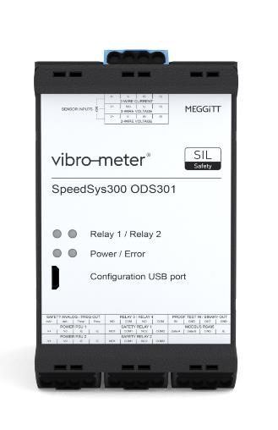
DESIGN CONCEPT
SpeedSys300 ODS301
Versatile modular architecture Design supports industry-standard speed sensors and uses external voting logic to ensure cost-effective solutions.
Advanced self-monitoring Advanced self-monitoring and diagnostics ensures accurate and reliable operation, with a proof-test interval of 10 years. Easy to install & retrofit Module and associated configuration software have been designed for ease of use which makes it suitable to any critical application (overspeed, underspeed and/or acceleration).
Driven by certification
API 670 compatible overspeed detection system (ODS).
SIL 3 in accordance with IEC 61508.
ATEX/IECEx Zone 0,1,2 (Ex ia) isolated inputs.

Slide 21
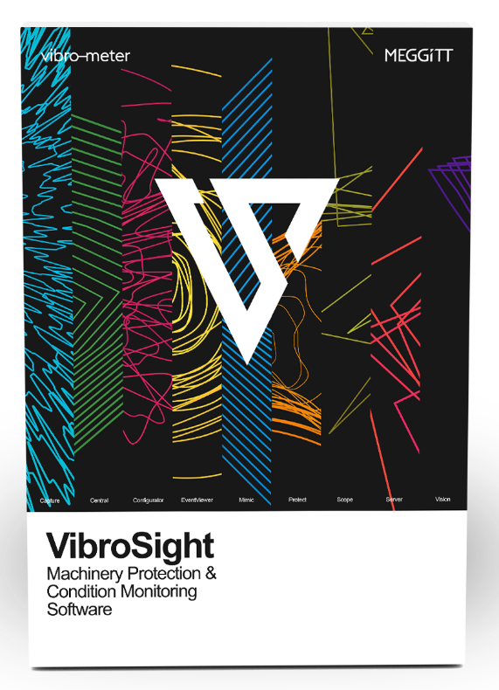
Software solutions
Advanced machinery protection and condition monitoring software for VM600 and VibroSmart® systems

Slide 22
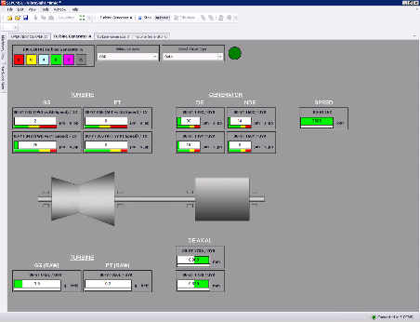
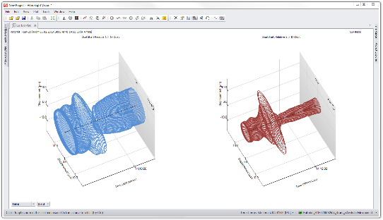
VibroSight® machinery monitoring system software
For VM600^{Mk2}/VM600 and VibroSmart® systems
Complete software suite
Highly-integrated software suite that supports the effective monitoring of all rotating machinery.
Modular design
Client-server architecture adapts to different machinery monitoring applications.
User-friendly User-friendly software modules with a deliberately simple and straightforward graphical user interface help to make tasks intuitive.
Powerful Proprietary VibroSight databases with optimised data handling for the fastest data retrieval and display, and tightly-integrated data management
Applications: Machinery vibration monitoring and analysis, Rolling-element bearing analysis, Hydro air-gap and magnetic-flux monitoring and analysis, Dynamic combustion monitoring and analysis, and more …

Slide 23
Thank you

Slide 24
Disclaimer
Business legal entity, Business address
Legal entity registration information as appropriate
Information contained in this document may be subject to export control regulations of the United Kingdom, European Union, United States or other national jurisdictions, including the US International Traffic in Arms Regulations and/or Export Administration Regulations.
Each recipient of this document is responsible for ensuring that transfer or use of any information contained herein complies with all relevant Export Control Regulations.
Copyright © 2022 Meggitt SA. All rights reserved.

