Slide 1

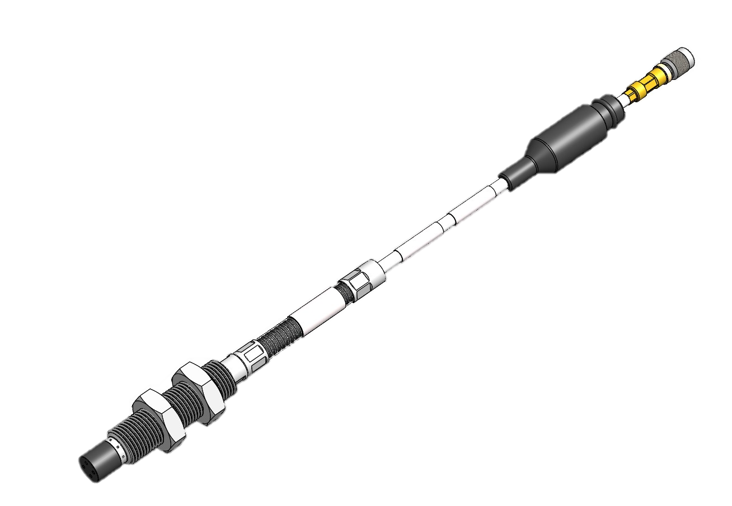
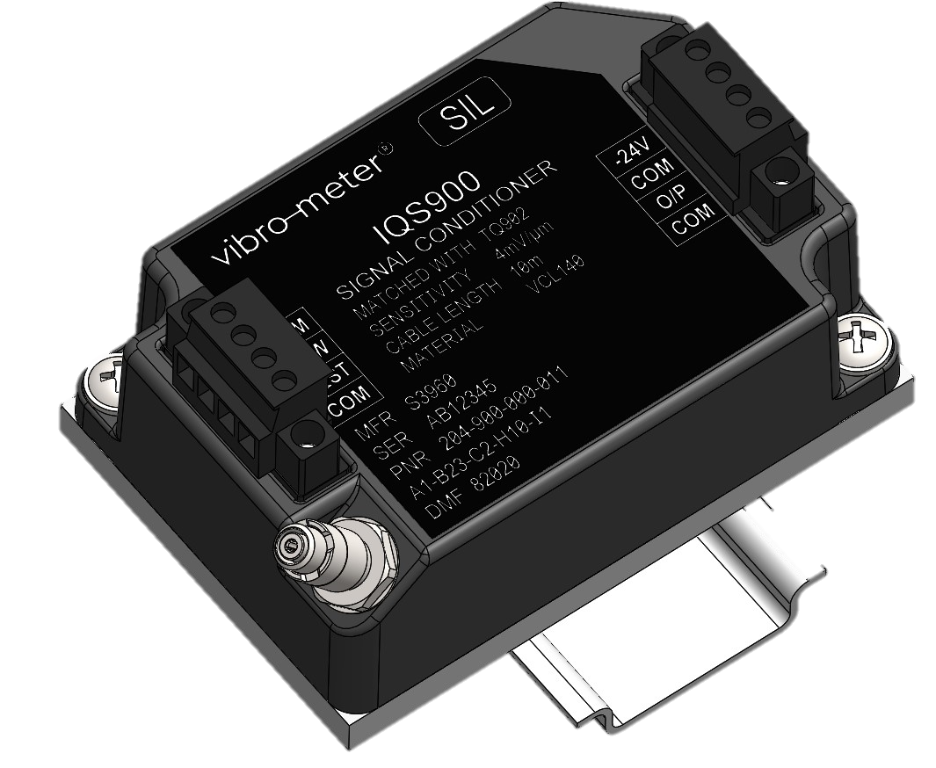
TQ9xx, EA90x and IQS9xx New Proximity Measurement Chains
Presenter:
Title:
Date:

Slide 2
TQ9xx, EA90x and IQS9xx proximity measurement chains
Context
Safety-driven market
Compliance with the latest EMC standards (EU conformity) and environmental directives (RoHS)
Safety (SIL) certification required by different markets
API 670 5th edition compliance required by oil & gas market
Legacy
More than 100,000 vibro-meter proximity measurement chains/systems sold globally
Decades of experience in harsh environments
Design
Obsolescence of several components for the IQS45x signal conditioner
Improve design characteristics: match or better the outstanding specifications and performance of our TQ4xx, EA40x and IQS45x proximity measurement systems
Backward compatibility with existing TQ4xx, EA40x and IQS45x systems
New IQS9xx platform for a low-power solution with a 4 to 20 mA current output (IQS910)
New IQS9xx platform for a measurement chain able to withstand nuclear environments (IQS7xx)

Slide 3
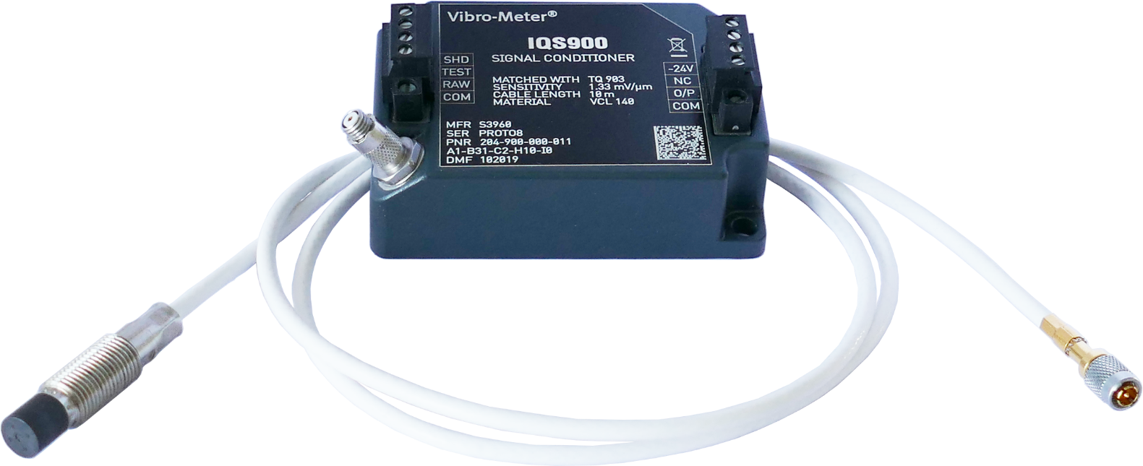
TQ9xx, EA90x and IQS9xx proximity measurement chains
Key features and benefits
Standards and certifications
Fully API 670 5th edition compliant
Ex certifications for many different regions and countries
SIL 2 certification by design for use in safety-related applications (functional safety contexts)
New features
IQS900 “TEST” input/pin allows signal conditioner (including transfer function) to be easily tested in situ
IQS900 “RAW output/pin allows senor and signal conditioner to be more easily tested in situ
Continuity
Backward compatible with TQ4xx, EA40x and IQS45x systems
Configurable IQS900 measurement range / sensitivity for different TQxxx sensors
Current (2-wire) output for long distance signal transmission or voltage (3-wire) output

Slide 4
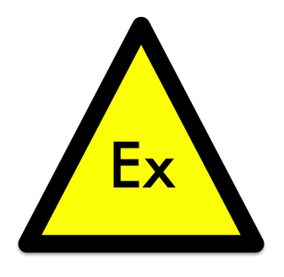



Environmental and certifications
Technical improvements
Tested for EMC against EN 61326-3-2 by an accredited laboratory in accordance with IEC 61508 (SIL) regulations.
New grounding concept improves frame-voltage immunity.
Ex ec G and Ex ia G (gas) and Ex ia D (dust)
vs. Ex nA G and Ex ia G (gas) for the TQ/EA/IQS45x
Ex certifications
RF emission / susceptibility
Certification by TÜV SÜD
SIL 2 in accordance with IEC 61508 (functional safety standard).
Cat 1 PL c in accordance with ISO 13849 (safety of machinery standard).
Operating temperature
−40 to 85 °C for the IQS900
vs. −35 to 85 °C for the IQS450
Safety
Certified for use throughout the world

Slide 5
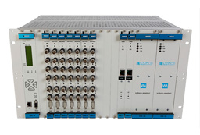
System compatibility
Technical improvements
Current (2-wire) signal transmission
IQS900 output impedance: > 60 kΩ vs. not defined for the IQS450
Recommended monitoring system input impedance: < 350 Ω
Improved output characteristics for better monitoring system compatibility
Voltage (3-wire) signal transmission
IQS900 output impedance: < 100 Ω (DC) / < 300 Ω (20 kHz) vs. < 435 Ω (DC) / < 800 Ω (20 kHz) for the IQS450
Improved voltage output signal transmission compared to IQS450
Recommended monitoring system input impedance: > 50 kΩ

Slide 6
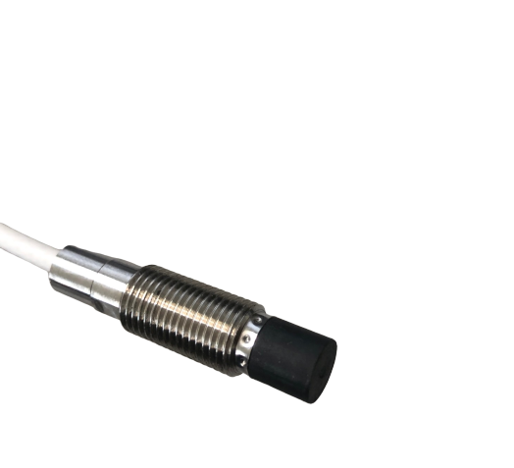
Fully compliant with API 670 5th edition
Technical improvements
TQ9xx sensor with PPS high-performance injection-molded thermoplastic tip, crimped to a stainless steel body
Differential pressure of 6 bar (100 psid) between sensor tip and body without leakage vs. 1 bar for the TQ4xx
TQ9xx sensors’s integral cable even more securely attached
Withstands pull test with a minimum tensile load of 225 N (50 lb) without damage vs. 200 N (45 lb) for the TQ4xx
TQ9xx/EA90x self-locking miniature coaxial connectors and cabling
Withstands pull test with a minimum tensile load of 225 N (50 lb) without damage vs. 100 N (22.5 lb) for the TQ4xx/EA40x

Slide 7
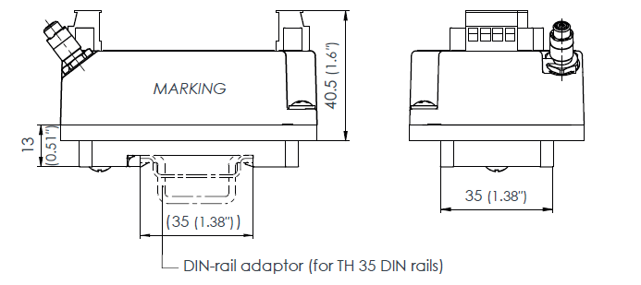
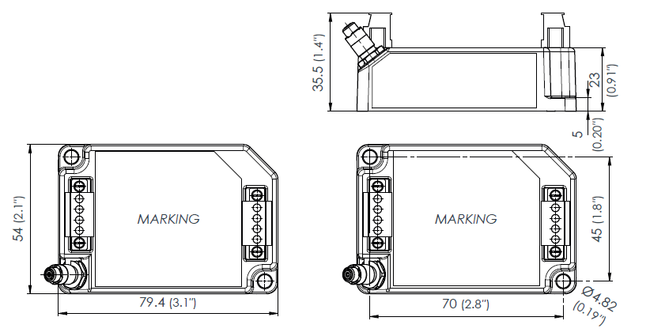
Installation
Technical improvements
Same physical footprint as IQS45x for easy replacement
Removable screw-terminal connectors simplify wiring
New compact and robust DIN-rail adaptor (for TH 35 DIN rails such as TH 35-7.5 or TH 35-15)

Slide 8
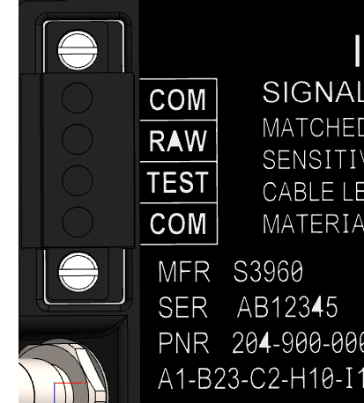
IQS900 system-level features
New features and improvements
RAW/COM output provides a “raw” voltage output signal that corresponds to the internal signal of the IQS900 signal conditioner, even if the IQS900 is configured with a current output. Note: The RAW output allows the measurement chain/system operation from sensor to signal conditioner to be easily verified in situ.
TEST/COM input allows a voltage input signal (AC) to be injected at the input to the IQS900 signal conditioner in order to test the IQS900 itself and/or cabling to the monitoring system. Note: The TEST input allows the measurement chain/system operation from signal conditioner to monitoring system to be easily verified in situ. Importantly, the TEST input supports the partial testing that is required in order to reach SIL 2 (increasing system safety).
Lower output impedance allows for improved voltage signal transmission and extended monitoring system compatibility (for example, reduced sensitivity error due to input impedance of connected apparatus).

Slide 9
Proximity measurement chains in safety-related applications
SIL 2 certification
TQ9xx proximity measurement chains using an IQS900 with diagnostics are SIL 2 “by design”
Existing TQ4xx measurement chains using an IQS900 with diagnostics are also SIL 2 by design
IQS900 with diagnostics is able to detect the following sensor / measurement chain problems:
Sensor missing or disconnected
Sensor short-circuited
Outputs short-circuited (TQxxx, EAxxx and/or IQS900)
Incorrect IQS900 power supply (outside of nominal input range)
Proof-test interval (PTI): 10 years
Diagnostic component (DC) value for an IQS900 |  |  | Measurement chain OK?
Description (output) | Current output (2-wire transmission) | Voltage output (3-wire transmission)
Normal operation | −15.5 to −20.5 mA | −1.6 to −17.6 V | Yes
Problem in the proximity chain | < −20.5 mA or > −15.5 mA | < −17.6 V or > −1.6 V | No

Slide 10
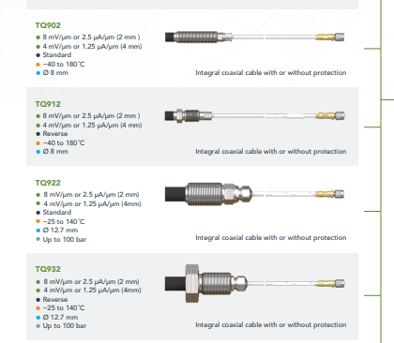
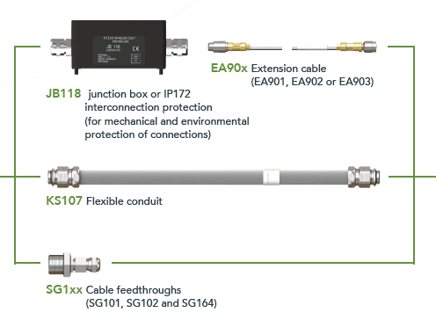
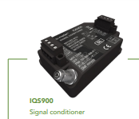
TQ9xx, EA90x and IQS9xx measurement chains overview
TQ9x2 / IQS900 measurement chains
TQ902/TQ912 and TQ922/TQ932 are available now, with different pressure capabilities:
TQ902/TQ912 (standard pressure): 6 bar at sensor tip (Ø 8.2 mm)
TQ922/TQ932 (high pressure): 100 bar at sensor tip (Ø 12.7 mm)

Slide 11
TQ9xx, EA90x and IQS9xx measurement chains overview
TQ9x2 / IQS900 measurement chain availability
TQ901, EA901 and IQS900
TQ903, EA903 and IQS900
TQ923, EA903 and IQS900
TQ942, EA902 and IQS900
IQS910 signal conditioner
Special low-power signal conditioner (based on IQS900)
Output: 4 to 20 mA current output only vs. current or voltage output for the IQS900
Power consumption: Standby current of 4 mA vs. −15.5 mA for the IQS900
Peakmeter processing: New signal processing (electronic stage) that converts the peak value of the dynamic component (AC) of the signal conditioner’s internal signal, corresponding to the measured vibration (displacement), into a nearly DC signal – that indicates the vibration level of a machine in a clear and simple way
Peakmeter monitoring: Peakmeter processing (input signal) is monitored by the IQS910 signal conditioner’s diagnostic circuitry (that is, built-in self-test (BIST)) that automatically detects and remotely indicates problems with a measurement chain
Note: In all other respects, the IQS910 and IQS900 will be the same: SIL safety, RAW output and TEST input functionality, etc.

Slide 12
TQ702/TQ712, EA702 and IQS742 measurement chains overview
Special versions of TQ9xx / IQS900 developed for nuclear applications
Proven Meggitt vibro-meter® reliability in nuclear vibration monitoring
General-purpose vibration monitoring in nuclear applications
Special radiation resistant versions for use in nuclear environments: TQ702/TQ712, EA702 and IQS742 (based on TQ902/TQ912, EA902 and IQS900)
The TQ702/TQ712 proximity sensors and EA702 extension cables are radiation-resistant components suitable for installation and operation in high-radiation nuclear environments: coaxial cable with ETFE (ethylene tetrafluoroethylene) insulation and coaxial LEMO connectors are used
A long EA70x extension cable is used to effectively lengthen the front-end in high-radiation environments, thereby allowing the IQS742 signal conditioner to be installed remote from radiation sources (in a non-irradiated area) and/or behind appropriate radiation protection, depending on the application
The TQ7xx sensor’s integral cable and the EA70x extension cable are available in fixed nominal lengths (1 m and 9 m respectively), which can be combined to obtain a total system length (TSL) of 10 m.

Slide 13
TQ/EA/IQS9xx
Useful links
Website product landing page:
https://meggittsensing.com/energy/proximitychains
Product overview (pdf download):
https://meggittsensing.com/wp-content/uploads/TQ9xx-EA90x-and-IQS900-product_overview-en_advance_information.pdf
Datasheet (pdf download):
https://meggittsensing.com/wp-content/uploads/DS_TQ902_TQ912_EA902_IQS900-en.pdf
Meggitt vibro-meter® Energy website:
https://meggittsensing.com/energy
vibro-meter® product catalogue
https://catalogue.meggittsensing.com

Slide 14
Thank you

Slide 15
Disclaimer
Business legal entity, Business address
Legal entity registration information as appropriate
Information contained in this document may be subject to export control regulations of the United Kingdom, European Union, United States or other national jurisdictions, including the US International Traffic in Arms Regulations and/or Export Administration Regulations.
Each recipient of this document is responsible for ensuring that transfer or use of any information contained herein complies with all relevant Export Control Regulations.
Copyright © 2022 Meggitt SA. All rights reserved.

