Slide 1

VM600 Mk2
Rack-based systems for machinery protection and/or condition monitoring
  Presenter:
Title:
Date:

Slide 2
VM600
Evolution through time
VM600 launch
VM600^{Mk2}
VM600 MPS (Mk1):
MPC4,
RLC16,
CPUM
MPSx software
VM600 SIL 2
“proven in use”
IRC4
CPUR
XMV16 and XMC16
VibroSight ® software
VM600 CMS:
CMC16
CMS software
AMC8
MPC4 SIL 1
CPUR2
2000
2005
2010
2015
2021
As of today (2022):
20+ years of machinery monitoring success
Over 8,000 VM600 racks sold worldwide – protecting and monitoring critical assets 24/7
40,000 MPC4/IOC4 machinery protection modules
5,500 CMC16/XMV16/XMC16 condition monitoring modules

Slide 3
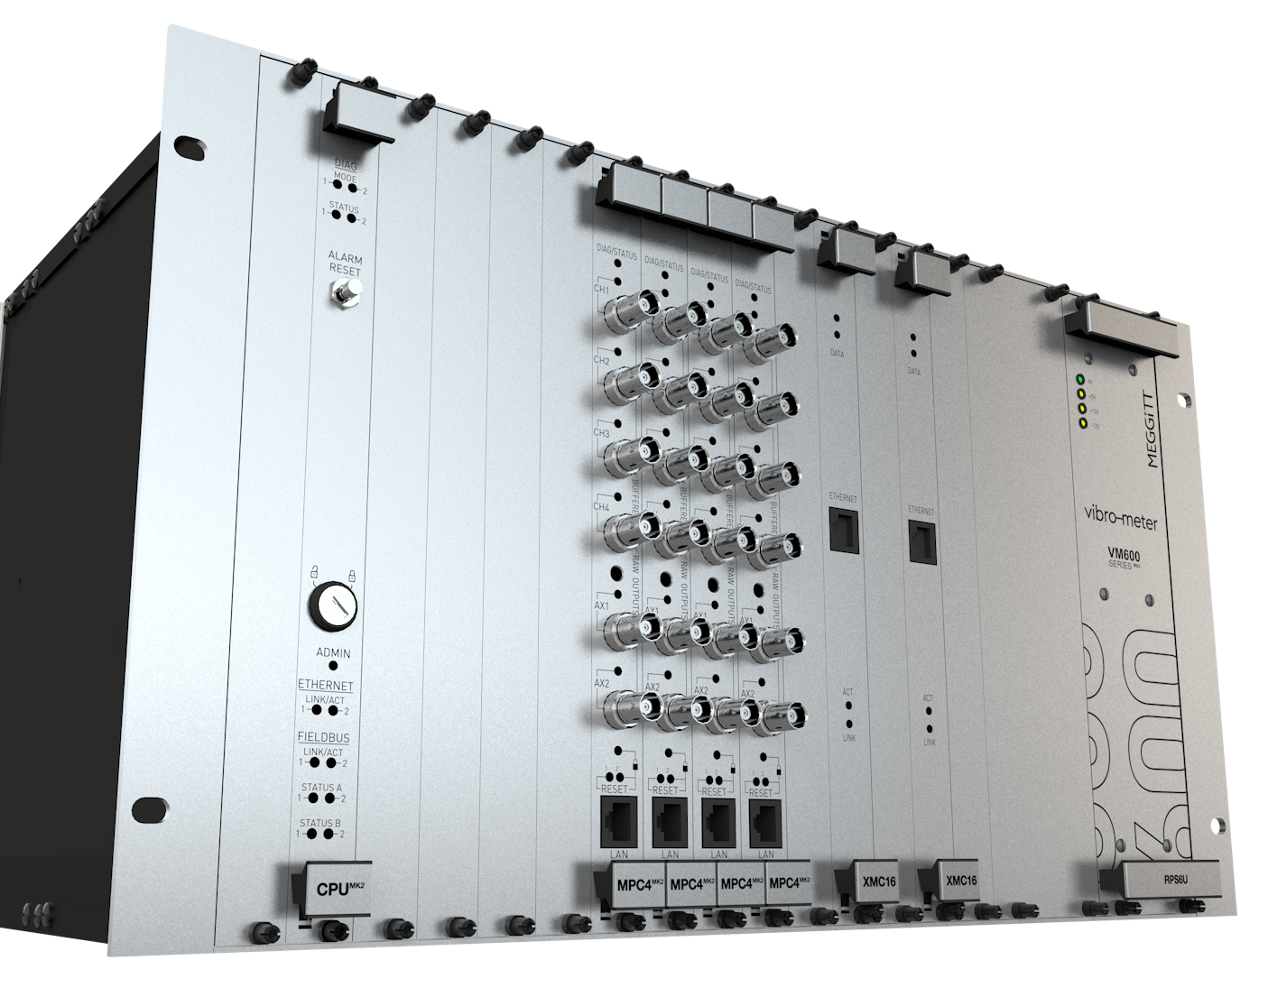
Why VM600^{Mk2} ?
Technical evolution
Next generation rack-based system for advanced machinery protection and condition monitoring
Component obsolescence issues
Benefit from state-of-the-art hardware and software technologies
Improved functionality and performance
Address new requirements and needs in
the machinery monitoring market

Slide 4
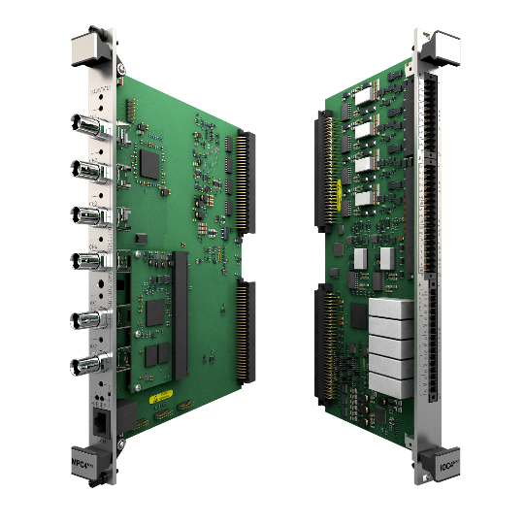
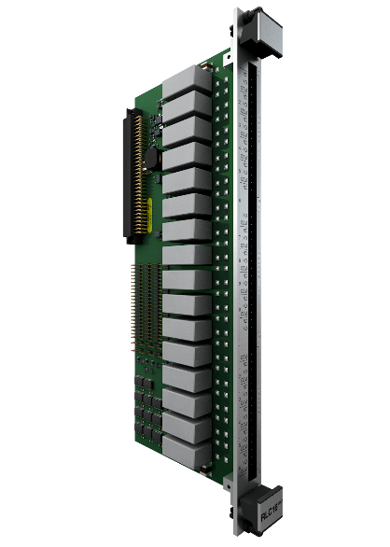
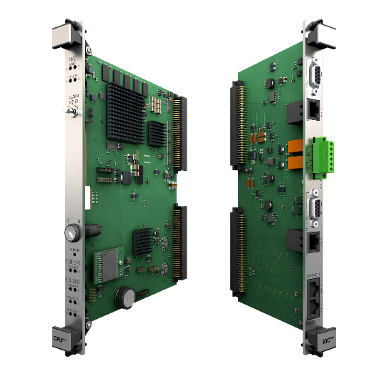
Key features: VM600^{Mk2} hardware
MPC4^{Mk2} + IOC4^{Mk2}
machinery protection and condition monitoring module
Availability:
MPC4^{Mk2} + IOC4^{Mk2} with support for machinery protection (Q1 2021)
MPC4^{Mk2} + IOC4^{Mk2} with support for machinery protection and condition monitoring (Q1 2022)
MPC4^{Mk2} + IOC4^{Mk2} with SIL 2 certification (Q4 2022)
New VM600^{Mk2} modules
MPC4^{Mk2} + IOC4^{Mk2}, RLC16^{Mk2}, CPUM^{Mk2} + IOCN^{Mk2}
  Enhanced features
        24 bit ADC resolution
        20 kHz bandwidth
        Up to 10 processed outputs per channel
        Epoxy-sealed relays, software configurable
        System safety-line to drive relays to a safe state
        Faster response rate for alarm and relay command - every 20 ms instead of 100 ms for protection.
    Added capabilities
      VM600^{Mk2} MPC4^{Mk2} + IOC4^{Mk2} module supports machinery protection (MPS) and condition monitoring (CMS)
      Note: MPC4^{Mk2} CMS functionality requires a license and can be added in situ!
      Cybersecurity certification as per IEC 62443
      Fully API 670 5th edition compliant
      SIL 2 “by design” as per IEC 61508 (Q4 2022)
RLC16^{Mk2} relay module
Availability:
RLC16^{Mk2} (Q1 2021)
RLC16^{Mk2} with SIL 2 certification (Q4 2022)
CPUM^{Mk2} + IOC4^{Mk2} rack controller and
communications interface module
Availability:
CPUM^{Mk2} + IOCN^{Mk2} (Q3 2021)

Slide 5
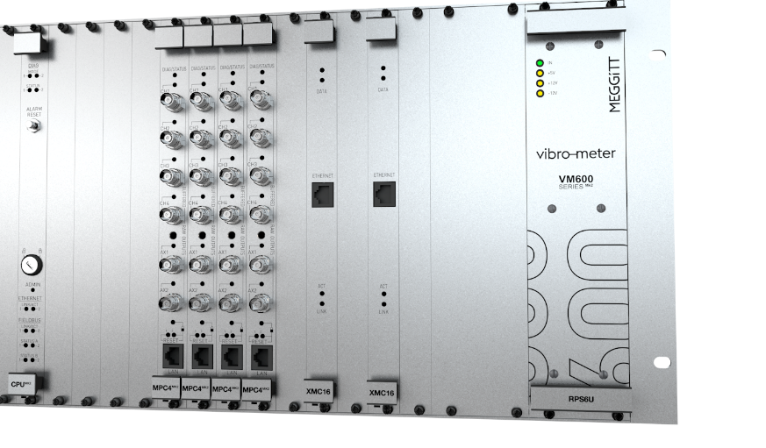
VM600^{Mk2}
Design concept enhancements
MPC4^{Mk2} with condition monitoring
  Covers most of the CMS requirements for the energy industry
  Note: XMx16 modules remain available for the most demanding CMS applications
  MPS and CMS completely segregated as per API 670 5th edition
  Comprehensive view of machinery behavior: MPS data can also be logged and displayed via the condition monitoring system (CMS)
New VibroSight software modules
  Designed and optimized specifically for operation with VM600^{Mk2}
  New user-friendly interface visually guides measurement channel configuration based on the sensor family and the type of processing required – for faster system configuration
  Separate application software modules – VibroSight Protect for MPS and VibroSight Capture for CMS – help ensure complete separation (“segregation”) of MPS and CMS in a single VM600^{Mk2}/ VM600 rack

Slide 6
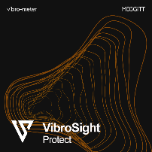

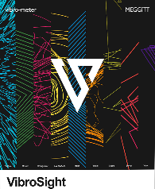
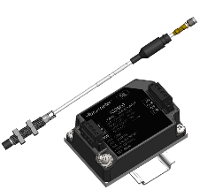
VM600^{Mk2}
Increased safety and security
Locked operational mode (MPS) for improved safety
and security
  Physical access to VM600^{Mk2} rack required in order
  to change the MPS configuration
Segregation of machinery protection (MPS)
and condition monitoring (CMS)
  In accordance with API 670 5th edition
  Temporary link via VibroSight Protect required
  for MPS configuration
  Permanent link to VibroSight Capture, VibroSight Server (database) for CMS functionality
(Temporary)
Ethernet communications link
(Permanent)
Condition Monitoring
XMV16
MPC4^{Mk2}
Machinery Protection
Machinery protection software
Condition monitoring software
VM600^{Mk2} rack

Slide 7
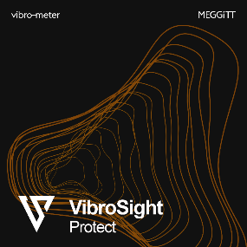
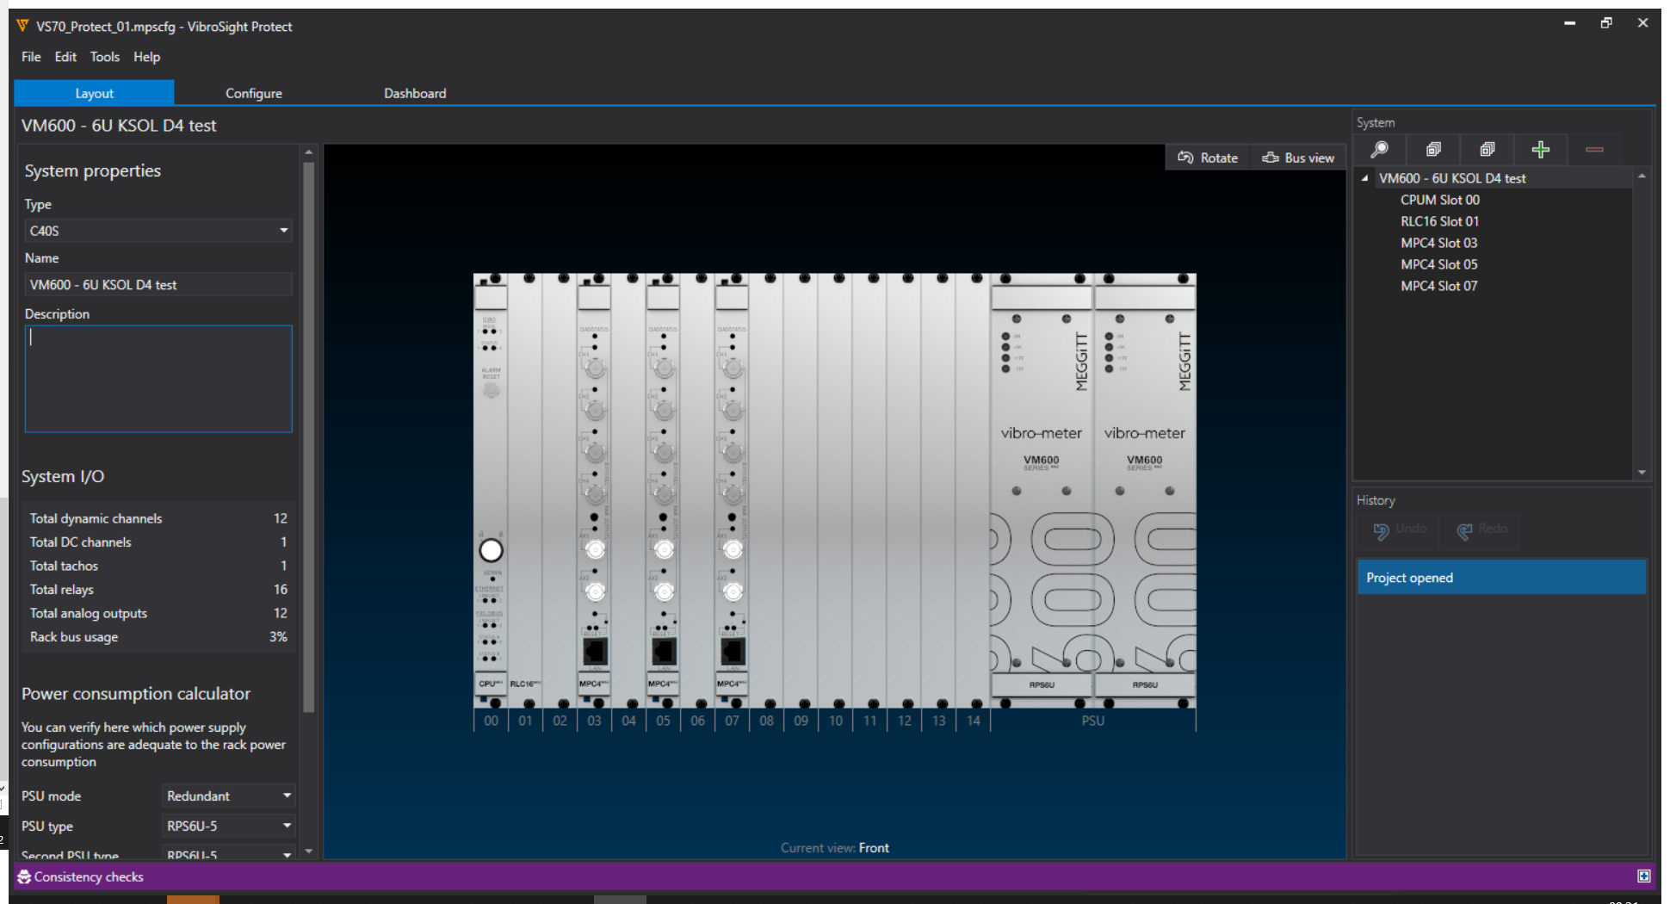
Key features: VM600^{Mk2} software
Machinery protection configuration software
VibroSight ® software module designed and optimized specifically for operation with VM600^{Mk2}
VibroSight Protect supports the configuration and operation of the machinery protection (MPS) functionality for a VM600^{Mk2} system: MPC4^{Mk2} + IOC4^{Mk2}, RLC16^{Mk2}, CPUM^{Mk2} + IOCN^{Mk2}
New easy to use and intuitive user interface
Separate configuration (*.mpscfg file)
Fast configuration
Checks overall system (rack) configuration consistency (as opposed to one-by-one module configuration)

Slide 8
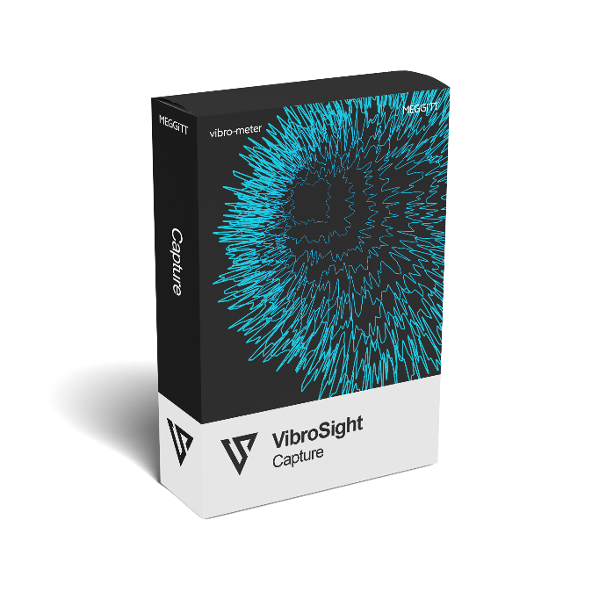
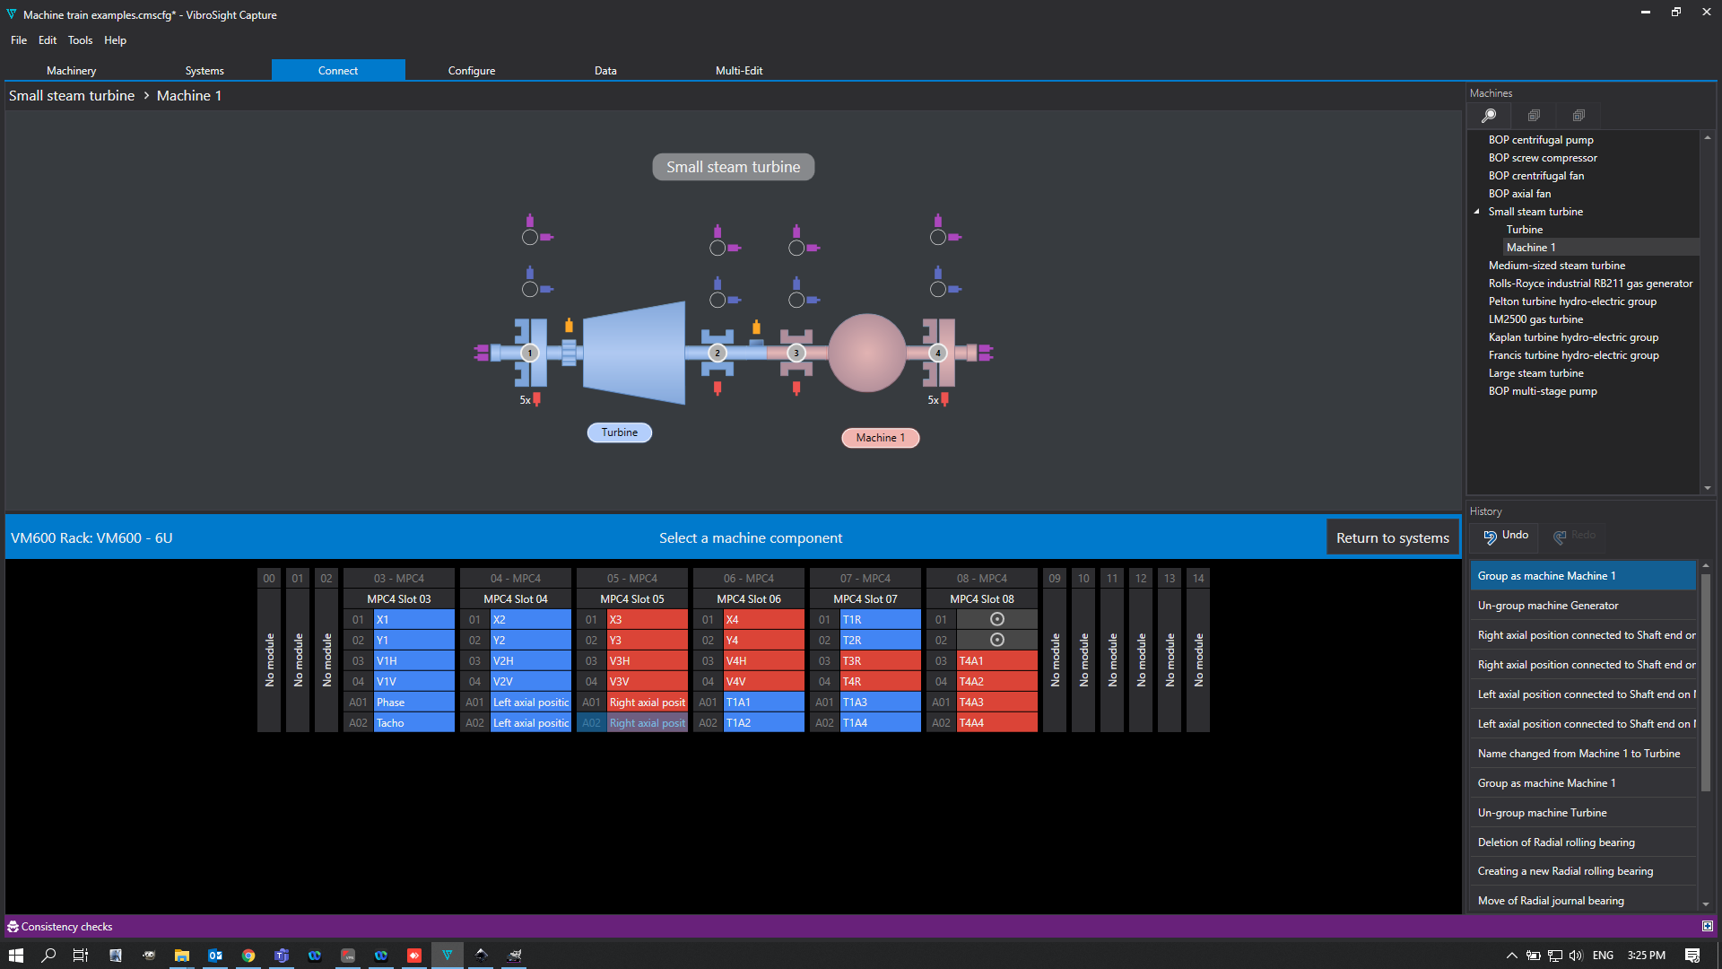
Key features: VM600^{Mk2} software
Condition monitoring configuration software
VibroSight ® software module designed and optimized specifically for operation with VM600^{Mk2}
VibroSight Capture supports the configuration and operation of the condition monitoring (CMS) functionality for a VM600^{Mk2} system: MPC4^{Mk2} + IOC4^{Mk2}
New easy to use and intuitive user interface
Separate configuration (*.cmscfg file)
Fast configuration
Fully-integrated support for VibroSight database management (no external data/database management tools are required)

Slide 9
VM600^{Mk2}
Advanced machinery protection and condition monitoring designed for critical rotating machinery
What do we offer?
The most reliable protection and monitoring systems for machinery
and equipment assets
Key benefits
Evolution of a proven and reliable platform
New simplified and intuitive interface
Modular design
Centralized system
  Designed to centrally process a wide range of dynamic inputs coming from a variety of critical assets
VM600^{Mk2}
Market category
Critical rotating machinery
Key differentiators
All measurements in one module
  Enables complex systems to be built with a minimum number of modules
  Simplifies spare parts inventory management
Cybersecurity compliance, as per IEC 62443
API 670 5th edition compliance
SIL 2 “by design”, as per IEC 61508
Integrated high-end CMS (in one module)
Applications
Power generation: gas, steam, hydro
and nuclear
Oil & gas
Other critical industrial applications

Slide 10
VM600^{Mk2}
Launch roadmap
Launch
VM600^{Mk2} MPC4^{Mk2} condition monitoring
- MPC4^{Mk2} (firmware and licensing)
Note: MPC4^{Mk2} modules can be upgraded in situ
- VibroSight 7. 0 / Vibrosight Capture
Launch
VM600^{Mk2} MPC4^{Mk2} machinery protection
MPC4^{Mk2}, RLC16^{Mk2}, CPUM^{Mk2}
Vibrosight 6.0 / Vibrosight Protect
VM600^{Mk2} program normalized
VM600^{Mk1} platform obsolete
(spares and upgrades support only)
VM600^{Mk2} MPS available to quote
(early adopters testing systems)
VM600^{Mk2} MPS and CMS available to quote
(for early adopters)
Q4 2020
Q1 2021
Q2 2021
Q3 2021
Q4 2021
H1 2022
H2 2022
2023
Features and certifications
Cybersecurity certification as
per IEC 62443 (targeting security
level 2 (SL2))
Update VibroSight 7.1
with MPS FW 6.0 and
CMS FW 2.0 (new processing available like airgap)
Profinet communication protocol
Features and certifications
Mk2 SIL certification
Temperature measurement(card AMC6/IOC6 Mk2)
CSA approvals (North America)
Add-on capabilities per market**

Slide 11
VM600^{Mk2}
Useful links
Website product landing page:
https://meggittsensing.com/energy/vm600mk2
Datasheets (pdf downloads):
https://meggittsensing.com/wp-content/uploads/DS_VM600_Mk2_MPC4_Mk2_IOC4_Mk2-en.pdf
https://meggittsensing.com/wp-content/uploads/DS_VM600_Mk2_RLC16_Mk2-en.pdf
https://meggittsensing.com/wp-content/uploads/DS_VM600_Mk2_CPUM_Mk2_IOCN_Mk2-en.pdf
Meggitt vibro-meter ® Energy website:
https://meggittsensing.com/energy
vibro-meter ® product catalogue:
https://catalogue.meggittsensing.com

Slide 12
Thank you

Slide 13
Disclaimer
Business legal entity. Business address.
Legal entity registration information as appropriate.
Information contained in this document may be subject to export control regulations of the United Kingdom, European Union, United States or other national jurisdictions, including the US International Traffic in Arms Regulations and/or Export Administration Regulations.
Each recipient of this document is responsible for ensuring that transfer or use of any information contained herein complies with all relevant Export Control Regulations.
Copyright © 2022 Meggitt SA. All rights reserved.

