Slide 1
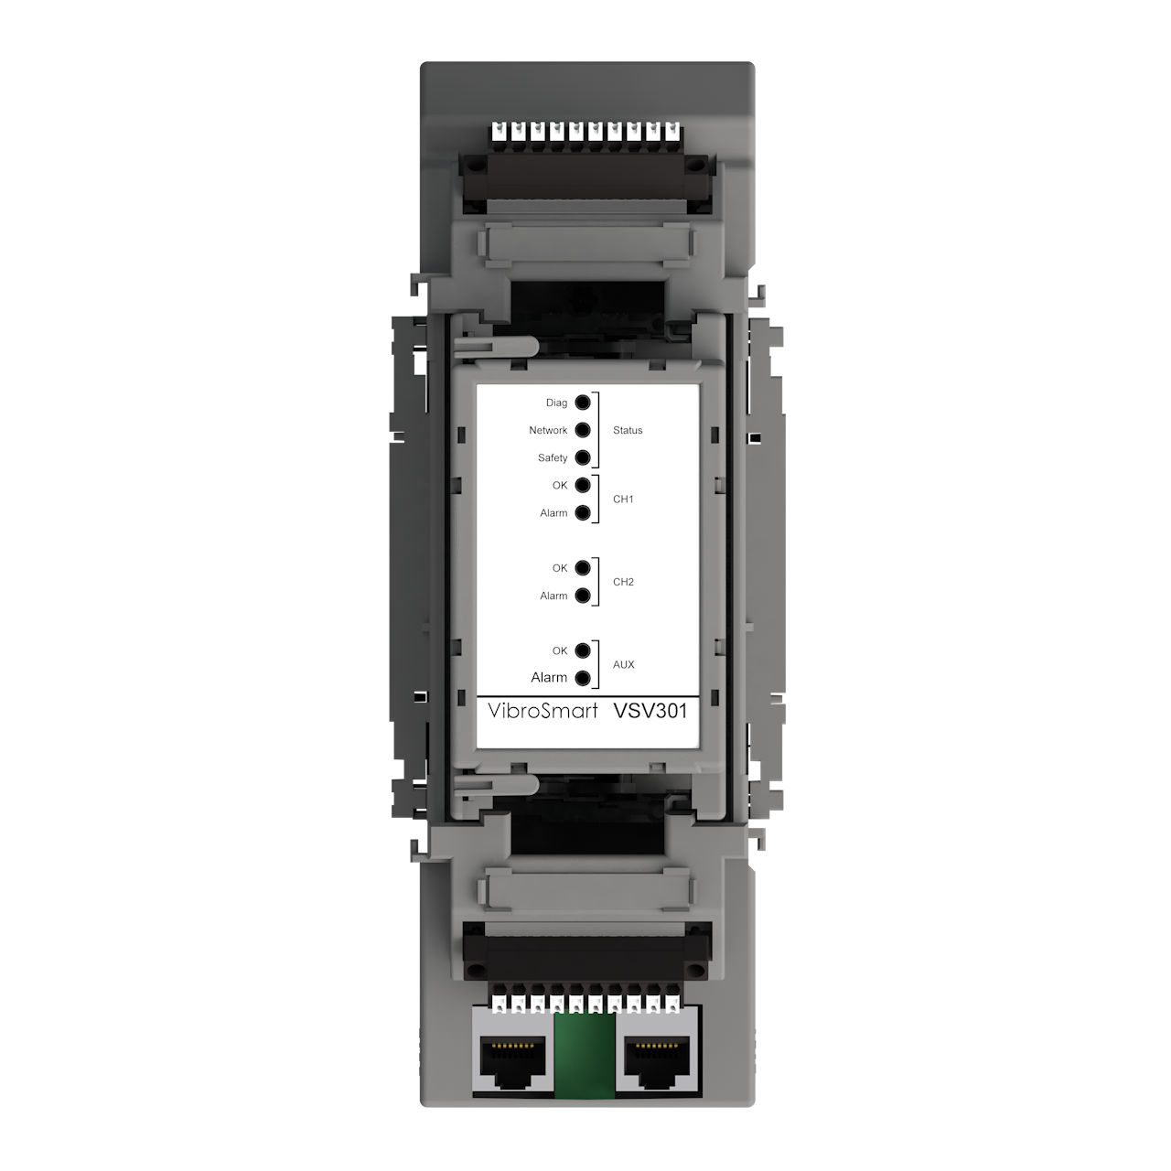

VIBROSMART
Distributed Monitoring System
  Presenter:
Title:
Date:

Slide 2

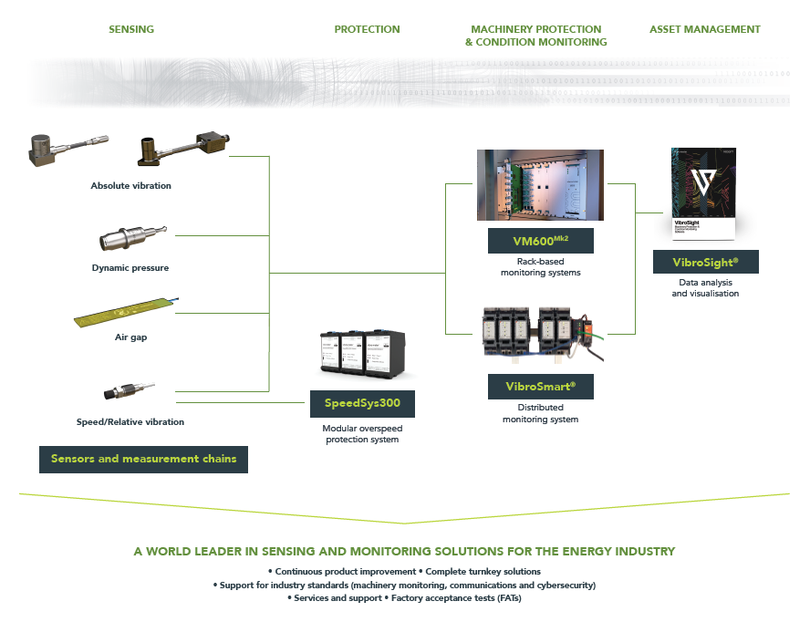
Portfolio overview

Slide 3
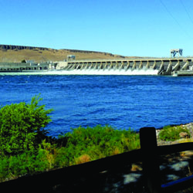

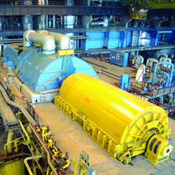

Why VibroSmart?
VibroSmart® fulfils the protection and monitoring needs of any plant machinery in a cost-effective way – enhancing machine safety, enabling machine condition monitoring for improved asset management and reducing maintenance costs through predictive maintenance.
One solution for all rotating machinery (small and large machines)
Provides machinery protection and/or condition monitoring
Flexible, scalable, highly reliable and cost effective
Easy integration with plant DCS, PLC, SCADA, etc.
VibroSight® software with application specific packages for hydro, combustion, data import and mathematics

Slide 4
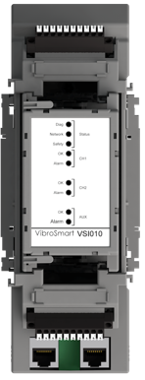
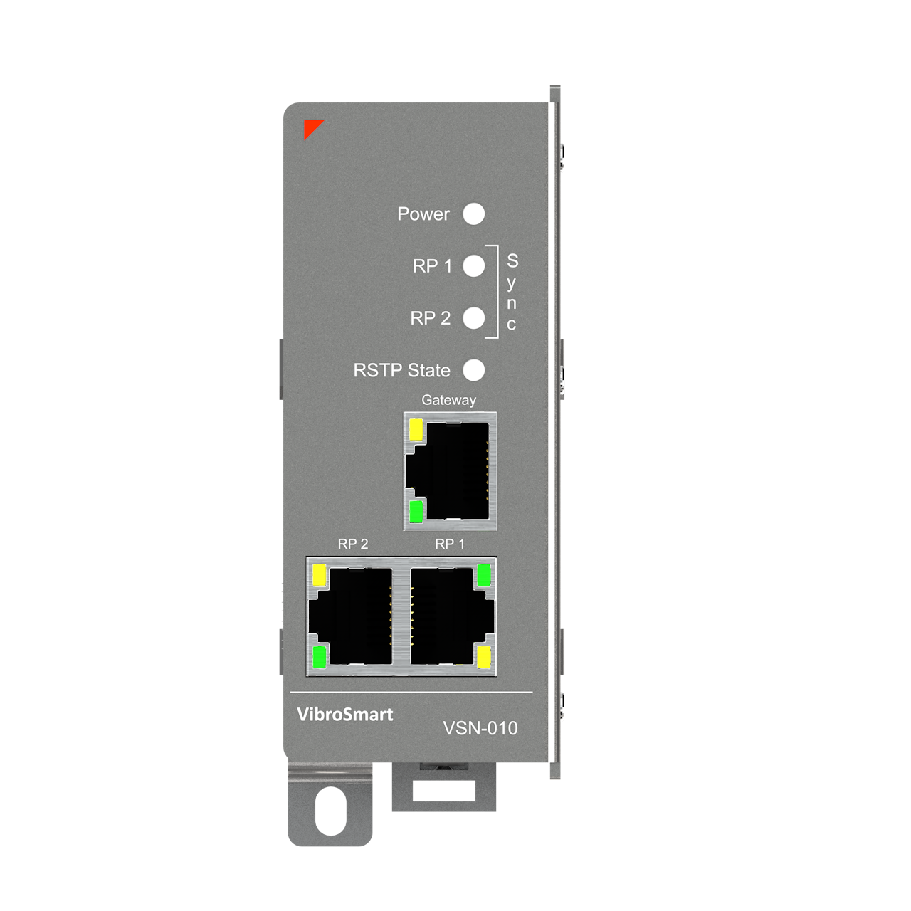
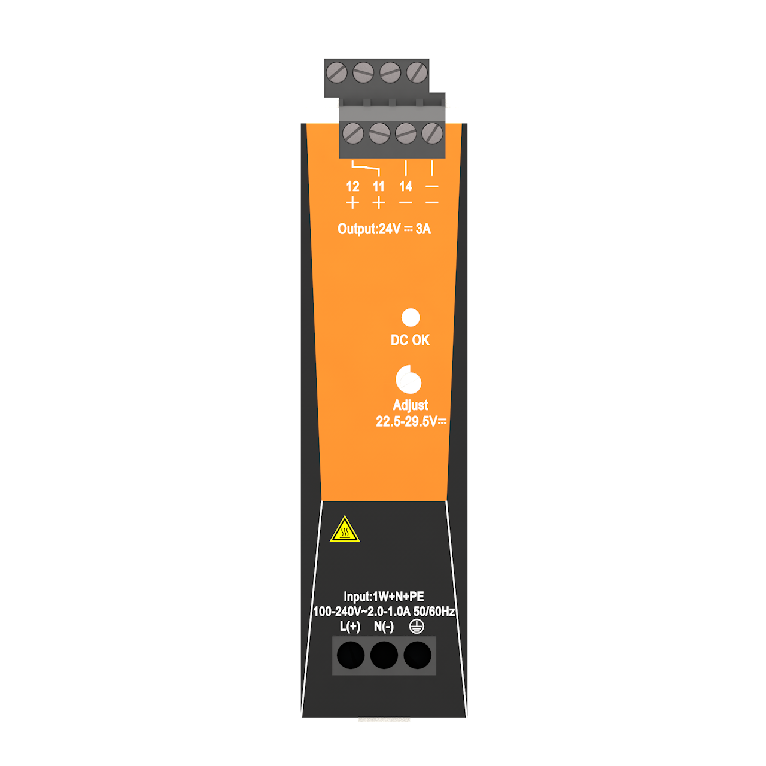
VibroSmart at a glance
From sensors / measurement chains
Relays, fieldbus
Control
system
DIN-rail
Plant LAN
Real-time Ethernet
Standard Ethernet

Slide 5
VibroSmart at a glance
Modules and key features
VSV301 + VSB300 monitoring module
A single VSV301 module for all machinery protection and condition monitoring requirements, with analog (current or voltage) and relay outputs
VSI010 + VSB010 communications interface module
A single VSI0101 module supporting industry standard fieldbuses (Modbus RTU/TCP, PROFIBUS DP and GOOSE (IEC 61850)), with additional relay outputs
VSN010 real-time Ethernet switch
Adds enhanced network functionality such as communications gateway (real-time to standard Ethernet), fault-tolerant redundant networks, and sub-millisecond data synchronisation between modules
Robustness and reliability:
  Designed to be installed directly onto machines
  Redundant 24 V_{DC} power supply inputs, Ex certifications and high MTBF
Fully meets requirements for the Power Generation, Oil & Gas and Process industries

Slide 6
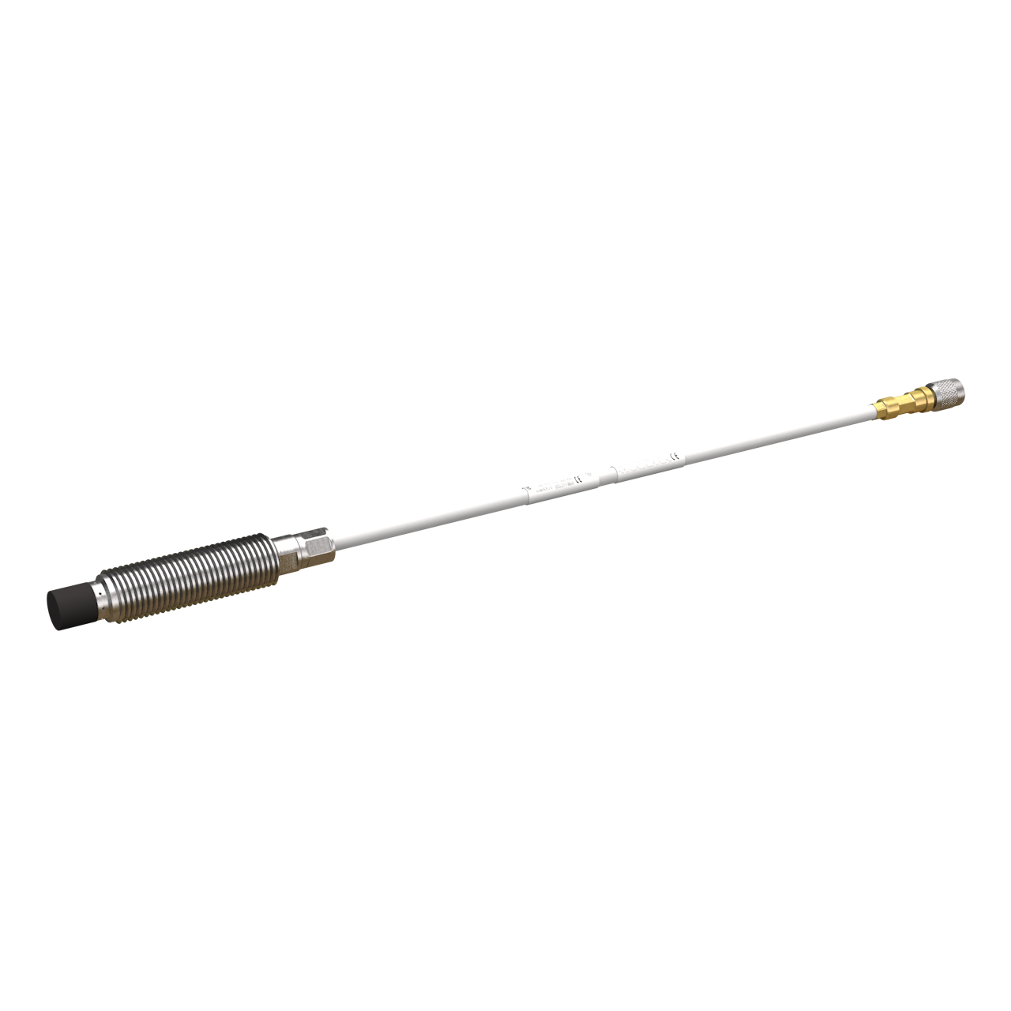
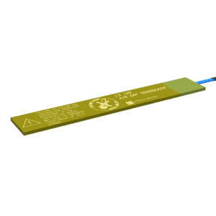
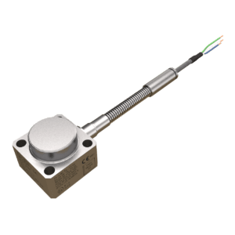
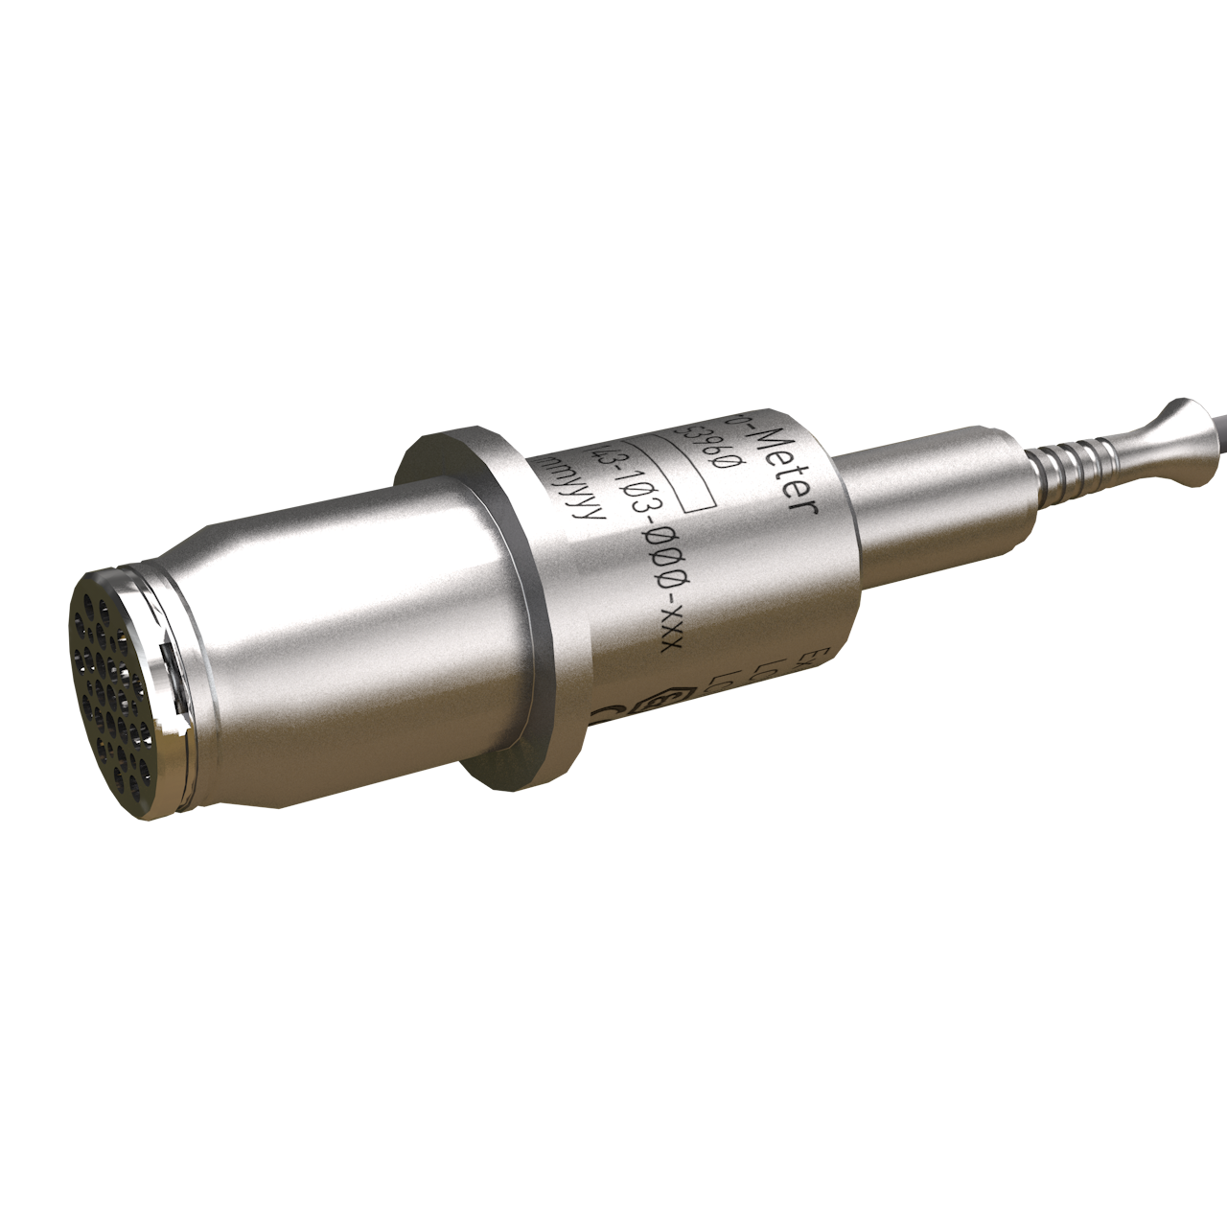
VibroSmart product overview
Flexible …
Flexible: All measurements in one module!
The same VSV301 module can be used to protect and monitor all of the machines in your plant, including:
  Critical machinery such as turbines and generators
  Auxiliary (BoP) equipment
Modular: A single VSV301 module is a complete protection and monitoring system with 2 dynamic channels and 1 auxiliary channel (speed/tacho or DC). For higher channel-counts, modules can be combined as required
Complete system: Sensor / measurement chain interfacing, signal processing (including FFT up to 1600 lines), outputs, alarms, analog and relay outputs (all in one module)
Versatile …
Versatile: Compatible with all sensor types:
  Vibration, proximity, combustion, air-gap
  Other common sensors (4-20 mA, 0-10 V, etc.)
Configurable: VibroSmart® modules can quickly, easily and safely configured or reconfigured to match changing system requirements (for example, additional channels, new sensors, alarm limits, etc.)

Slide 7
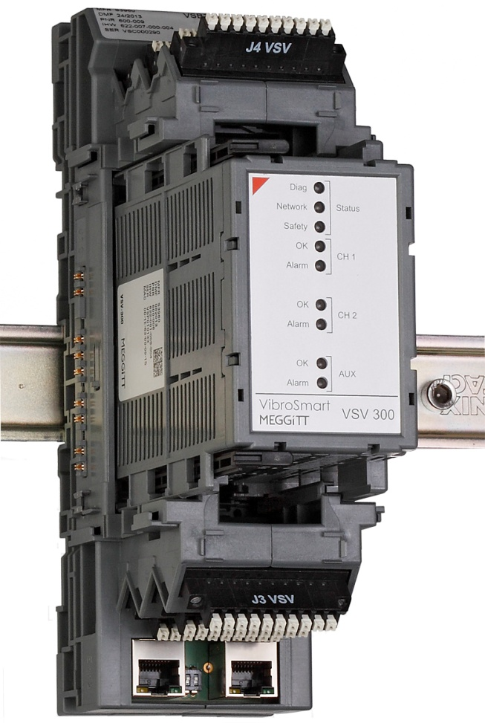

VibroSmart product overview
Scalable …
Configurable: Suitable for small to large channel-count applications, from 1 to 256 dynamic channels, with different installation requirements (vibration, combustion, hydro, etc.)
Distributed: Modules can be installed in close proximity of the machine, reducing cabling requirements
Scalable: Need additional measurements or to monitor additional machinery? No problem, simply add more VSV301 modules to the system.
Cost-effective …
Cost effective: You only pay for what is required in terms of protection and monitoring
Save costs on spare parts: Simplified spare parts inventory management (one highly-configurable VSV301 module)
Straightforward and easy to use: Training for all applications limited to a few modules only (VSV301 and VSI010)
Hot swappable: Live insertion and removal of modules with automatic reconfiguration (short MTTR)
Eliminates 30% of system installation costs by:
  Limiting the use/length of expensive low-noise cables running from/to sensors
  Mounting modules directly onto the equipment being monitored
  IP / NEMA protection rated enclosure(s), eliminating costly 19” cabinets
  Standard Ethernet cables from/to the control room
  Simple installation compared to rack-based systems

Slide 8
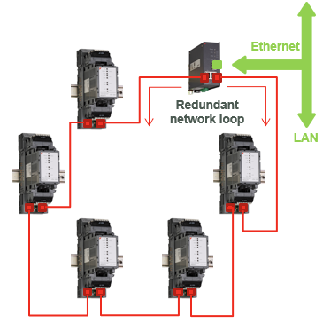
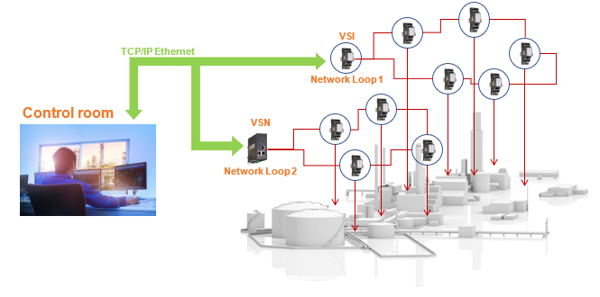
Vibrosmart networks
Distributed and connected
Distributed and integrated
Networking: Standard or redundant (HSR ring) topologies
Real-time Ethernet technology
  Digitally shares information such as tachometers, alarms, logical functions and statuses between modules
  Installing modules onto machines replaces expensive sensor cabling with standard Ethernet cabling
  Up to 100 m between modules
Gateway: VSN010 module acts as a gateway between a VibroSmart® real-time network and standard Ethernet network
Guaranteed no single point of failure: HSR ring using VSN010

Slide 9
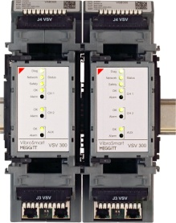
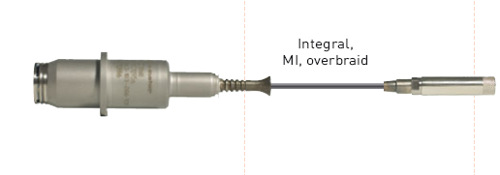
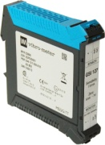
VibroSmart application environments
Designed for harsh industrial environments
Hazardous area
Zone 1
Hazardous area
Zone 2
Sensors
IPC70x
GSI127
Robust and reliable:
  Robust enclosures with DIN-rail mounting adaptor
  Operating temperature range of −20 to 70°C (− 4 to 158°F)
Hazardous areas:
  Ex certified for use in potentially explosive atmospheres
  (Ex Zone 2 in accordance with ATEX, IECEx, cCSAus and others)

Slide 10
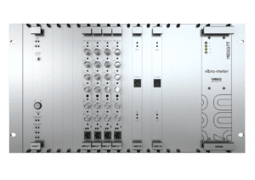
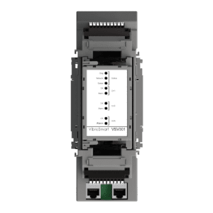
VM600^{Mk2} or VibroSmart ?
A high-level comparison
Architecture | Centralised | Distributed
Typical applications | Critical machinery | All machinery
Channel count | Medium to high (++) 4 + 2 channels per MPC4^{Mk2} 16 + 4 channels per XMx16 Note: Up to 12 modules per rack. | Low to medium (+) 2 + 1 channels per VSV301 Note: Up to 128 modules per system (without VSN010 modules).
FFT | Up to 6400 lines | Up to 1600 lines
Hazardous areas | Standard (non-hazardous) areas only | Ex Zone 2

Slide 11
Vibrosmart system architecture

Slide 12
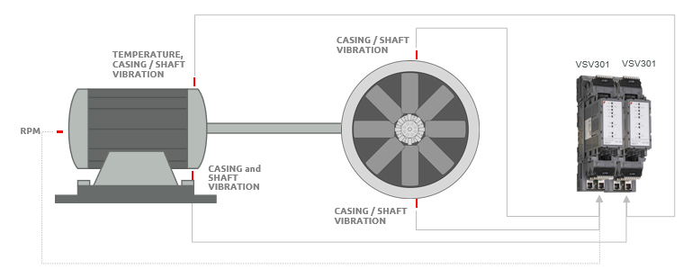
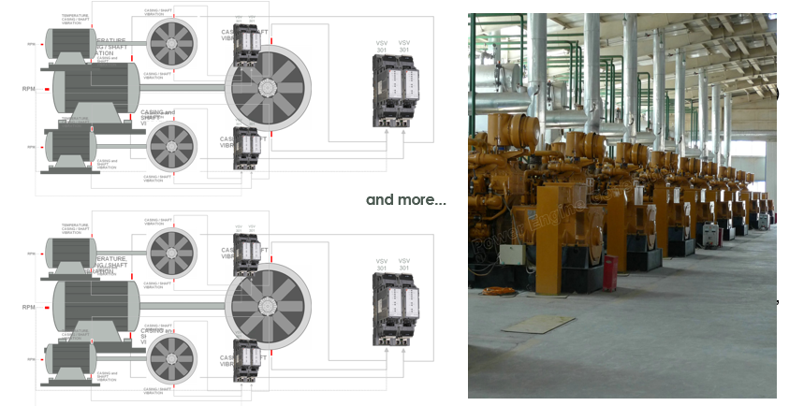
Machinery protection
Simple, reliable and cost effective …
… and scalable

Slide 13
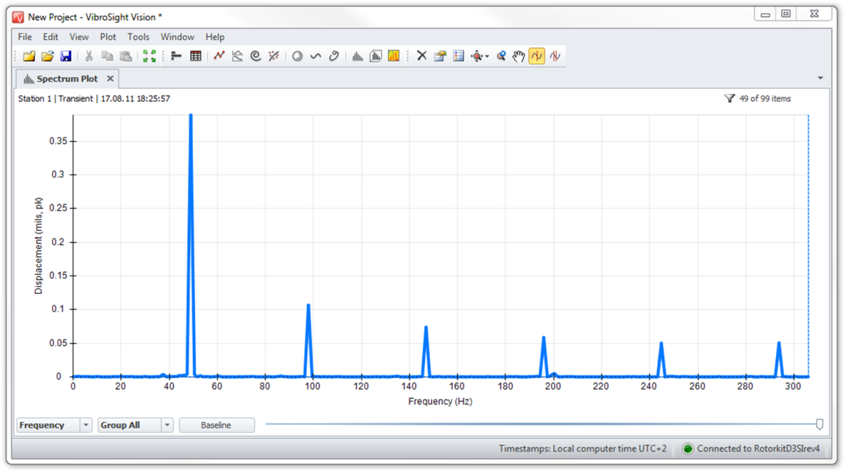
Complete machinery protection and monitoring
Comprehensive capabilities
The VSV301 module supports up to 10 extracted values per channel, including:
Speed harmonics/components ( 1x, 2x, 3x, etc.)
  Detection of blade damage, imbalance and alignment errors
Filtering (low-pass, high-pass, band-pass)
  Detection of bearing damage, cavitation and changing impact behavior

Slide 14
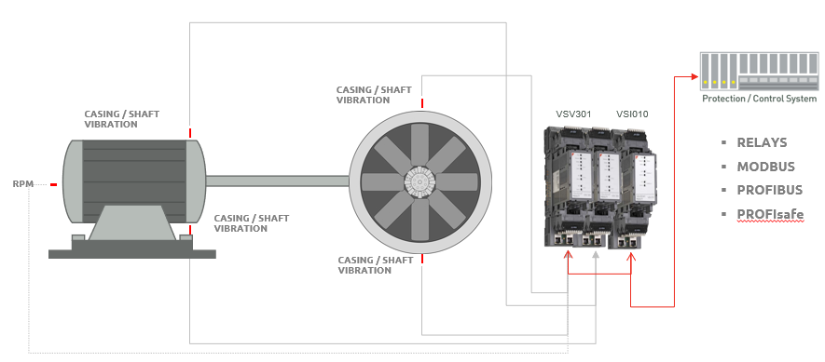
Easy integration
Interfaces with plant DCS, PLC, SCADA, etc.

Slide 15
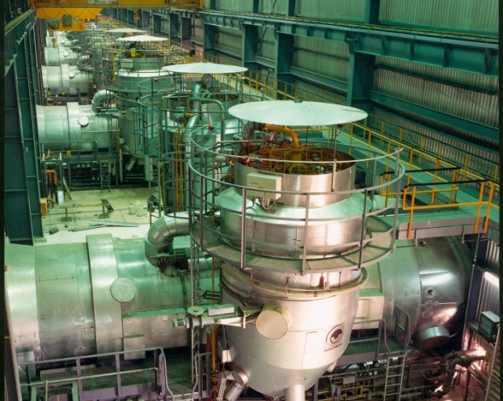
Easy integration
Interfaces with plant DCS, PLC, SCADA, etc.
Communication:
The VSI010 module has serial and Ethernet fieldbus interfaces to communicate process parameters to systems such as DCS or PLC
Customisation: Flexible fieldbus register mapping for detailed machine data and status identification
Supported protocols:
  Modbus RTU/TCP
  PROFIBUS DP
  PROFIsafe
  GOOSE (IEC 61850)

Slide 16
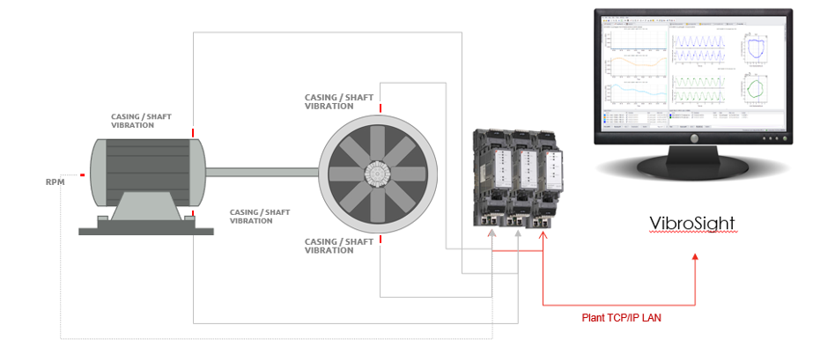
VibroSight
Enables machine condition monitoring

Slide 17
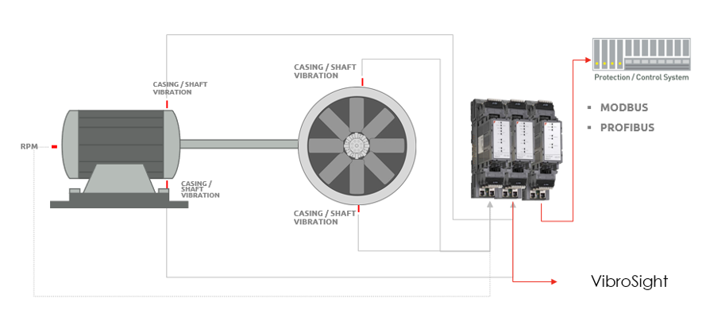
Machine protection and condition monitoring
Extended capabilities

Slide 18
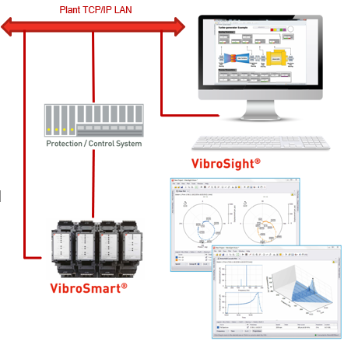
Adding machinery condition monitoring
VibroSight machinery monitoring system software
A VibroSmart® system combined with the VibroSight® software enables comprehensive machinery condition monitoring
VibroSight® integrates all standard condition monitoring functionality – data logging, visualisation and analysis
VibroSight® uses a server-client architecture and provides remote access capabilities for diagnostic purposes – online or offline analysis

Slide 19
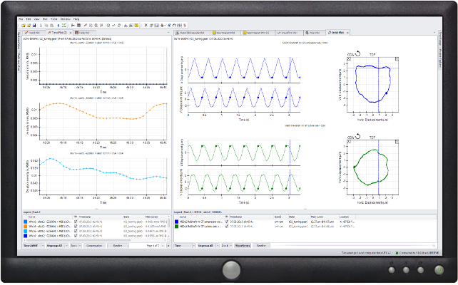
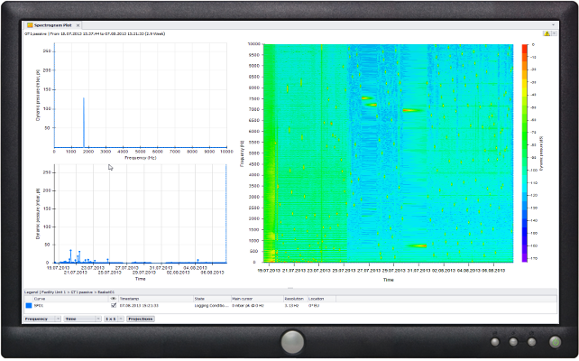
VibroSight
Access to all data
Access to your data made easy:
Online and offline data visualisation and analysis
Plots, charts and trending analysis:
Comprehensive set of static and dynamic plots
  Time analysis, FFT analysis, Orbits, Waterfall plots, etc.
  Unlimited data visualisation possibilities for trending analysis (display large quantity of data over long period of time)

Slide 20
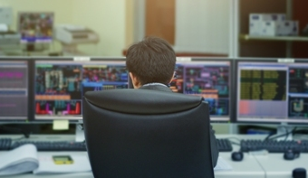
VibroSight
Integrated solution
Interface to enterprise software
VibroSight® built-in database optimized for global plant data architecture
Via OPC communication interface, data can be exchanged with other third party’ systems such as ASPEN software’s, PI systems, etc.

Slide 21
VibroSmart application solutions

Slide 22
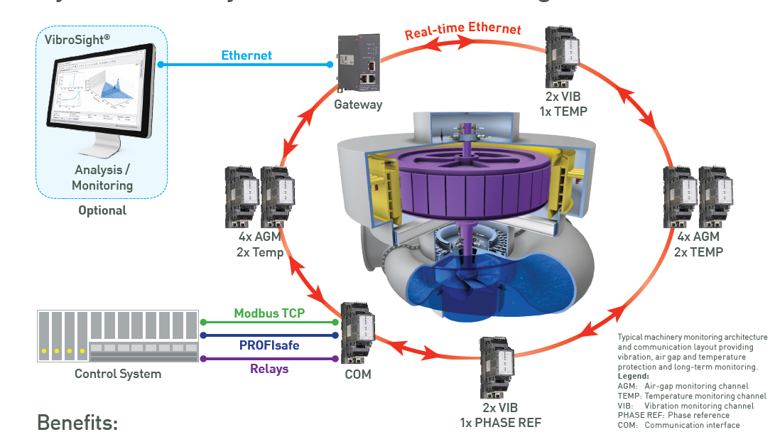
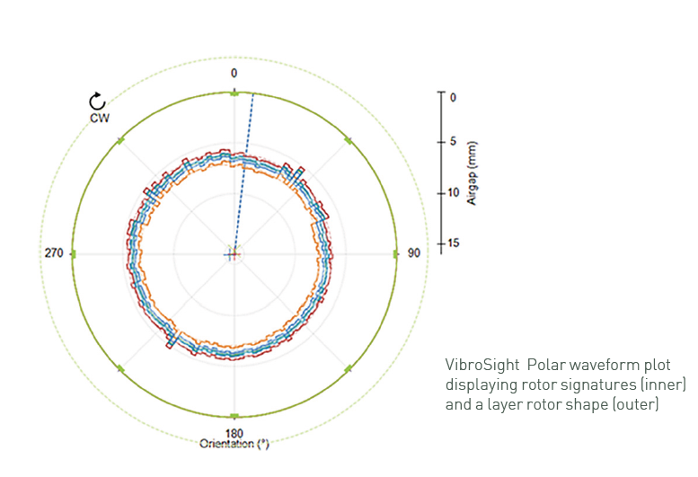
Hydropower applications
Protection and condition monitoring
Benefits:
True rotor and stator circularity measurements
  Standardised and reliable calculations in accordance with CEATI industry standards ensure measurements that you can trust!
Measurements / functionality
VIB: Vibration monitoring
AGM: Air-gap monitoring
TEMP: Temperature monitoring
PHASE REF: Phase reference
COM: Communications interface

Slide 23




Oil & Gas applications
Compliance with API 670 5th edition
Machinery protection (MPS)
  MPS functions fully addressed by VibroSmart® VSV301 module
  VibroSmart® modularity allows the separation (“segregation”) of MPS and CMS functionality
Condition monitoring and diagnostics (CMS)
  API 670 5th ed. contains new section regarding CMS
  Clear and defined scope for analysis and diagnostics systems
  Section for malfunction identification and rules
  Stated CMS functions also addressed by VibroSmart®
Cybersecurity
  VibroSmart® modules include a module lock feature
  that helps meet cybersecurity requirements
Typical Oil & Gas applications
  Steam turbine driven recip
  Motor-driven pumps, extruders, screw compressors
  Turbo expander
  Motor-driven cooling towers and fans
  Gas turbine compressor
  Steam turbine compressor
  Motor recip compressor

Slide 24
Vibrosmart
CASE STUDIEs

Slide 25

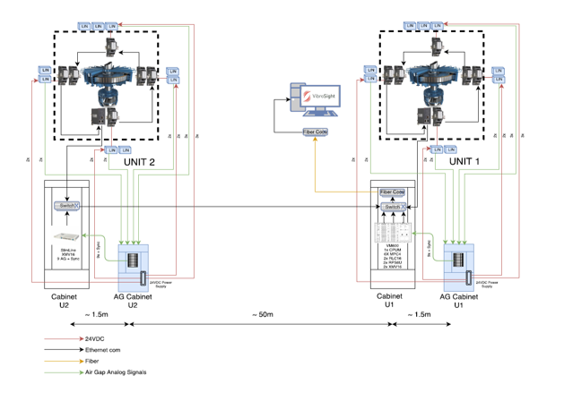
Case study 1: Hydropower
Columbia Power – Arrow Lake project
Application: Two hydro turbines located >50 m apart
Solution: Straightforward upgrade of existing CMS to VibroSmart® for sole-plate measurement and VibroSight® for vibration and air-gap monitoring:
  12 × VibroSmart® VSV30x modules
  2 × VM600^{Mk2}/VM600 XMV16 modules
  VibroSight® software with
  Hydro air-gap monitoring package
Versatile and flexible: Compatible with existing sensors (regardless of vendor)
Cost effective: Distributed monitoring was an enabler and also reduced cabling costs

Slide 26

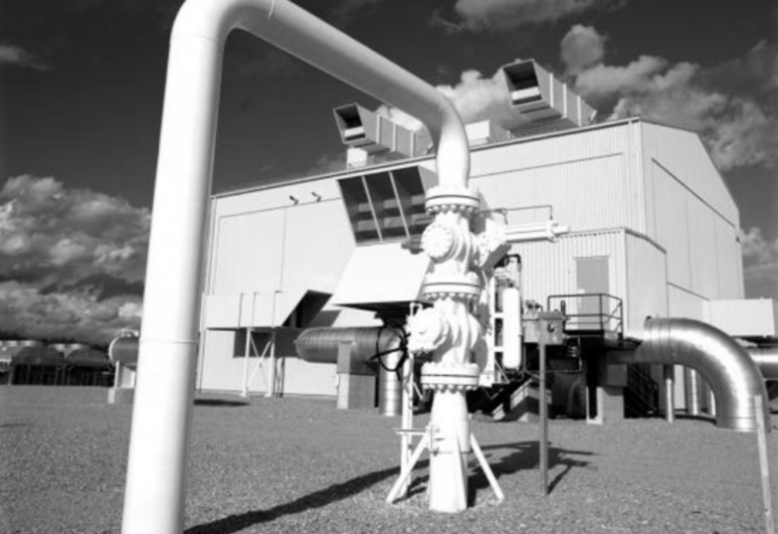
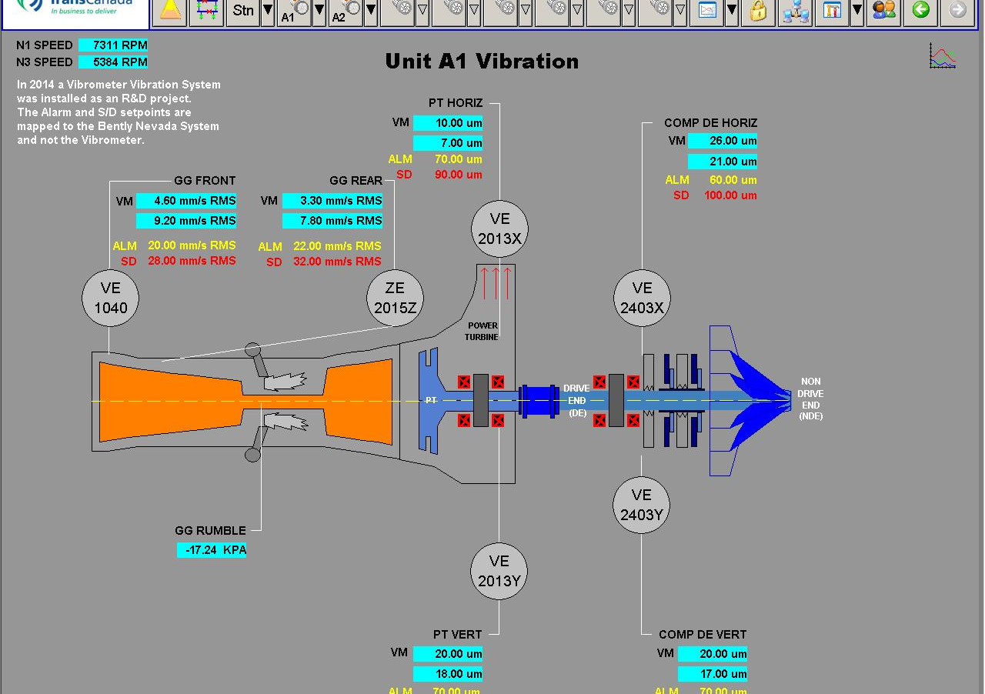
Case study 2: Oil & Gas mid-stream
Compressor stations
TransCanada Pipeline (TCPL) operates >9,000 km of natural gas pipelines in North America
VibroSmart® vibration and combustion monitoring solution
Typical equipment for each compressor unit includes:
  6 to 8 VibroSmart® modules (VSV30x and VSI010)
  Accessories (GSI127 galvanic separation unit and VSA004 BNC patch panels)
VibroSmart® is standard-fit on all future TCPL compressor station upgrades
Differentiators
Ease of integration: TCPL is upgrading their control system to Siemens PLC
(VibroSmart® offers straightforward integration into Siemens PLC)
One-stop shopping: Single-source provider for high-temperature sensors for vibration and combustion monitoring, monitoring systems and software
Straightforward upgrade: Efficient replacement for 3300 series monitoring systems
Performance: VibroSmart® is the only distributed monitoring system that can extract 5 frequency bands for combustion monitoring
Service and support: Local support from Meggitt’s Canada office

Slide 27

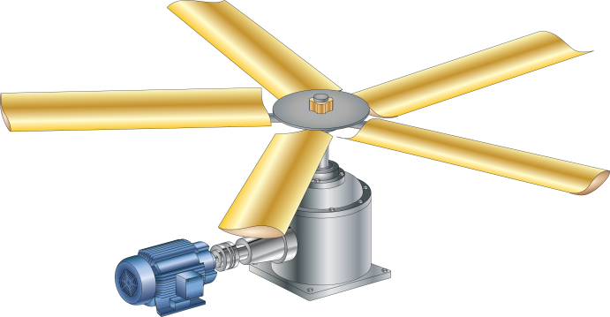
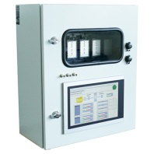
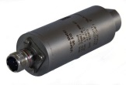
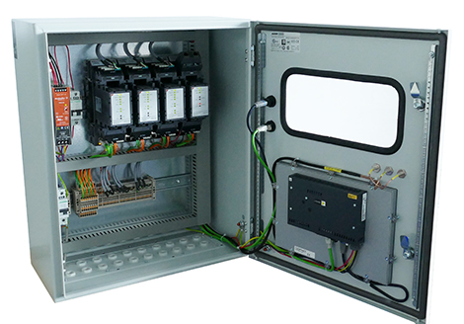

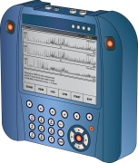

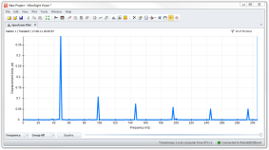
Case study 3: Petrochemical cooling tower
SABIC
Motor-driven
cooling tower fan
Cooling tower fans: Low-speed fans equipped with variable speed drives (VSD) to optimise performance and save energy
Legal requirement: Vibration monitoring is a mandatory requirement in order to comply with EU machinery directive
Flexible: VibroSmart® VSV301 module’s adaptive monitoring and alarming capabilities are used to base the alarm and trip levels on the running speed
Scalable: The second channel of the module can be used to monitor the gearbox or to detect blade lift, as required
Asbsolute bearing vibration
(velocity or acceleration)
Analog out
Distributed control system (DCS)
Digital out
Safety shutdown system (PLC)
+24 V_{DC}
(redundant)
Buffered out

Slide 28

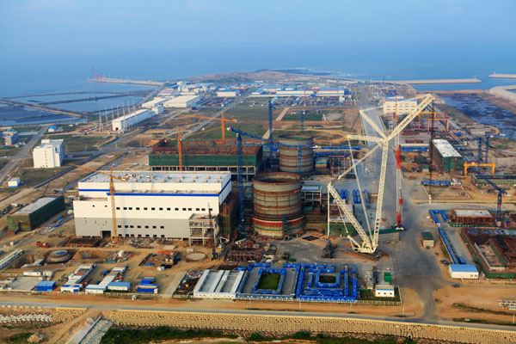
Case study 4: Steam turbine and BoP
Haiyang nuclear power plant
New Haiyang power plant
Awarded by China Power Engineering Consulting Group (project EPC)
Main steam turbine (ST) and balance of plant (BOP) equipment:
  Various sensors / measurement chains
  2 × VM600 racks
  132 × VibroSmart® VSV301 modules
  VibroSight® software
Main differentiators
One-stop shopping and cost effectiveness:
Single-source provider for sensors, monitoring systems and software
Performance: Integrated and connected monitoring network

Slide 29

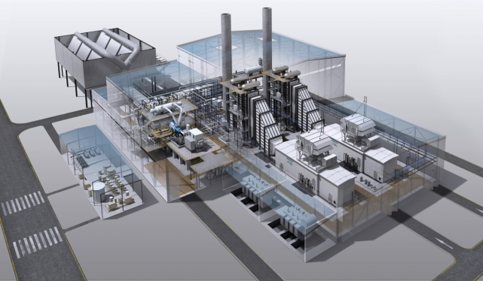
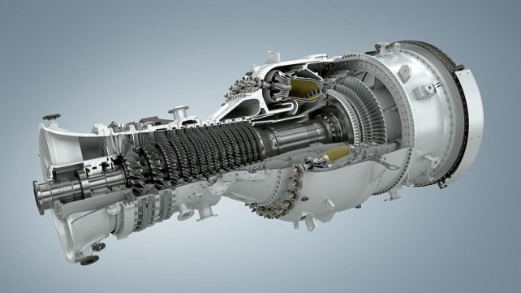
Case study 5: Gas-fired power plant
Siemens SGT-800 and SGT-750
VibroSmart® is standard-fit on SGT-800 and SGT-750 industrial gas turbines
Complete solution: Replaces two different systems with one solution (VSV301):
  Combustion monitoring
  Vibration protection
Integrated PROFIsafe communications to Siemens PLC (VSI010)
Versatile and flexible: Compatible with all sensor types (not tied to monitoring system vendor)
Cost effective: Lowest total cost of ownership:
    Reduced cabling costs
    Less cabling work during installation/production
    Distributed monitoring frees up control room space

Slide 30

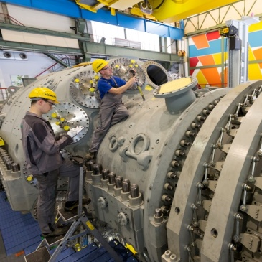

Conclusion
Vibrosmart solutions
Allows cost-effective monitoring of more of your assets, across more plants, with no compromise on performance
Priced by channel so assets with lower channel-counts can be monitored
for less investment
Easily scalable due to modular design
  From a standalone system for machinery protection (MPS) to a
  complete condition monitoring (CMS) solution
  Straightforward upgrade from 3300 series monitoring systems and CMS systems
  Better asset management decisions through advanced prognostics
Real-time networking features for critical assets
Condition monitoring with VibroSight supports efficient predictive maintenance

Slide 31
Thank you

Slide 32
Disclaimer
Business legal entity, Business address
Legal entity registration information as appropriate
Information contained in this document may be subject to export control regulations of the United Kingdom, European Union, United States or other national jurisdictions, including the US International Traffic in Arms Regulations and/or Export Administration Regulations.
Each recipient of this document is responsible for ensuring that transfer or use of any information contained herein complies with all relevant Export Control Regulations.
Copyright © 2022 Meggitt SA. All rights reserved.
02 May 2022

