Slide 1

Protection & monitoring systems
Presenter:
Title:
Date:

Slide 2
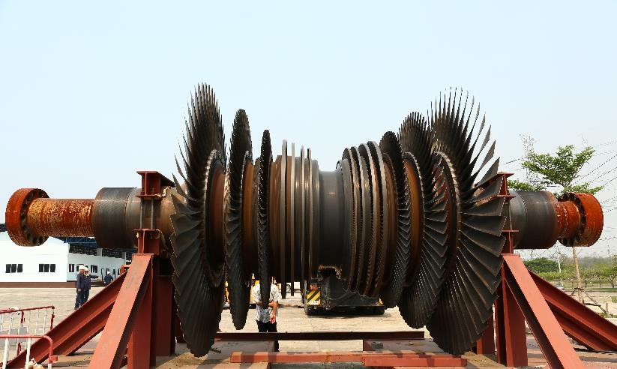
Advanced systems for machinery protection and condition monitoring specially designed for critical rotating machinery within the power generation, oil & gas, and process industries.

Slide 3




Product lines overview
Sensors & Conditioners
Protection & Monitoring Systems
Software Solutions
Sensing solutions to monitor critical plant and equipment
Protection and monitoring system hardware for critical rotating machinery
Advanced machinery protection and condition monitoring software

Slide 4
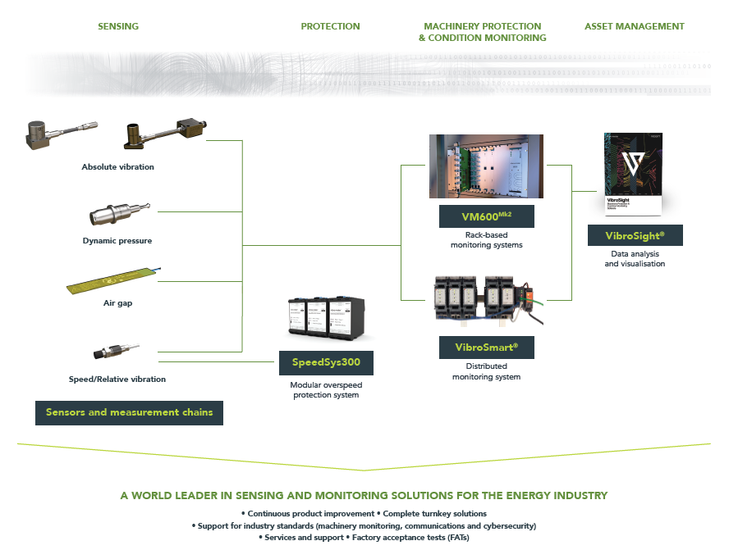

Portfolio overview

Slide 5
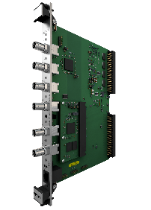
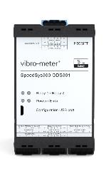
PORTFOLIO OVERVIEW Advanced machinery protection, condition and performance monitoring for high-value rotating machinery
VM600^{Mk2} Centralized rack-based advanced machinery protection and condition monitoring system. Suitable for applications with a medium-to-high channel count.
* Standard rack heights of 6U and 1U.
Protection and/or condition monitoring
VibroSmart® Distributed module-based scalable system suitable for applications with a low-to medium channel count.
SpeedSys300 Scalable, robust and independent layer of protection to deliver fast and reliable protection against overspeed.
Overspeed detection and protection
Notes:
Product line logic
Add real examples of application (number of VM600 installed etc)

Slide 6
Vm600^{Mk2}/ VM600 Rack-based systems For machinery Protection and/or condition monitoring

Slide 7
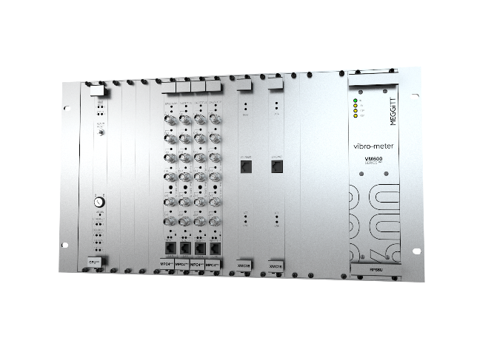
VM600^{Mk2}/ VM600 racks
19″ system racks (ABE04x) with a standard height of 6U
19″ slimline rack (ABE056) with a standard height of 1U
Note: Space (rack slots) for up to 12 processing modules, such as MPC4^{Mk2} + IOC4^{Mk2}.
Note: Space (rack slot) for 1 processing module, such as MPC4^{Mk2} + IOC4^{Mk2}.

Slide 8
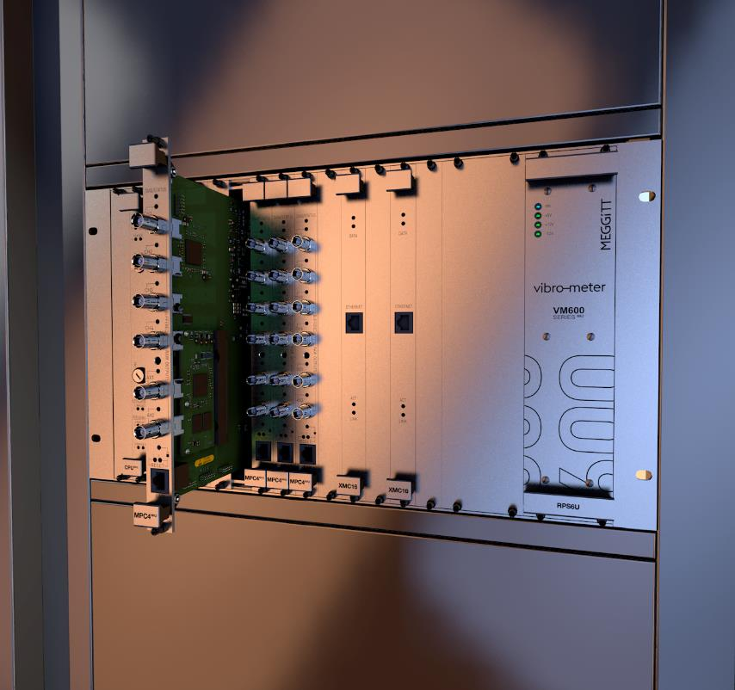
DESIGN CONCEPT
VM600^{Mk2}
Centralized system – designed to centrally process a wide range of different input signals coming from a variety of critical assets.
All measurements in one module – enables complex systems to be built with a minimum number of modules (modular structure with smart function combination).
MPC4^{Mk2} module supports machinery protection and condition monitoring
Flexible network architecture – easy integration with VibroSmart® distributed monitoring system for optimal and flexible network architecture in a condition monitoring system platform.
Industry standards
API 670 compliant.
Cybersecurity in accordance with IEC 62443.
SIL 2 in accordance with IEC 61508.

Slide 9


Our Legacy
VM600 success story
20+ years of machinery monitoring success
VM600 was introduced to the market in 2001
Over 8,000 VM600 racks installed worldwide with:
40,000 machinery protection modules (MPC4)
5,500 condition monitoring modules (/XMV16/XMC16/CMC16)
Innovation drive: VM600^{Mk2} is our latest rack-based system for protection and condition monitoring (replacing the VM600)

Slide 10
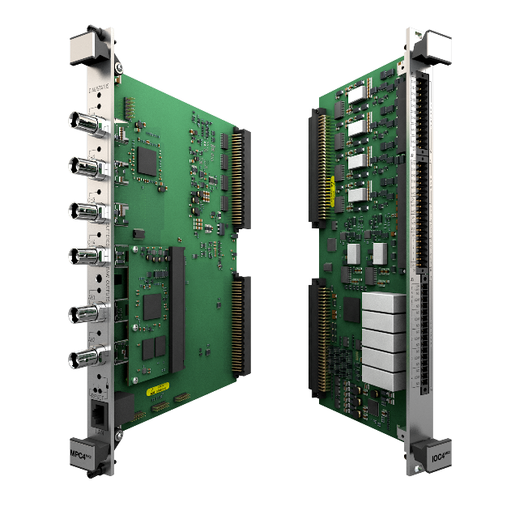
VM600^{Mk2} MPC4^{Mk2} + IOC4^{Mk2}
VM600^{Mk2} machinery protection and condition monitoring module
4 dynamic channels + 2 auxiliary channels (configurable as tacho or DC)
Up to 10 processed outputs per channel
4 user-configurable relays + 1 common circuit-fault relay (module fault)
4 analog outputs (4 to 20 mA or 0 to 10 V)
6 BNC connectors for buffered “raw” outputs
2 front panel buttons for module lock/unlock, reboot and recovery
Diagnostics (built-in self-test (BIST)) provides continuous feedback on the health of the module
VM600^{Mk2} system safety-line to drive all system relays to a safe state
Ethernet (100 Mbps) for communication with VibroSight® software
Conforms to API 670
VME bus communications with CPUM^{Mk2}

Slide 11

New approach with enhanced monitoring capabilities
VM600^{Mk2}/ VM600 machinery protection and condition monitoring solutions
(Temporary)
Ethernet communications link
(Permanent)
Condition monitoring
XMV16
VibroSight ® condition monitoring software
VibroSight ® machinery protection software
MPC4^{Mk2}
Machinery protection
VM600 rack
Sensors / measurement chains
VM600^{Mk2} MPC4^{Mk2} + IOC4^{Mk2} module supports both machinery protection (MPS) and condition monitoring (CMS) – MPC4^{Mk2} CMS requires a license!
VibroSight Protect for MPC4^{Mk2} machinery protection (MPS) functionality / VibroSight Capture for MPC4^{Mk2} condition monitoring (CMS) functionality
Visibility of relay status, protection alarms and processing results from the monitoring software
Using separate software modules for the configuration and operation of MPC4^{Mk2} functionality/systems helps ensure complete separation (“segregation”) of MPS and CMS in a single VM600^{Mk2}/ VM600 rack.
Change of MPC4^{Mk2} machinery protection requires physical access to the VM600^{Mk2} rack => cybersecure

Slide 12
New approach with enhanced monitoring capabilities
VM600^{Mk2}/ VM600 machinery protection and condition monitoring solutions
Permanent Ethernet communications link
Condition monitoring
XMV16
VibroSight ® condition monitoring software
VibroSight ® machinery protection software
MPC4^{Mk2}
Machinery protection
VM600 rack
Sensors / measurement chains
VM600^{Mk2}/ VM600 XMx16 + XIO16T modules support condition monitoring only (XMV16 for vibration, XMC16 for combustion)
VibroSight Configurator to configure XMx16 condition monitoring
Other VibroSight software modules are used for the operation and management of VM600^{Mk2}/ VM600 modules/systems in the usual way. For example, VibroSight Vision for data display and analysis, VibroSight System Manager to configure hardware (IP addresses), update firmware, manage licensing, etc.

Slide 13
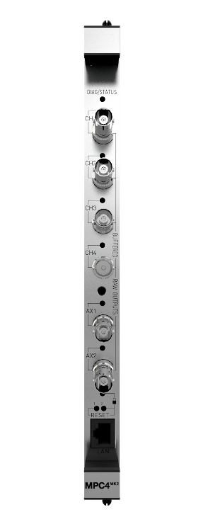

VM600^{Mk2} MPC4^{Mk2} comparison against MPC4 (Mk1)
VM600^{Mk2} MPC4^{Mk2} + IOC4^{Mk2} module
Feature / specification | VM600^{Mk2} MPC4^{Mk2} | VM600 MPC4
Analog to digital converter (ADC) resolution | 24 bit | 12 bit
Frequency bandwidth | 20 kHz | 10 kHz
Measurement outputs per channel | Up to 10 | Up to 2
Waveforms and spectra for troubleshooting | Yes | No
Epoxy sealed relays with all contacts (COM, NC, NO) available | Yes (4 + 1) | No (4)
Software configurable relays (normally energized (NE) or normally de-energized (NDE) – without jumpers) | Yes | No
System safety-line to drive relays to a safe state | Yes | No
Physical module lock for cybersecurity | Yes | No
Condition monitoring | Yes | No
SIL 2 | Yes “by design” (2022) | Yes “proven in use”

Slide 14
Single-channel processing
VM600^{Mk2} MPC4^{Mk2} + IOC4^{Mk2} module
VibroSight Protect software |  | VM600 MPSx software (equivalent)
Bearing absolute vibration |  | (BBAB) Broad Band Absolute Bearing Vibration
Bearing absolute vibration or Shaft relative vibration |  | (NB) Narrow Band (Tracking) Vibration
Shaft relative vibration |  | (RS) Relative Shaft Vibration
Position Shaft axial position (collar) Shaft axial position (shaft end) | Rotor position (collar) Differential expansion (collar) Rotor expansion (collar) | (PS) Position
Shaft eccentricity |  | (EC) Eccentricity
Housing expansion |  | (HE) Absolute Housing Expansion
Differential expansion (pendulum) |  | (SEP) Relative Shaft Expansion With Pendulum
Broad band pressure |  | (BBP) Broad Band Pressure
Quasi-static pressure |  | (QSP) Quasi-static Pressure
Quasi-static temperature |  | (QST) Quasi-static Temperature
Bearing absolute vibration or Shaft relative vibration |  | (NBFS) Narrow Band Fixed Frequency
Speed |  | Speed

Slide 15
Dual-channel processing
VM600^{Mk2} MPC4^{Mk2} + IOC4^{Mk2} module
VibroSight Protect software | VM600 MPSx software (equivalent)
X-Y shaft relative vibration | (SMAX) Smax
Differential housing expansion | (DHE) Differential Housing Expansion
Differential expansion (single taper) Differential expansion (dual taper) | (RST) Relative Shaft Expansion (Shaft taper)
Shaft axial position (collar) Shaft axial position (shaft end) Differential expansion (collar) | (RSC) Relative Shaft Expansion (Shaft collar)
Mathematical function | (DMF) Dual Mathematical Function
Delta Quasi-static Pressure | (DQSP) Delta Quasi-static Pressure
Delta Quasi-static Temperature | (DQST) Delta Quasi-static Temperature
Shaft absolute vibration | (AS) Absolute Shaft Vibration

Slide 16
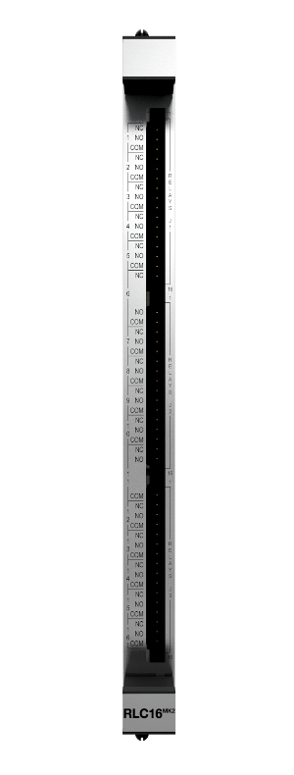
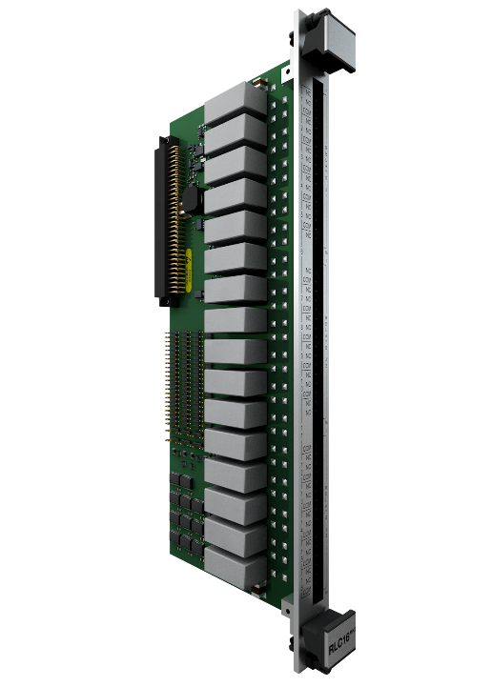
VM600^{Mk2} RLC16^{Mk2}
VM600^{Mk2} relay module
Feature / specification | VM600^{Mk2} RLC16^{Mk2} | VM600 RLC16
Machinery protection relays (user configurable) | 16 | 16
Epoxy sealed relays with all contacts (COM, NC, NO) available | Yes | No
Software configurable relays (normally energized (NE) or normally de-energized (NDE) – without jumpers) | Yes | No
Module OK via Raw bus line (“Status”) | Yes | No
System safety-line to drive relays to a safe state (“Redline”) | Yes | No
SIL 2 | Yes “by design” (2022) | Yes “proven in use”

Slide 17
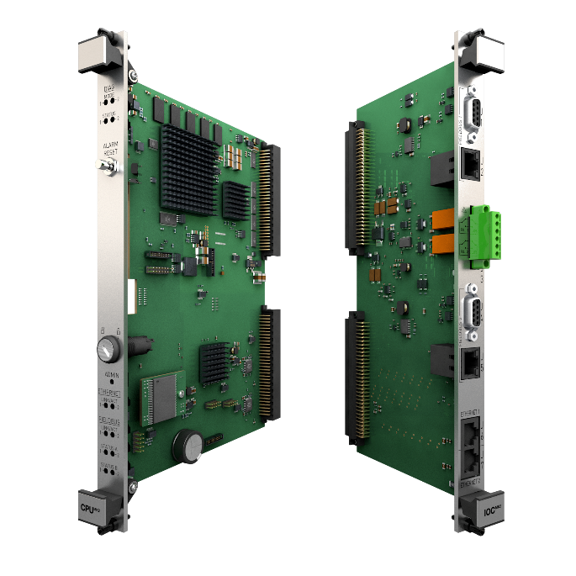
CPUM^{Mk2} + IOCN^{Mk2}
VM600^{Mk2} rack controller and communications interface module
VM600^{Mk2} module data aggregation, processing and sharing (VME bus communications with MPC4^{Mk2}, XMx16)
Industry standard fieldbus communications interfaces: Modbus TCP and PROFIBUS DP
Mathematical operations on fieldbus data
System/module status (health) information available via fieldbus
Front-panel alarm reset (AR) button
VM600 rack (CPUM^{Mk2}) security with a removable key
Two system Ethernet connections and two fieldbus connections can run simultaneously
Communications redundancy with two fieldbuses: Ethernet and/or serial
Two relays to signal system status and alarm information

Slide 18

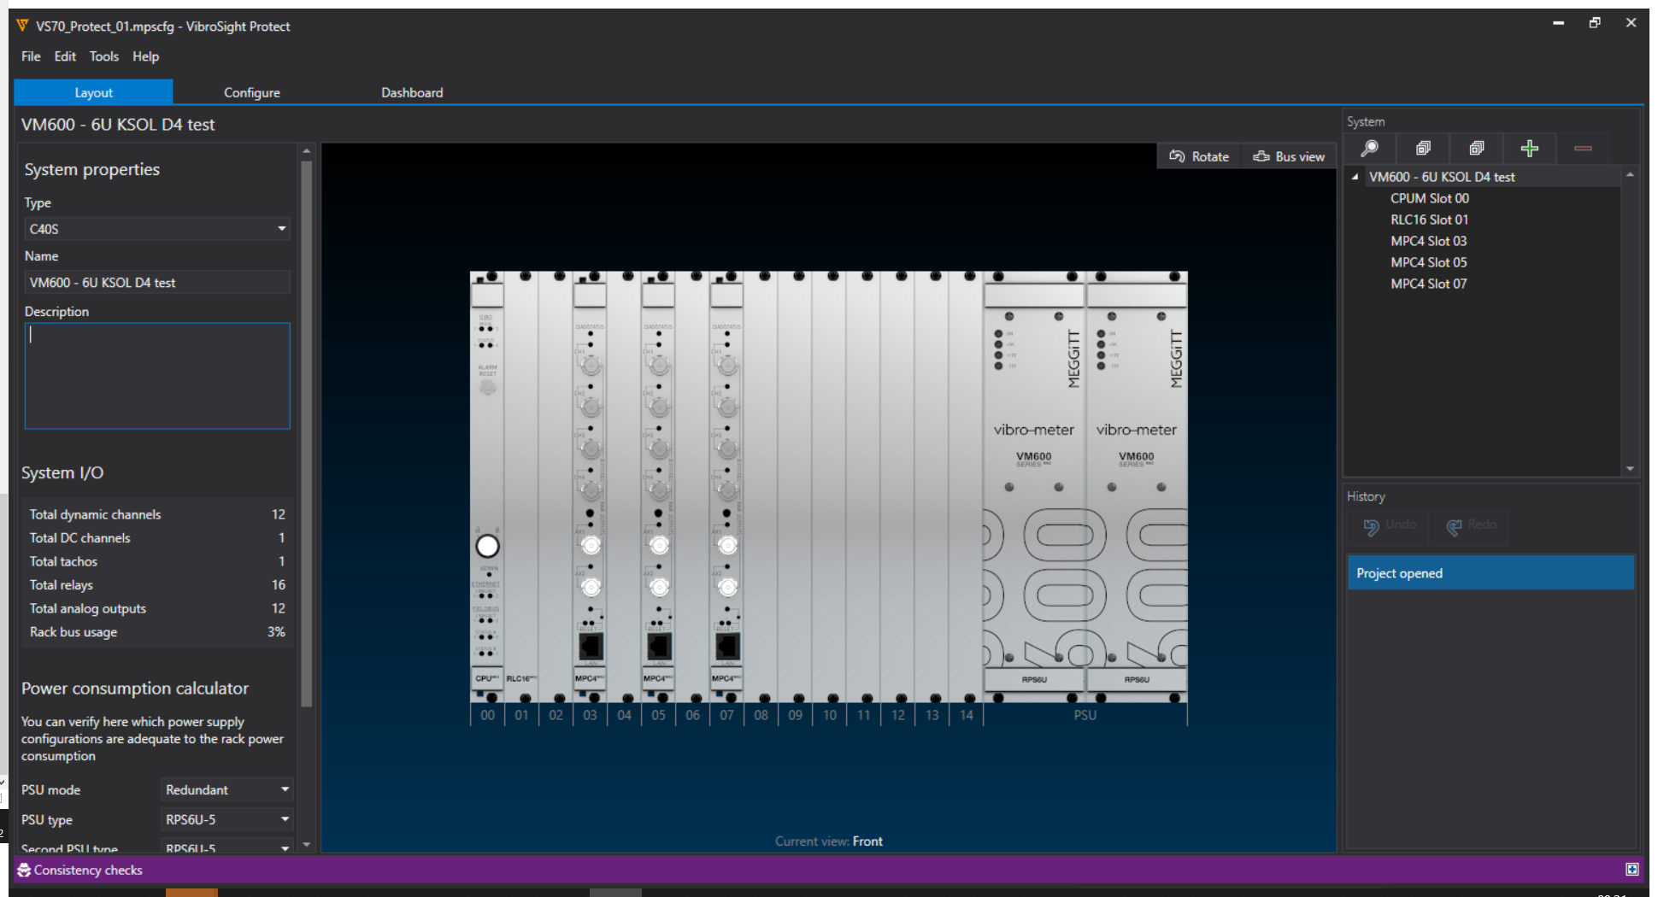
VibroSight Protect
Machinery protection configuration software
VibroSight ® software module designed and optimized specifically for operation with VM600^{Mk2}
VibroSight Protect supports the configuration and operation of the machinery protection (MPS) functionality for a VM600^{Mk2} system: MPC4^{Mk2} + IOC4^{Mk2}, RLC16^{Mk2}, CPUM^{Mk2} + IOCN^{Mk2}
New easy to use and intuitive user interface
Separate configuration (*.mpscfg file)
Fast configuration
Checks overall system (rack) configuration consistency (as opposed to one-by-one module configuration)

Slide 19

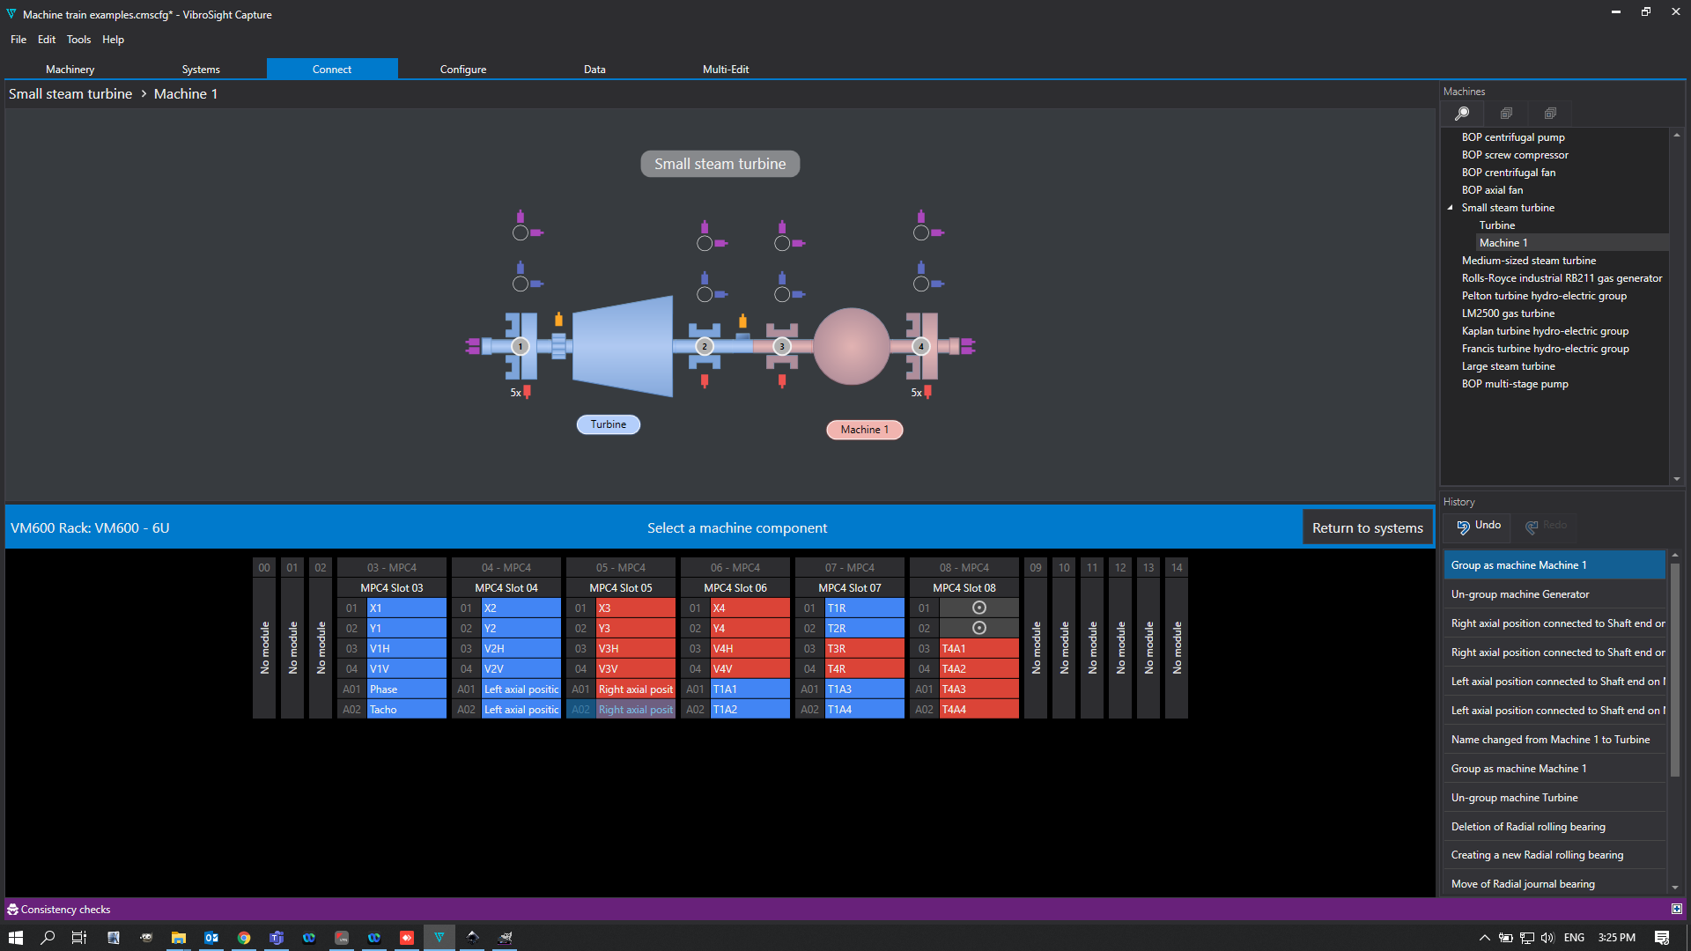
VibroSight Capture
Condition monitoring configuration software
VibroSight ® software module designed and optimized specifically for operation with VM600^{Mk2}
VibroSight Capture supports the configuration and operation of the condition monitoring (CMS) functionality for a VM600^{Mk2} system: MPC4^{Mk2} + IOC4^{Mk2}
New easy to use and intuitive user interface
Separate configuration (*.cmscfg file)
Fast configuration
Fully-integrated support for VibroSight database management (no external data/database management tools are required)

Slide 20
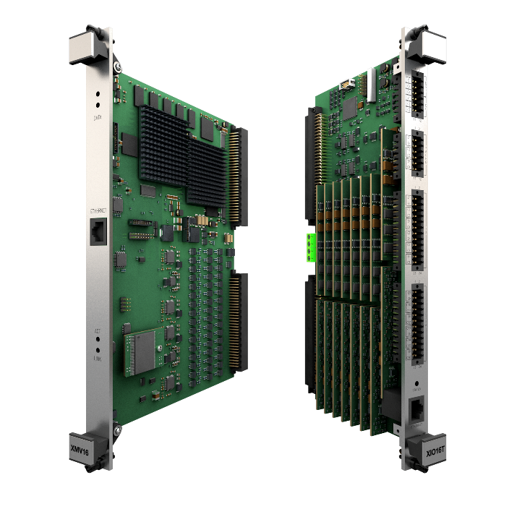
VM600^{Mk2}/VM600 XMV16 + XIO16T
VM600^{Mk2}/ VM600 condition monitoring module for vibration
Vibration monitoring for critical and large industrial applications requiring higher-performance and/or larger channel counts
16 dynamic channels + 4 tacho (speed) channels, also configurable as DC
Individually configurable channels with simultaneous and seamless data acquisition (fixed frequency or order tracked)
Up to 20 processed outputs per channel
High-resolution spectra (FFT): up to 6400 lines every 500 ms, up to 3200 lines every 200 ms, up to 1600 lines every 100 ms
Multiple alarms per output with configurable limits, hysteresis and time delay
Gigabit Ethernet (1000 Mbps) for communication with VibroSight®
VME bus communications with CPUM^{Mk2}

Slide 21

VM600^{Mk2}/VM600 XMC16 + XIO16T
VM600^{Mk2}/ VM600 condition monitoring module for combustion
Optimised for combustion (and vibration) monitoring
Combustion: Specific FFT windows options / Proprietary algorithm included (OEM applications)
16 dynamic channels + 4 tacho (speed) channels, also configurable as DC
Individually configurable channels with simultaneous and seamless data acquisition (fixed frequency or order tracked)
Up to 20 processed outputs per channel (Combustion: Band-peak extraction for combustion monitoring)
High-resolution spectra (FFT): up to 6400 lines every 500 ms, up to 3200 lines every 200 ms, up to 1600 lines every 100 ms (Combustion: Data aggregation of internal spectra)
Multiple alarms per output with configurable limits, hysteresis and time delay
Gigabit Ethernet (1000 Mbps) for communication with VibroSight®
VME bus communications with CPUM^{Mk2}

Slide 22

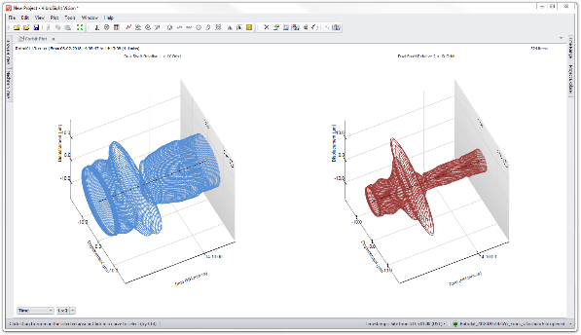
VibroSight software suite
VM600^{Mk2} condition monitoring system
Key features
User-friendly advanced vibration monitoring and analysis
Allows to efficiently handle large numbers of measurement points and extensive volumes of data
Easy correlation of data from different systems is supported in cybersecure environments
Modular, flexible and comprehensive machinery protection and condition monitoring solutions for a wide range of applications within the power generation, oil & gas and process industries.

Slide 23
VibroSmart ® Distributed monitoring system For machinery Protection and/or condition monitoring

Slide 24
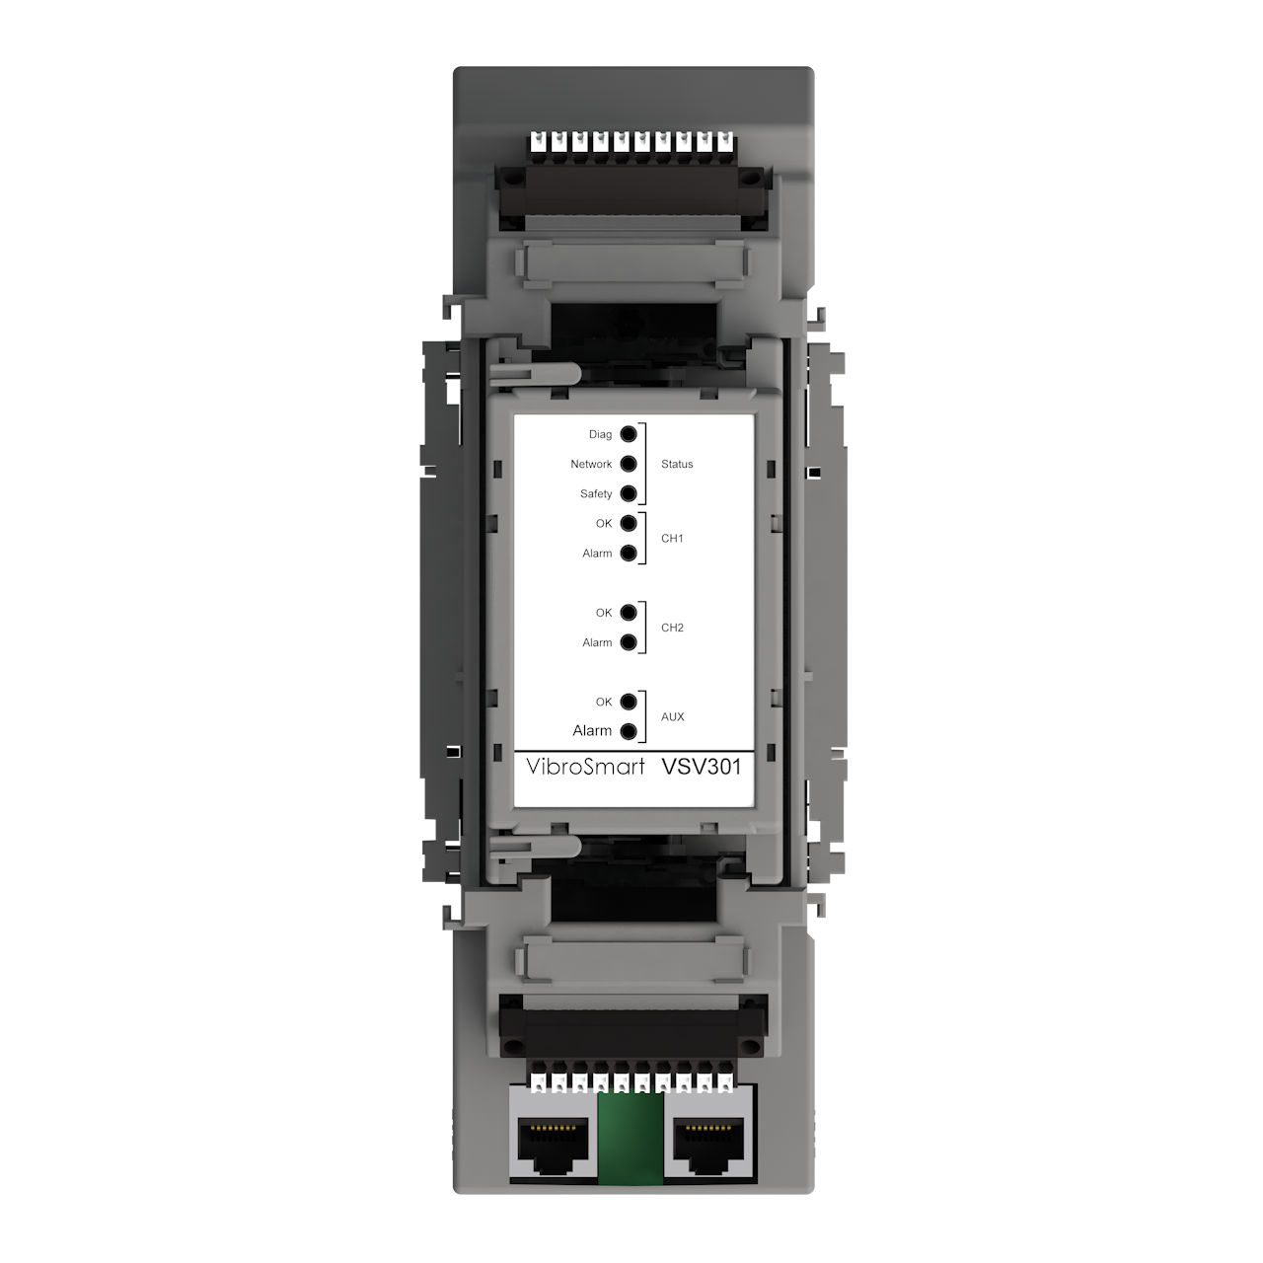
DESIGN CONCEPT
VibroSmart VSV30x
Distributed system
Modular and scalable system designed for condition monitoring and machinery protection applications of critical assets.
Flexible Highly scalable and easy to extend.
Wide range of applications From stand-alone module on balance of plant equipment, up to several connected units for larger critical rotating machinery.
Real-time communication Via Ethernet or fieldbus.
Lower installation costs Skid-mounting of modules closer to machinery reduces expensive cabling.
Industry standards
API 670 fully compliant
Cybersecurity certification per IEC 62443
SIL 2
ATEX-certified (Zone 2)

Slide 25
SYSTEM FEATURES
VibroSmart VSV301 + VSB300
ATEX-certified (Zone 2)
Directly mounted to the machine (DIN-rail)
Measurement chain: suitable for accelerometers, proximity (eddy current) and velocity sensors.
VibroSight: compatible with vibro-meter’s analysis and data processing software
2 dynamic channels and 1 analog input
Auxiliary input channel for tachometer
4 basic and 2 advanced logic functions to drive the module’s relays
Ethernet communications

Slide 26

SYSTEM FEATURES
VibroSmart VSI010 + VSB010
ATEX-certified (Zone 2)
Directly mounted to the machine
Fieldbus server (slave) device acting as a data bridge between the modules and fieldbus master devices
(third-party systems)
VibroSight: compatible with vibro-meter’s analysis and data processing software
Up to 2 fieldbus ports
8 basic and 4 advanced logic functions to combine alarm and status information to drive module’s relays
Communications interfaces for industry standard fieldbuses: Modbus RTU, Modbus TCP, PROFIBUS DP and
GOOSE (IEC 61850)

Slide 27
SpeedSys300 Overspeed detection system

Slide 28
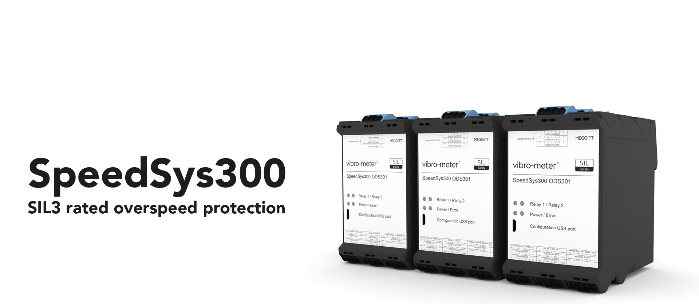

Slide 29
Design concept
SpeedSys300 ODS301 is designed as an independent layer of protection; to be fundamentally simple and robust. It delivers fast and reliable protection for speed and acceleration, and complies to important industry standards such as SIL and ATEX.

Slide 30
SpeedSys300 ODS301
Key features and benefits
Safety by design
Scalable
API 670 compliant
Advanced self-monitoring and diagnostics
SIL 2 and SIL 3 capable: certified “by design”
Proof-test interval (PTI): 10 years
Modular design
Compatible with industry standard speed sensors
Ex certified input channel interfaces for use with sensors / measurement chains installed in hazardous areas
Dedicated overspeed system (isolated layer or protection)
Fast response time
External voting logic

Slide 31
SpeedSys300 ODS301
Specfications
SpeedSys300 ODS301 features/specificatons
Sensor compatibility | Proximity (eddy current), electronic (Hall effect) or magnetic (variable reluctance) speed sensors / measurement chains
Signal processing | The ODS301 module counts measurement chain pulses and converts them to rotational speed and acceleration measurements, which are compared against configured alarm limits. Safety outputs are activated for critical alarms while non-safety outputs are used for other alarms/status information.
Frequency range | 0.025 Hz to 35 kHz
Response time | 10 ms (typical)
Safety outputs | 2 × double-pole single-throw (DPST) safety relays and 1 × analogue 4 to 20mA current loop – certified for SIL safety loops
Non-safety outputs | 2 × single-pole single-throw (SPST) relays, 1 × frequency (speed) output, 1 × binary (status) output and 1 × Modbus RTU serial interface (read only)
Diagnostics technology | Advanced self-monitoring and diagnostics (that is, built-in self-test (BIST)) monitors and reports the health/status of the complete system
Proof test interval (PTI) | 10 years (typical)

Slide 32
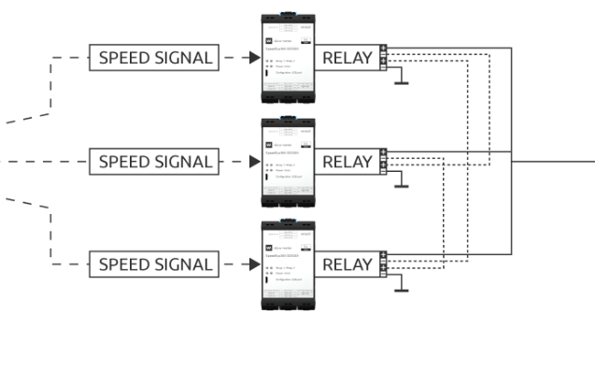
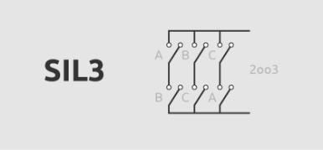

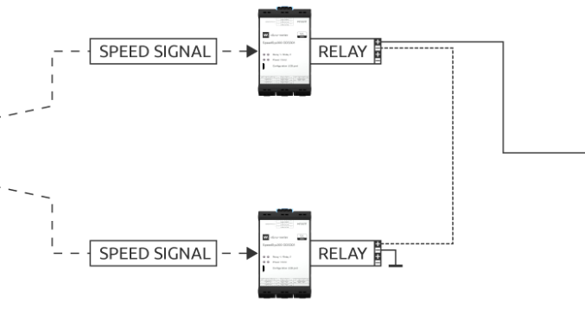

SIL 3 solutions – relays
SpeedSys300 ODS301
SPEED SIGNAL
SPEED SIGNAL
PCS/ACTUATOR
SPEED SIGNAL
SPEED SIGNAL
PCS/ACTUATOR
SPEED SIGNAL

Slide 33
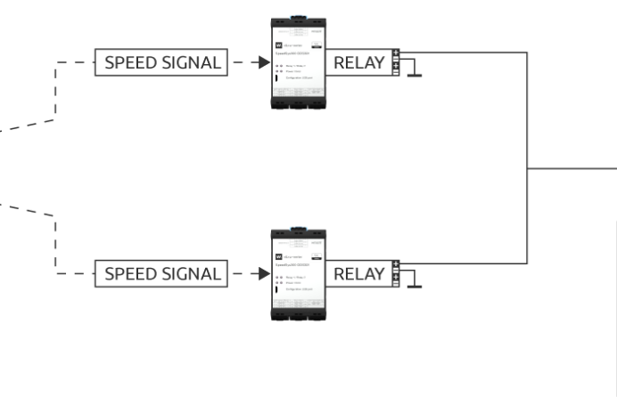
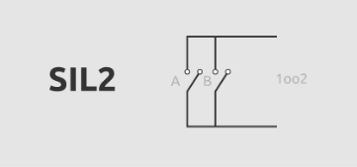
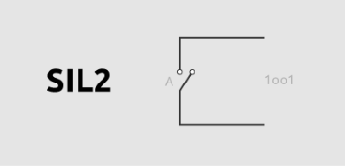
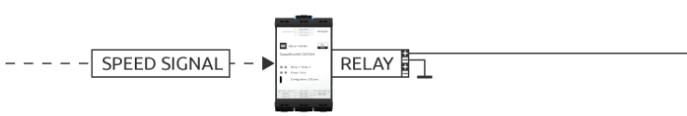

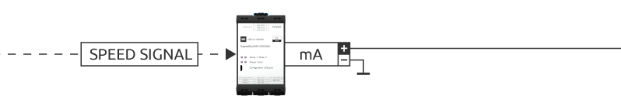
SIL 2 solutions – relays and analog output
SpeedSys300 ODS301
SPEED SIGNAL
PCS/ACTUATOR
SPEED SIGNAL
SPEED SIGNAL
PCS/ACTUATOR
SPEED SIGNAL
PCS/ACTUATOR

Slide 34
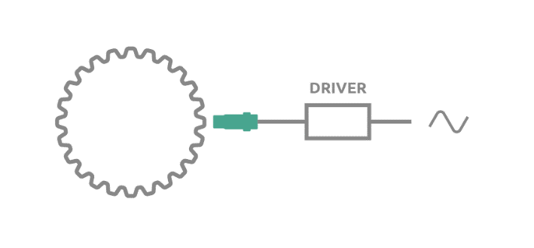
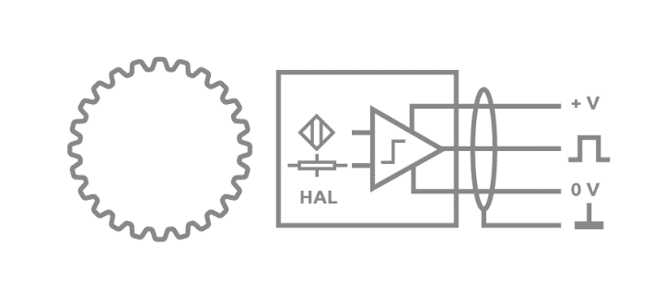
SpeedSys300 ODS301
Sensor input compatibility
Proximity (eddy current)
Electronic (Hall effect)
Magnetic (variable reluctance)
Interface: 2-wire current signal (analogue)
TQ9xx, EA90x and IQS900 proximity measurement chains – with optional diagnostics for SIL safety related applications →more info here
Wide speed range
Operation up to 180°C
Long distance signal transmission (up to 1 km – further than any other solution)
Preferred solution for a wide range of applications
Interface: 3-wire voltage signal (digital)
Preferred for low rpm / zero speed applications
Easily transmittable and processable digital output signal
Less vulnerable to electromagnetic interference (EMI)
Interface: 2-wire voltage signal (analogue)
Preferred for high rpm applications
Suitable for high temperature applications (300°C)
Self-powered

Slide 35
Thank you

Slide 36
Disclaimer
Business legal entity, Business address
Legal entity registration information as appropriate
Information contained in this document may be subject to export control regulations of the United Kingdom, European Union, United States or other national jurisdictions, including the US International Traffic in Arms Regulations and/or Export Administration Regulations.
Each recipient of this document is responsible for ensuring that transfer or use of any information contained herein complies with all relevant Export Control Regulations.
Copyright © 2022 Meggitt SA. All rights reserved.

