Slide 1

Sensors & conditioners
Sensors / measurement chains for turbomachinery & essential rotating equipment
Presenter:
Title:
Date:

Slide 2

Our comprehensive Sensors & Conditioners product portfolio includes complete measurement chains for absolute and relative vibrations such as acceleration, velocity, displacement or gap.
We provide accurate, safe and reliable solutions for extreme environments and critical applications such as bearing and relative shaft vibration protection of rotating equipment, gas turbine online combustion tuning, generator air-gap monitoring, housing expansion, etc.

Slide 3



Product lines overview
Sensors & Conditioners
Protection & Monitoring Systems
Software Solutions
Sensing solutions to monitor critical plant and equipment
Protection and monitoring system hardware for critical rotating machinery
Advanced machinery protection and condition monitoring software

Slide 4
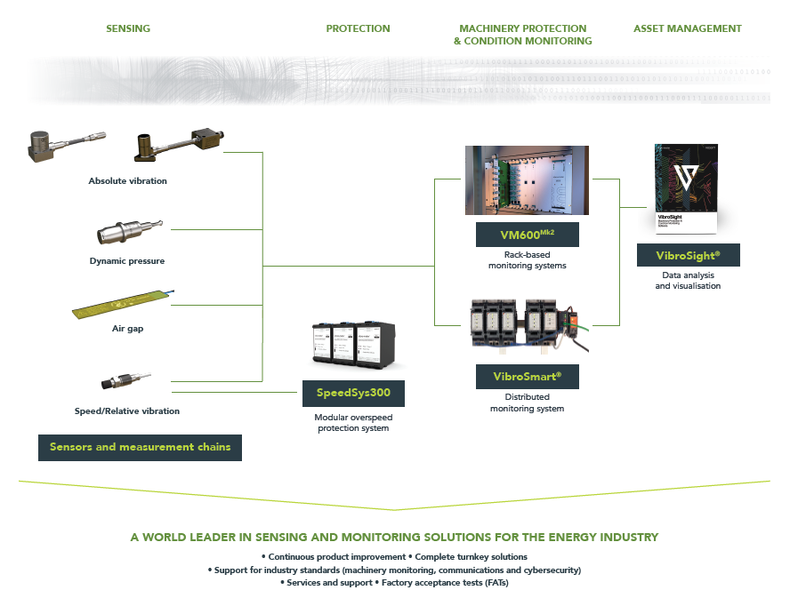

Portfolio overview

Slide 5
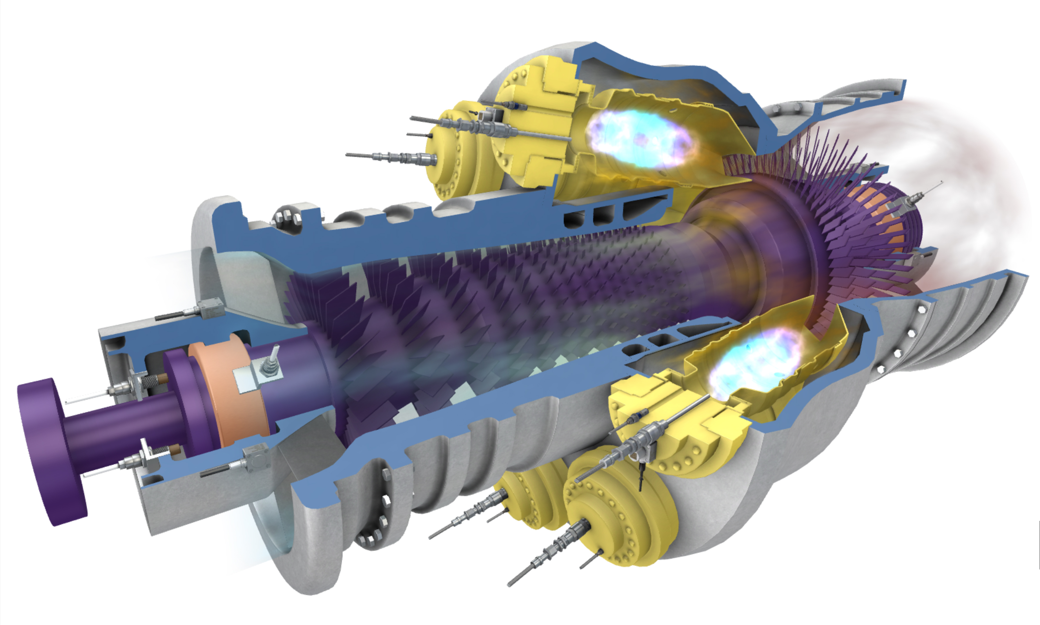
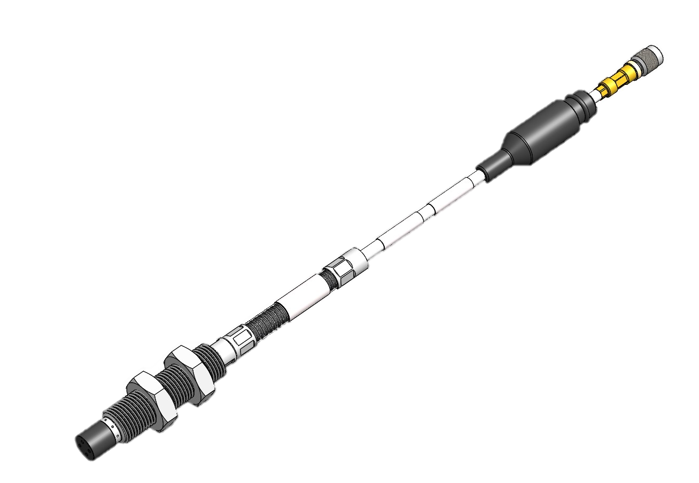
Sensing solutions for harsh environments
Gas turbines
Absolute vibration
(accelerometers)
Displacement - Position - Speed
(proximity sensors)
Combustion
(dynamic pressure sensors)

Slide 6
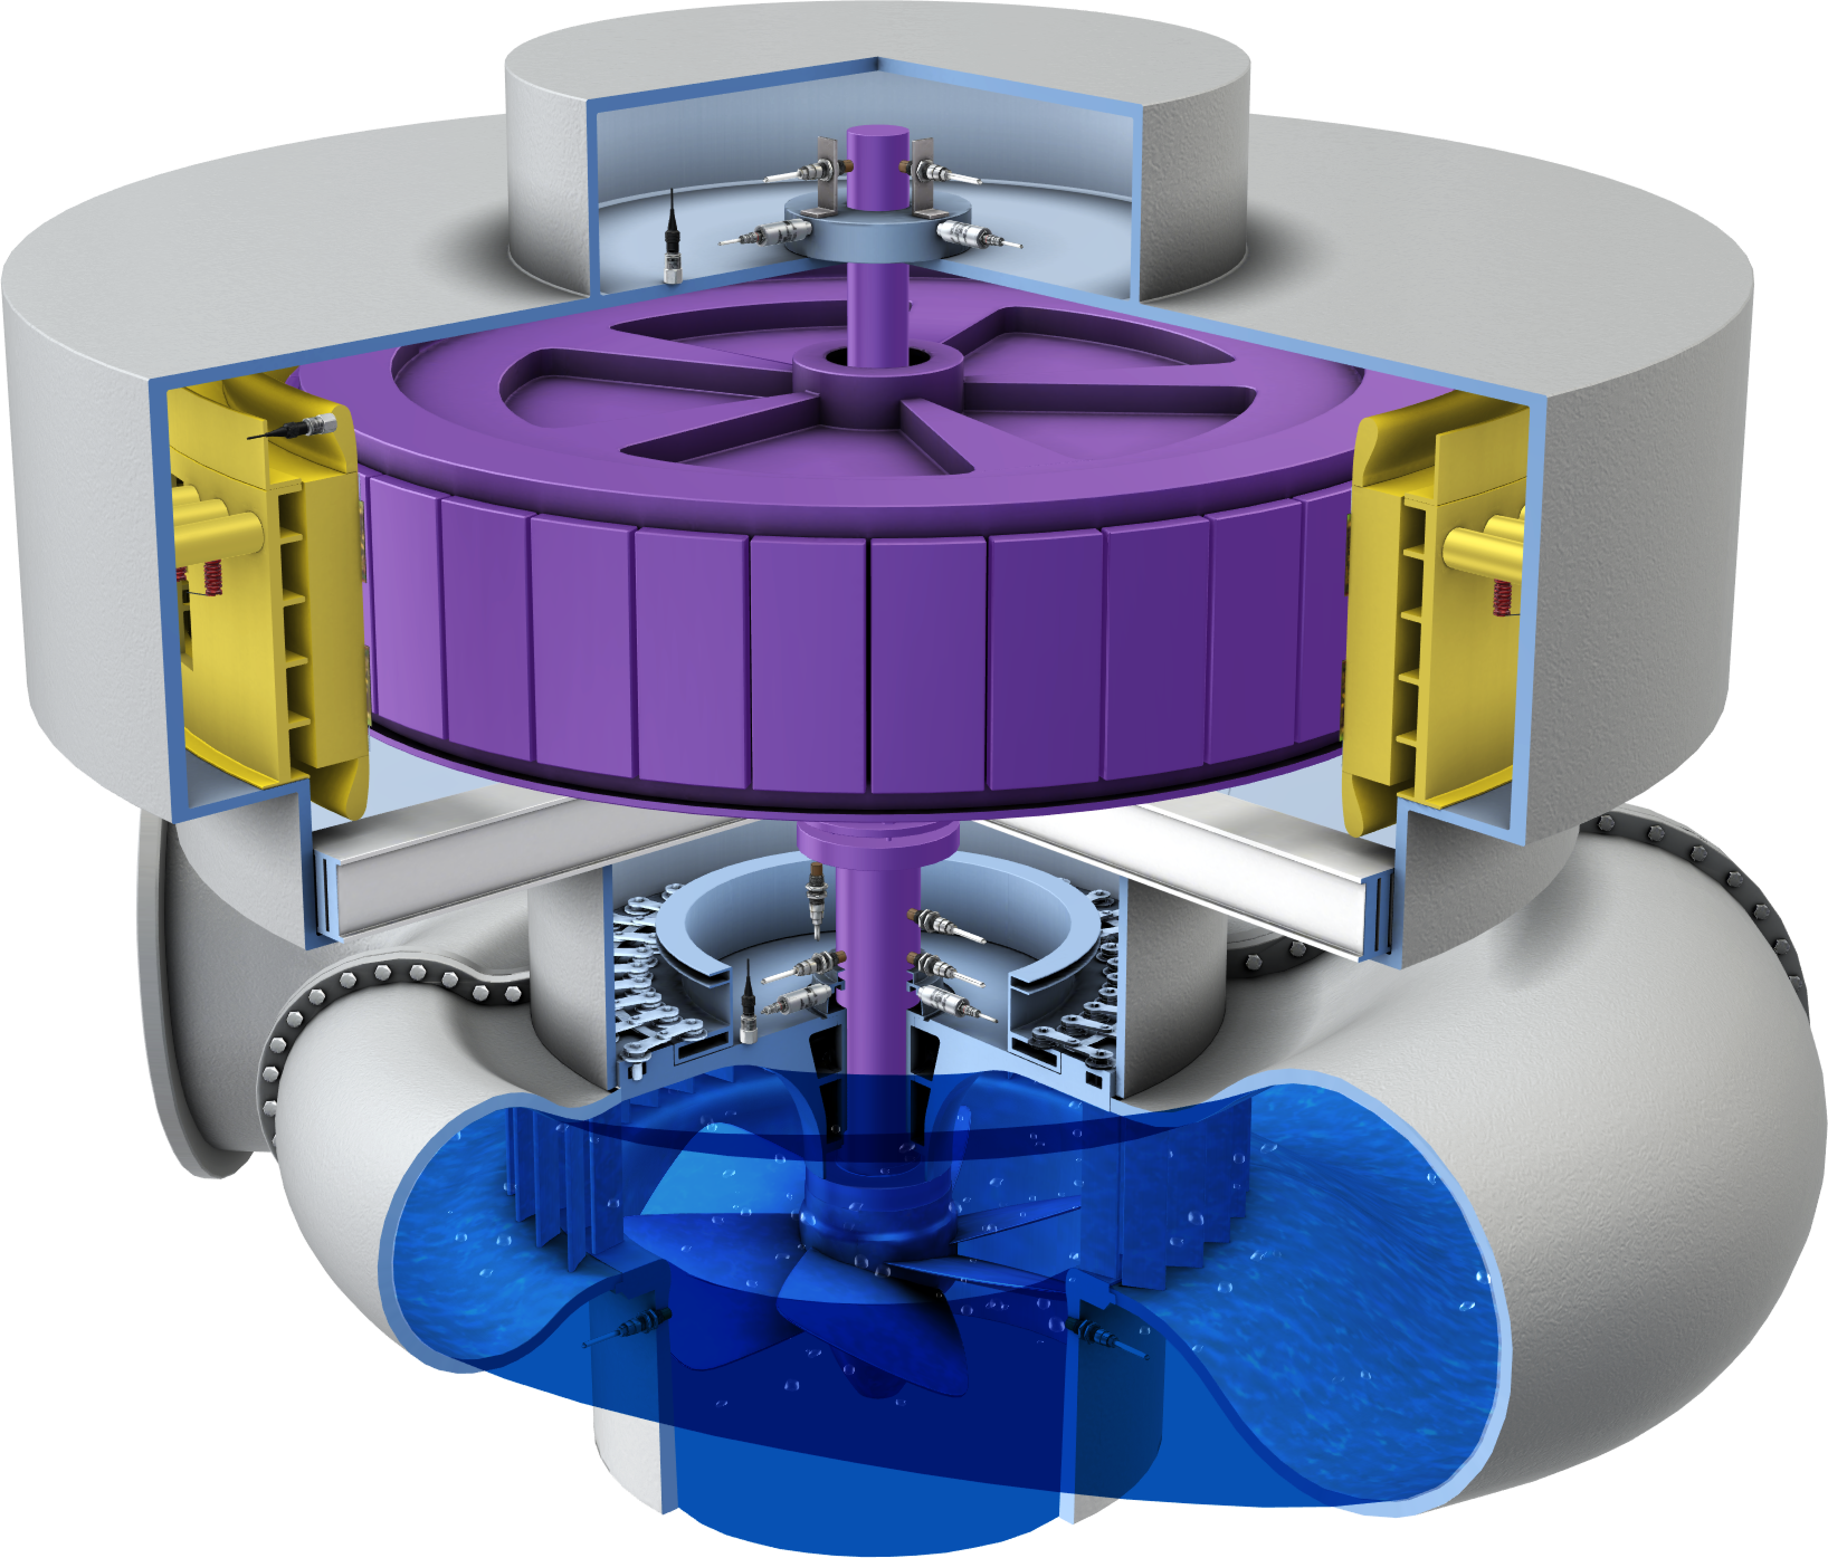

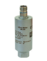
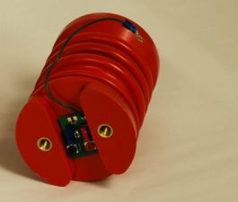
Sensing solutions
Hydro turbines
Absolute vibration
(accelerometers)
Rotor-stator gap
(air-gap sensors)
Vibration as velocity
(velocity sensors)
Displacement - Position - Speed
(proximity sensors)
Winding current
(partial discharge)

Slide 7
Absolute vibration

Slide 8

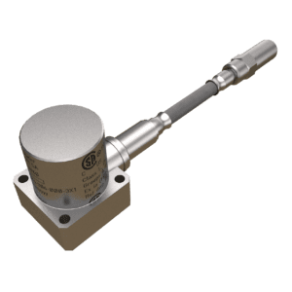
High-temperature piezoelectric accelerometers
CA series
Key features and benefits
Safety standards | Ex certified Up to SIL 2 (using IPC707 signal conditioner)
Operating temperatures | Up to 700 °C for sensors and 85 °C for IPC707 signal conditioner
Sensitivities | From 10 to 100 pC/g
Measurement ranges | From 0.001 to 500 g (dynamic) Up to 1000 g (overload)
Frequency responses | From 0.5 to 10,000 Hz
Signal conditioner | IPC707 has optional diagnostics (built-in test equipment (BITE)), required for SIL 2. Uses external IPC707 signal conditioner.
Linearity (typical) Transverse sensitivity Sensitivity tolerance | ± 1 % < 5 % ± 5 %
Our piezoelectric-based accelerometers are designed for the long-term measurement and monitoring of absolute vibration in the most severe of environments

Slide 9
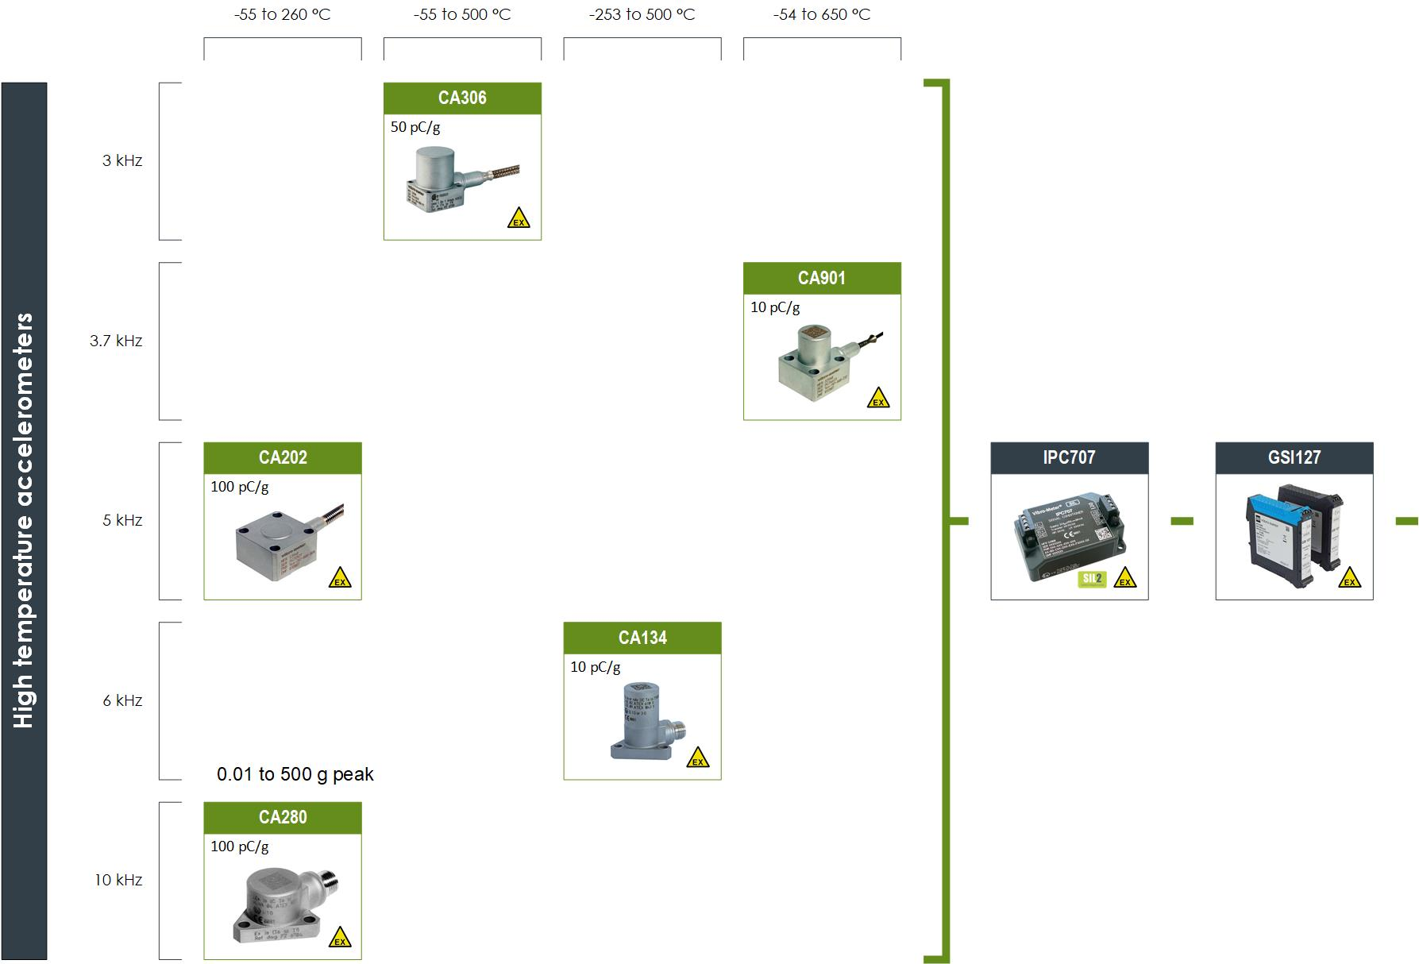
CA series overview
Signal conditioner
Galvanic separator
More than 10,000 CA sensors / measurement chains installed yearly by OEMs and end users worldwide

Slide 10

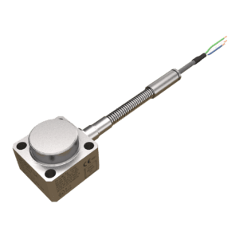
Accelerometers and velocity sensors
With attached or integrated electronics
Key features and benefits
 | With attached electronics | With integrated electronics
Safety standards | Ex certified | Ex certified
Operating temperatures | Up to 350 °C | Up to 140 °C
Sensitivities | From 5 to 50 μA/g | From 50 to 500 mV/g (CE6xx) From 4 mV/mm/s (PV660)
Measurement ranges | From 0.001 to 400 g (dynamic) Up to 2000 g (overload) | Up to 80 g (CE6xx) Up to 100 mm/s (PV6xx)
Frequency responses | From 2 to 10,000 Hz | From 2 to 10,000 Hz
Signal conditioning | Uses attached or integrated electronics. Note: No external signal conditioner, so no connectors close to the machinery being monitored and easier to install.
For applications that do not require the temperature capabilities of a CA series sensor, this series provides a more cost-effective and easier to install solution

Slide 11
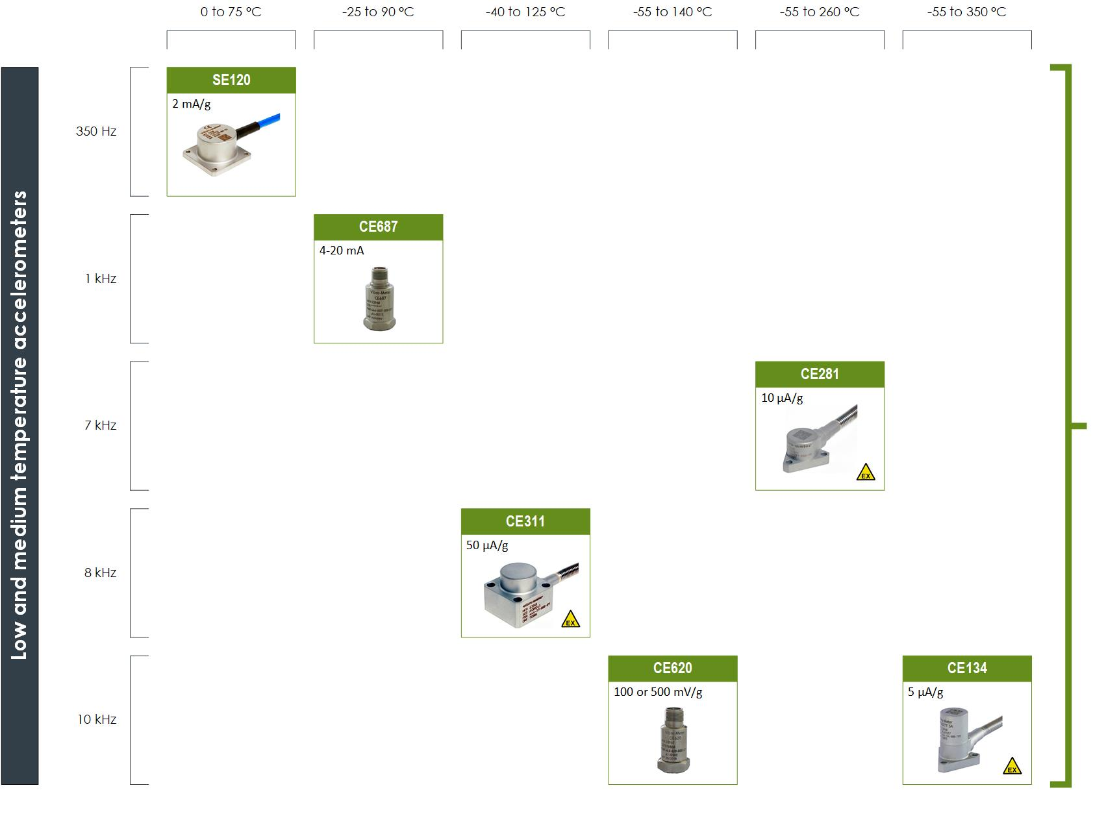
Accelerometers overview
With attached or integrated electronics

Slide 12
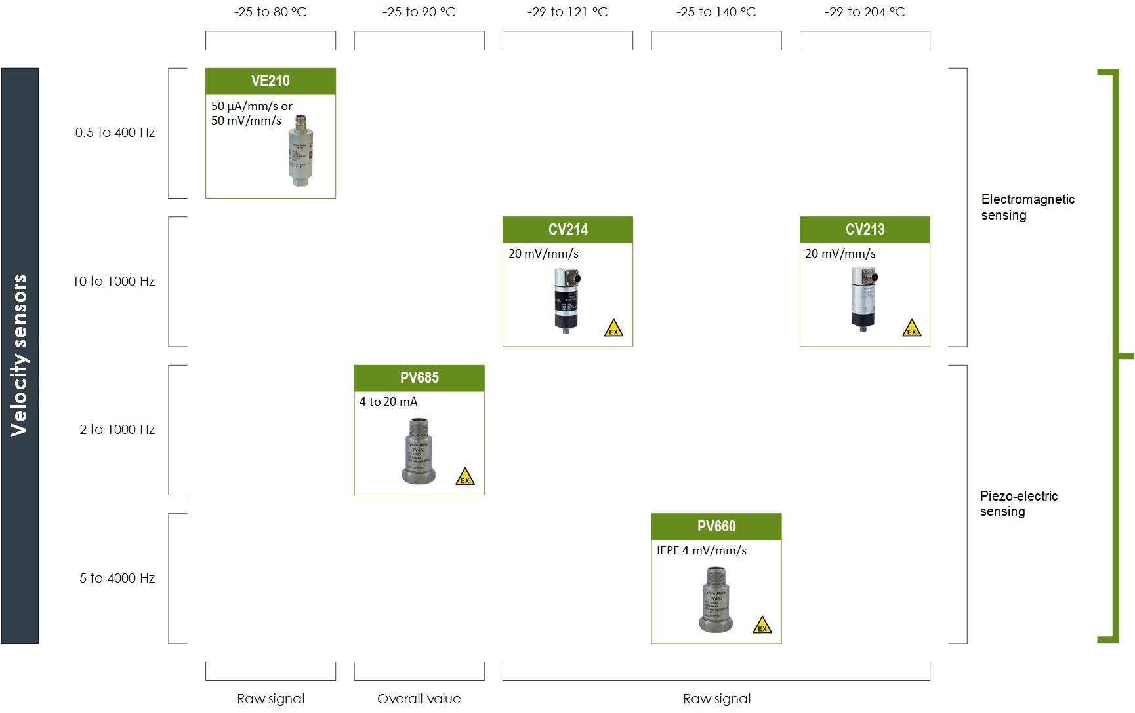
Velocity sensors overview
With attached or integrated electronics

Slide 13
Dynamic pressure

Slide 14

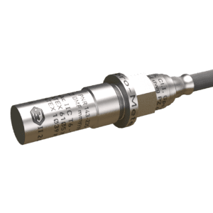
Piezoelectric dynamic pressure sensors
CP series
Key features and benefits
Safety standards | Ex certified Up to SIL 2 (using IPC707 signal conditioner)
Operating temperatures | Up to 700 °C for sensors and 85 °C for IPC707 signal conditioner
Sensitivities | From 25 to 750 pC/bar
Measurement ranges | From 0.00005 to 250 bar (dynamic) Up to 350 g (overload)
Frequency responses | From 2 to 15,000 Hz
Linearity (typical) | ±1%. Note: Low sensitivities to acceleration.
Signal conditioner | Uses external IPC707 signal conditioner. IPC707 has optional diagnostics (built-in test equipment (BITE)), required for SIL 2.
Our piezoelectric-based dynamic pressure sensors are designed for the long-term measurement and monitoring of combustion in gas turbines: combustor pulsations and combustion dynamics.

Slide 15
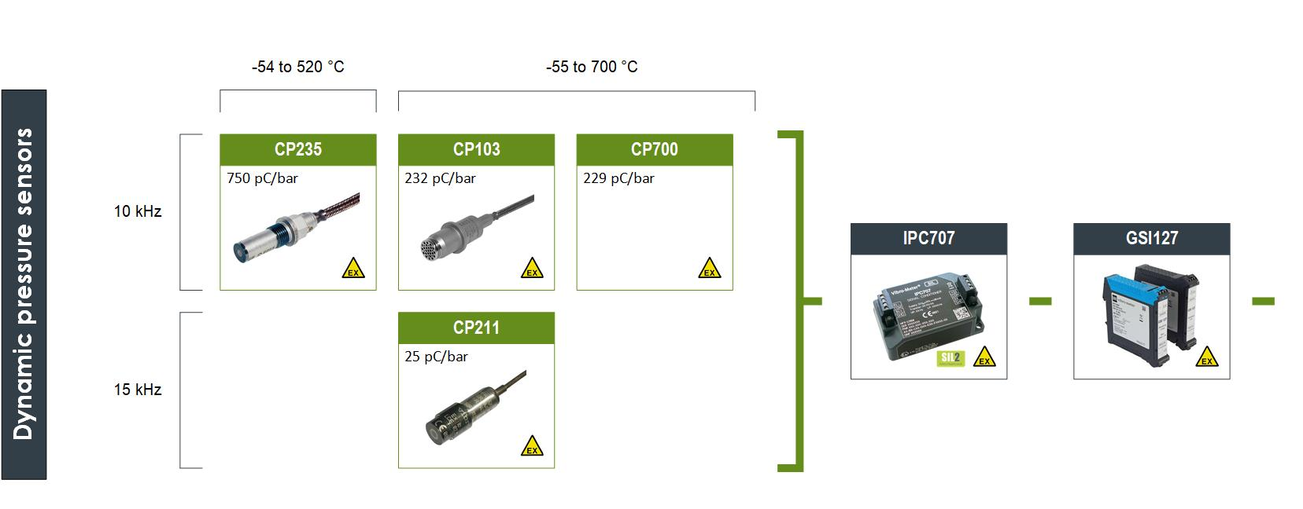
CP series overview
Patented acceleration-compensated designs with the highest temperatures and pressure sensitivities in the industry

Slide 16
Relative vibration

Slide 17

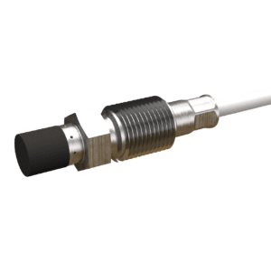
Proximity measurement chains
TQ9xx / IQS900 series
Key features and benefits
Safety standards | API 670 5th edition compliant Ex certified Up to SIL 2 (using IQS900 signal conditioner)
Operating temperatures | −40 to 180 °C for sensors and cabling −40 to 85 °C for signal conditioner
Measurement ranges | TQ9x1: 2 mm range with 8 mV/μm or 2.5 μA/μm sensitivity (Ø 5 mm tip) TQ9x2: 2 mm range with 8 mV/μm or 2.5 μA/μm sensitivity or 4 mm range with 4 mV/μm or 1.25 μA/μm sensitivity (Ø 8 mm tip) TQ9x3: 12 mm range with 1.33 mV/μm or 0.417 μA/μm sensitivity (Ø 18 mm tip)
Frequency response | DC to 20,000 Hz
Mounting | Standard, reverse or right-angle (90°) mounting
Pressure | Up to 100 bar (tip) for high-pressure applications
Signal conditioner | Uses IQS900 signal conditioner. IQS900 has optional diagnostics (built-in test equipment (BITE)), required for SIL 2.
Signal transmission | Up to 1000 m (IQS900 configured with current output)
Our eddy-current based sensors are designed for the contactless measurement of the relative displacement of moving machine elements

Slide 18
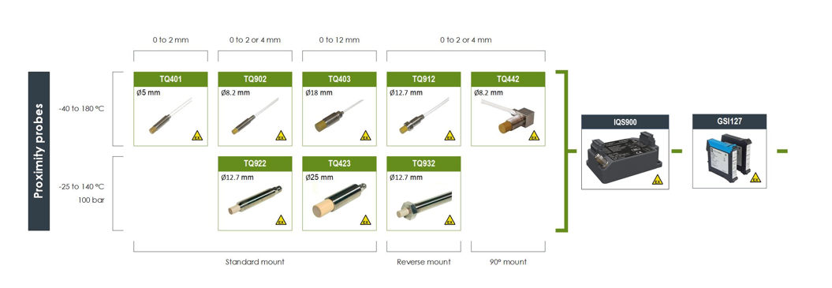
Proximity measurement chains overview
Comprehensive radial vibration, axial position, rotational speed and phase reference (1/ REV pulse) measurement solutions

Slide 19
Air gap

Slide 20
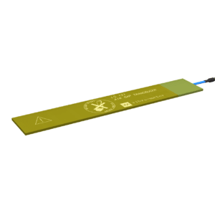
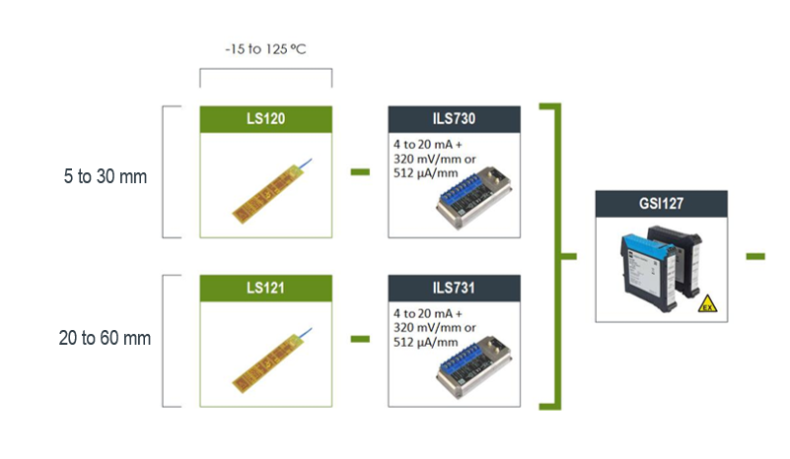
Air gap sensor measurement chains
LS12x / ILS73x series
Electric field (capacitance) technology for the contactless measurement of air gap (rotor and stator) in hydroelectric generators and other large machines
Key features and benefits
Contactless measurement: No wear-out
Measurement ranges: 30 or 60 mm versions
Three voltage output signals: Pole profile, Rotor profile and Minimum gap (suitable for direct protection)
One current output signal: Configurable as one of Pole profile, Rotor profile or Minimum gap
Easy, fast and reliable installation
Enhanced filtering of noise and spikes induced by high excitation currents

Slide 21
Housing expansion probes

Slide 22
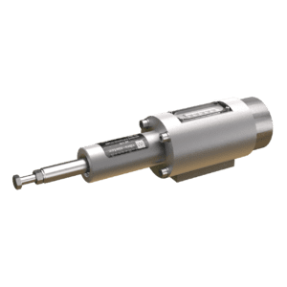
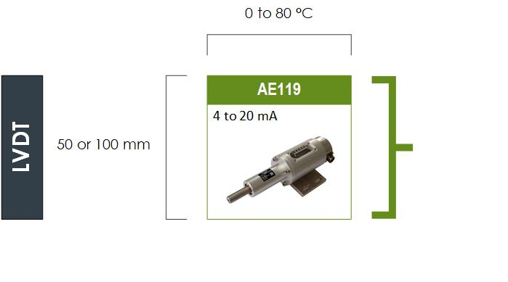
Housing expansion probes
AE119
Eddy-current technology for the contactless measurement of absolute housing expansion on medium to large thermal machines such as gas turbines and steam turbines
Key features and benefits
Contactless measurement: No wear-out
Measurement ranges: 50 or 100 mm versions
Integrated electronics: Current output signal
Splash proof: IP54 protection rating

Slide 23
Thank you

Slide 24
Disclaimer
Business legal entity, Business address
Legal entity registration information as appropriate
Information contained in this document may be subject to export control regulations of the United Kingdom, European Union, United States or other national jurisdictions, including the US International Traffic in Arms Regulations and/or Export Administration Regulations.
Each recipient of this document is responsible for ensuring that transfer or use of any information contained herein complies with all relevant Export Control Regulations.
Copyright © 2022 Meggitt SA. All rights reserved.

