Slide 1
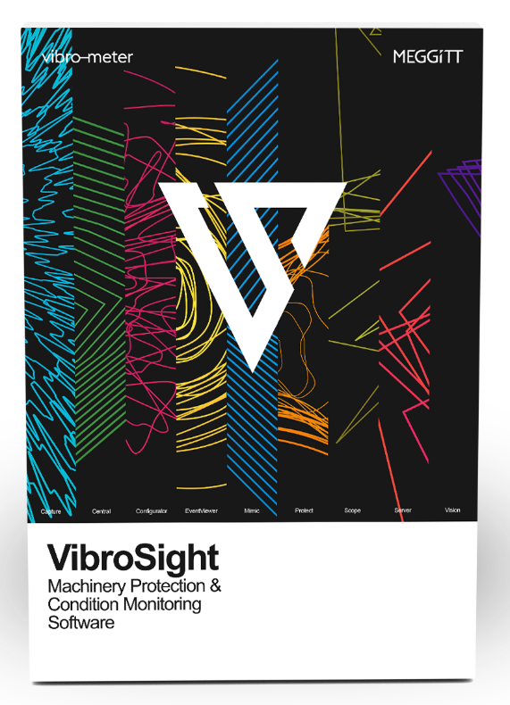
VIBROSIGHT
Advanced machinery protection and condition monitoring software
  Presenter:
Title:
Date:

Slide 2

VibroSight enables modular, flexible and comprehensive machinery protection and condition monitoring solutions for a wide range of applications within the power generation, oil & gas, and process industries.

Slide 3

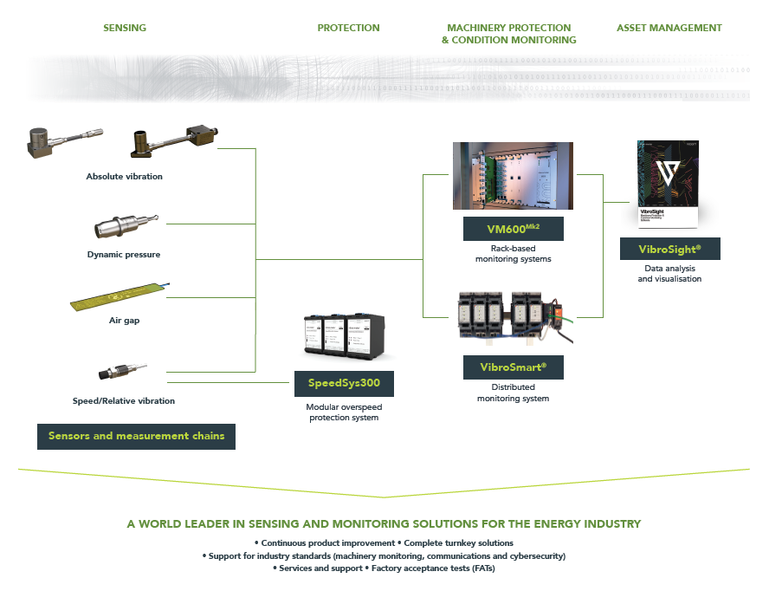
Portfolio overview

Slide 4





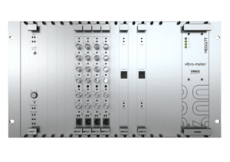
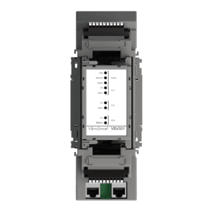
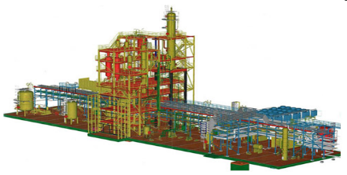
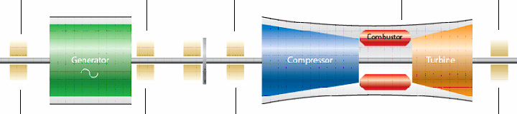
System Architecture
Example VibroSight System
Data display workstations
Offline analysis
Database
Plant data highway (Ethernet)
Configuration and local data display
VM600^{Mk2} system
VibroSmart ®
system
Digital control system
Process parameters
Vibration, speed, pressure, temperature, etc.

Slide 5



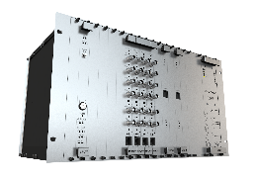






System architecture
VibroSight software architecture
MONITORING SYSTEM HARDWARE
Database
INDUSTRIAL MACHINERY

Slide 6
VibroSight demo

Slide 7
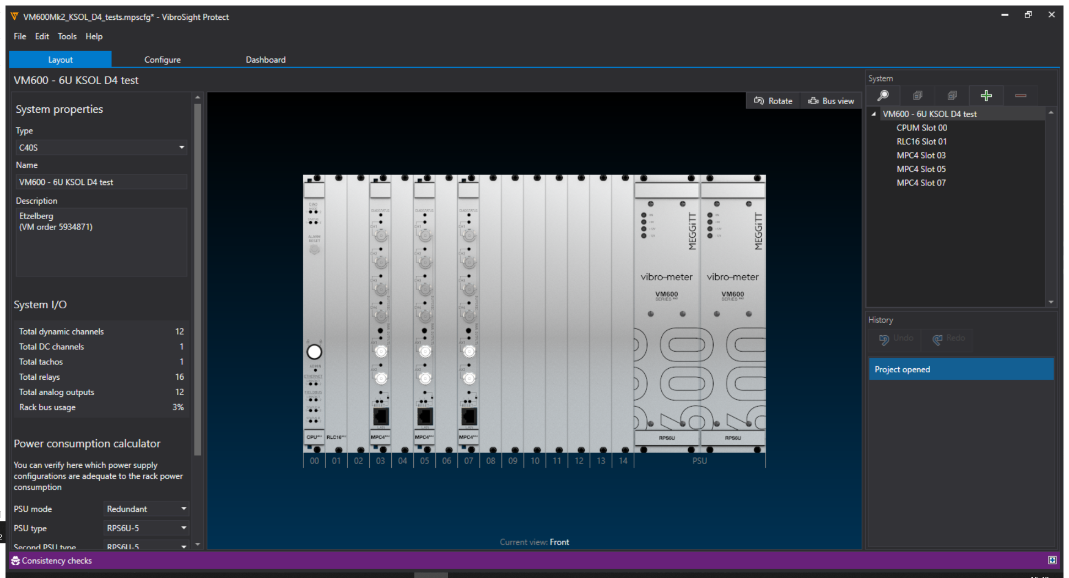
VibroSight demo
Machinery protection system configuration using Protect
Creation of a new protection configuration
Adding cards to the VM600 rack
Input channel configuration including
  Processing functions
  Measurement outputs
  Alarms limits
Logical functions configuration
Relays configuration
Analog outputs configuration
Upload on the configuration to the VM600 rack

Slide 8
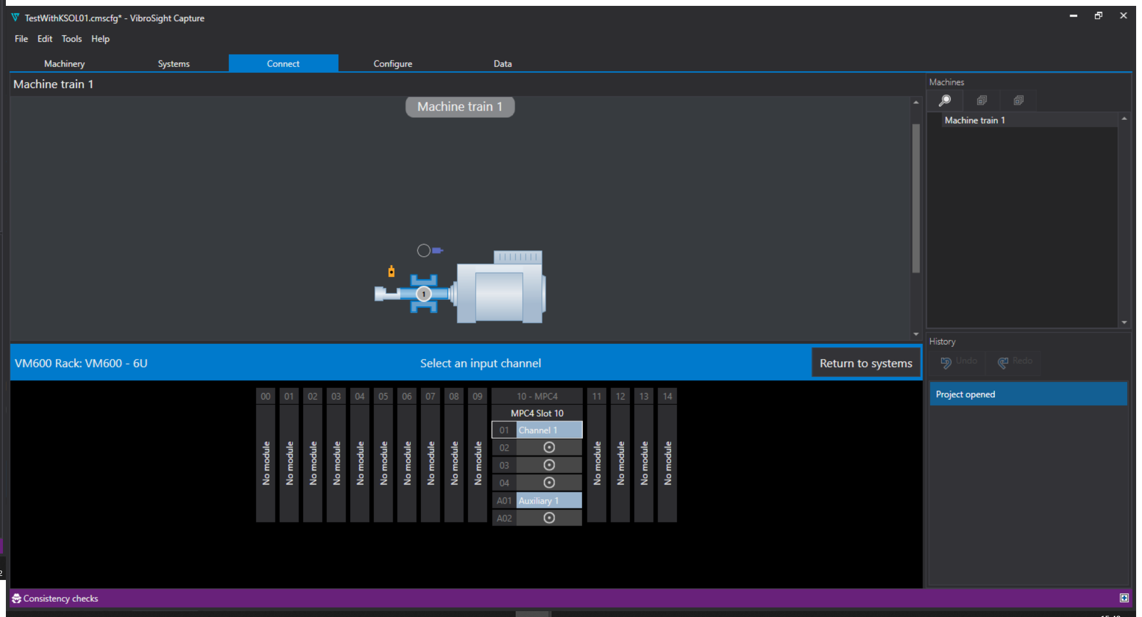
VibroSight demo
Condition monitoring system configuration using Capture
Creation of a new monitoring configuration
Creation machine trains
Import of machinery protection racks configuration
Connection of sensors to machine train components
Fine tuning of condition monitoring processing outputs
Machine states configuration
Logging rules configuration
Database management configuration
  Database backup
  Database purge
  Offline data repository
Data export to other systems

Slide 9
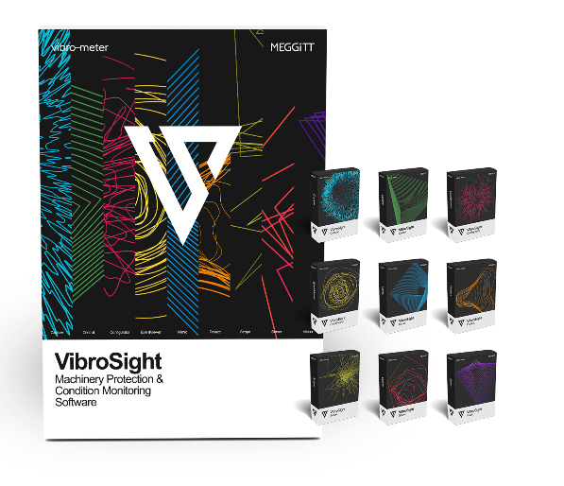
Software Suite
VibroSight has a modular client-server architecture composed of system configuration, monitoring and management software modules

Slide 10

VibroSight Protect
for the configuration of
VM600^{Mk2} machinery protection
For the configuration of machinery protection
functionality for VM600^{Mk2} systems.
(More specifically, MPS using MPC4^{Mk2} + IOC4^{Mk2}, RLC16^{Mk2} and CPUM^{Mk2} + IOCN^{Mk2} modules.)

Slide 11

VibroSight Capture
for the configuration of
VM600^{Mk2} condition monitoring
For the configuration of condition monitoring
functionality for VM600^{Mk2} systems.
(More specifically, CMS using MPC4^{Mk2} + IOC4^{Mk2}
modules.)

Slide 12
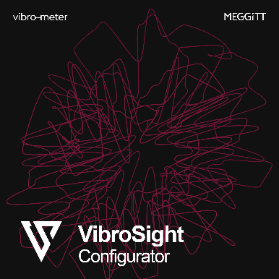
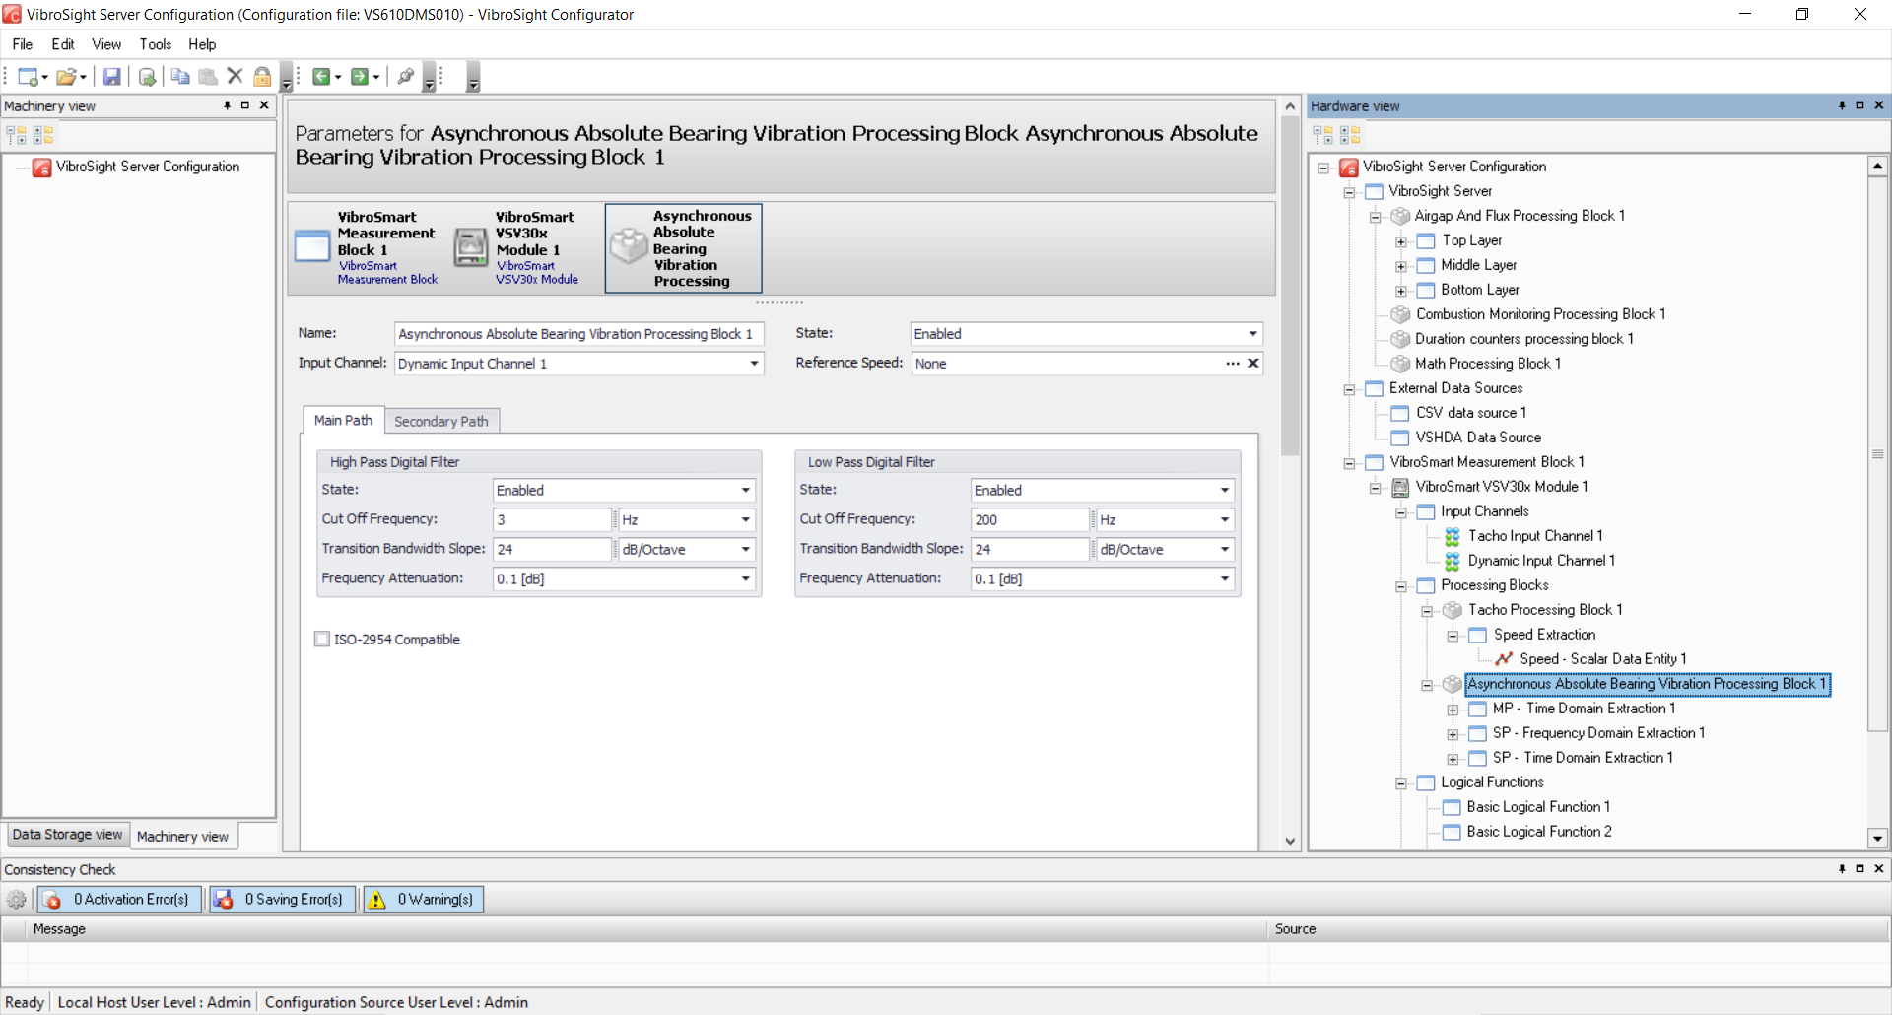
VibroSight Configurator
for the configuration of
VM600^{Mk2}/ VM600 XMx16 and VibroSmart ®
For the configuration of VM600^{Mk2}/ VM600 XMx16 + XIO16T systems and VibroSmart ® systems.
(More specifically, CMS using VM600^{Mk1}/ VM600 XMx16 + XIO16T modules, and
MPS and/or CMS using VibroSmart ® VSV301 + VSB300 and VSI010 + VSB010 modules.)

Slide 13

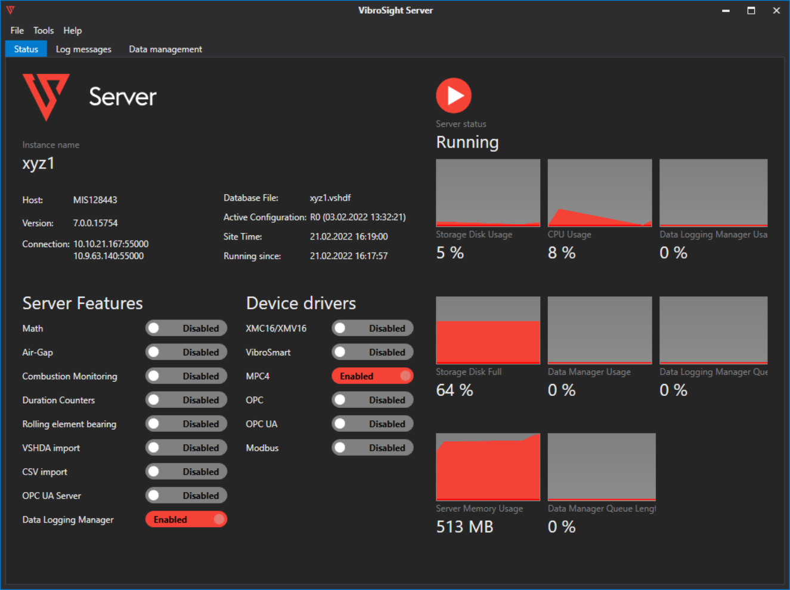
VibroSight Server
(online database)
The core server software module that interacts with all other parts of the machinery monitoring system and manages the online database.

Slide 14

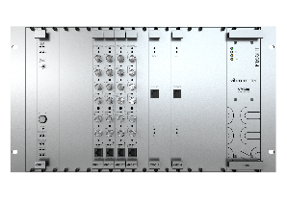


Integrated database management
VibroSight Server
VibroSight uses a proprietary, highly-optimised system of databases to help ensure high-performance data retrieval and display
Tightly-integrated data management simplifies the configuration and operation of databases (for example, database backup, purge and offline data storage)
Backup
Incremental backups
Data logging
Database
Data purge
Trash bin
Monitoring system
Data copy
Historical data files

Slide 15

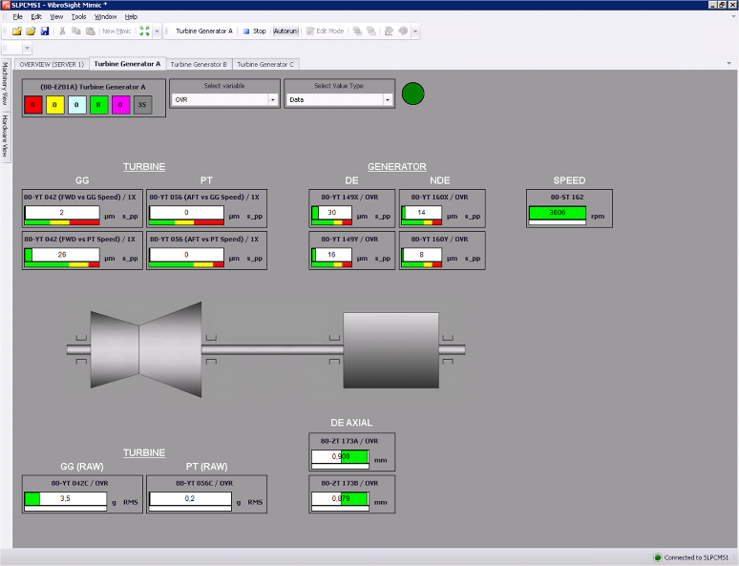
VibroSight Mimic
(machine operator interface)
Provides an overview of the machinery being monitored using live measurement data.
VibroSight Mimic uses shortcuts that allow static and dynamic measurements of interest to automatically open VibroSight Vision in order to display the measurement in more detail.

Slide 16

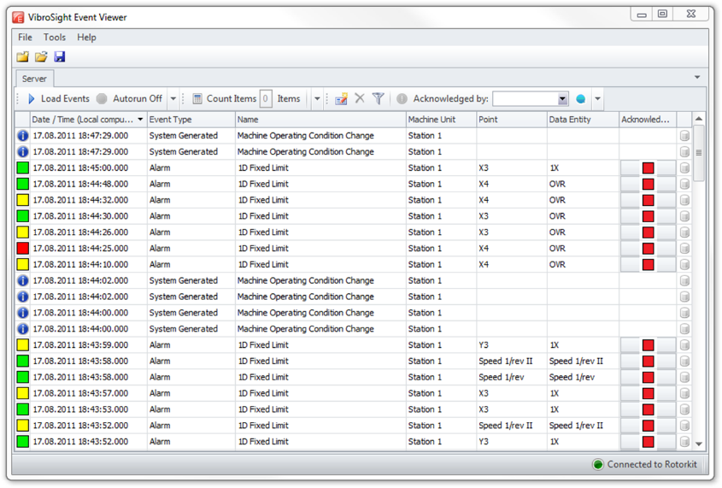
VibroSight Event Viewer
(monitoring of alarms and system events)
Allows the monitoring of alarms and system events from monitoring systems or stored in VibroSight databases.
For example, VibroSight Mimic Event Viewer provides a comprehensive overview of alarms (severity states), which may have been triggered by factors such as excessive vibration levels in the machinery being monitored.

Slide 17

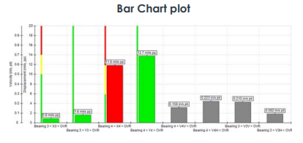
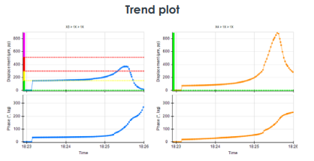
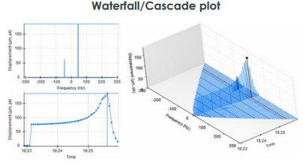
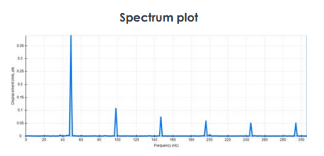
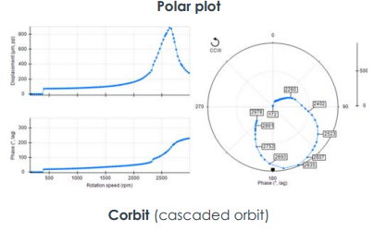
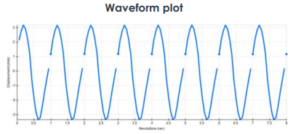
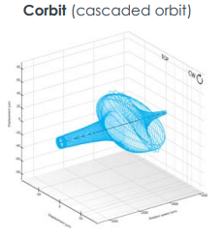
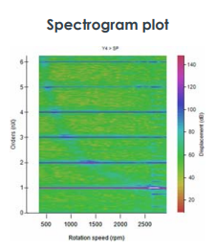
VibroSight Vision
(data visualization and analysis)
VibroSight Vision offers exceptional data handling and visualization capabilities in order to support the fast display and analysis of data.
It includes a complete catalogue of plots with cursor synchronisation that allows all of the information relevant to a particular event or time period to be more easily displayed for even quicker analysis.

Slide 18
Key Features and Benefits

Slide 19

Easy to use
Navigation and use of the software is deliberately simple
and straightforward in order to make tasks intuitive
Fast installation and configuration from a single setup file.
Fully-graphical user interface
Tightly-integrated and automated database management.
Fast data analysis and machinery diagnosis using a comprehensive plot catalogue, featuring cursor and zoom synchronisation.
Fully customisable machine states including run-ups and run-downs.

Slide 20

Complete
Modular, flexible and comprehensive solutions
for a wide range of applications
Machinery protection and/or condition monitoring applications
Compatible with VM600^{Mk2}/ VM600 and VibroSmart ® monitoring systems
to support a wide range of input signals such as vibration, combustion, air gap, magnetic flux, temperature, etc.
More than 15 different plot types including Corbit (cascaded orbit), Long waveform and Spectrogram plots for detailed data visualisation and analysis.
Application specific solutions for improved analysis and diagnostics
Application specific packages are available in order to process data optimally and improve data visualisation and analysis for specific industrial applications: Hydro air-gap monitoring, Combustion monitoring, External data file import (database mirroring) and Custom mathematical calculation engine (with your own rules).

Slide 21

High performance
Efficiently handle large numbers of measurement points
and huge volumes of data
Highly optimised, proprietary databases that are much faster than standard (off the shelf) databases.
Flexible data storage including an online database (VSHDF) for data logging and stand-alone historical data archive files (VSHDA) for offline data analysis and/or data sharing.
Exceptional data handling with effortlessly fast data retrieval and display for faster and easier data display and analysis (VibroSight Vision)
Data logging for very large systems including more than 700 measurements point per system (VibroSight Server).

Slide 22

Cybersecurity and IoT
Easy correlation of data from different systems is supported in cybersecure environments
Support for remote monitoring and diagnostics using mirrored databases (replica VibroSight Servers)
Support for industry-standard communication protocols allows data exchange with other systems, via Modbus RTU and TCP, OPC Classic and UA, PROFIBUS DP, CSV and VSHDA files, and Python connector.
Centralised diagnostic centers and decision making are enabled with seamless data display across multiple systems, databases and/or historical data archive files.

Slide 23

VibroSight current status
Ready for cybersecure environments
Use of VSHDA files to create a remote copy of a VibroSight database
Historical data files (VSHDA)
Firewall
Historical data files
Monitoring system
VibroSight database (VSHDF)
Mirrored database
Local
Remote
Notes:
A VibroSight Server uses an online database, which consists of a VSHDF (VibroSight historical data folder) file and associated storage subfolders.
A VSHDA (VibroSight historical data archive) file is an offline copy of the data (or a subset) from a VibroSight database (VSHDF) that makes it easier to work with the data. For example, to work offline, to work with particular data of interest, to share data more quickly and easily – especially in cybersecure environments.
Notes:
Import of VibroSight HDA files into the VibroSight database
For the creation of a replica/mirror of a remote database in a central diagnostics centre.
The synchronization of the original and replica database servers is done via the transfer for VibroSight data files.
Useful when the original database is located:
Behind a network data diode
Behind a firewall
In a remote location connected via an unreliable network.

Slide 24
communication interfaces

Slide 25


Data export capabilities
Communications interfaces
Modbus RTU
OPC Classic
Modbus TCP
OPC UA
Database
Plant data highway (Ethernet)
Note: For a VM600^{Mk2}/ VM600 system, the CPUM^{Mk2} module can be used to share data using industry standard communication protocols such as Modbus TCP and PROFIBUS DP.
Modbus TCP
VM600^{Mk2} system
VibroSmart ®
system
Modbus RTU
Note: For a VibroSmart ® system, the VSI010 module can be used to share data using industry standard communication protocols such as Modbus RTU, Modbus TCP, PROFIBUS DP and GOOSE (IEC 61850).
PROFIBUS DP
Modbus TCP
PROFIBUS DP
IEC 61850

Slide 26


Data import capabilities
Communications interfaces
Modbus RTU
OPC Classic
CSV files
Modbus TCP
VSHDA files
Database
Note: VibroSight’s “External data file import (database mirroring)” application specific package uses CSV and/or VSHDA (VibroSight historical data archive) files to import external data into an VibroSight Server.
For example, this supports cybersecure remote monitoring and diagnostics.
Plant data highway (Ethernet)
VM600^{Mk2} system
VibroSmart ®
system

Slide 27
Thank you

Slide 28
Disclaimer
Business legal entity, Business address
Legal entity registration information as appropriate
Information contained in this document may be subject to export control regulations of the United Kingdom, European Union, United States or other national jurisdictions, including the US International Traffic in Arms Regulations and/or Export Administration Regulations.
Each recipient of this document is responsible for ensuring that transfer or use of any information contained herein complies with all relevant Export Control Regulations.
Copyright © 2022 Meggitt SA. All rights reserved.

