Slide 1

Meggitt

Slide 2





OUR VALUES
TEAMWORK
We support each other and recognise outstanding contributions. We build highly skilled teams passionate about what we do and how we do it.
INTEGRITY
We conduct ourselves with integrity and the highest standards of ethical behaviour across the business.
EXCELLENCE
We enable the extraordinary at Meggitt. We deliver the most ambitious technologies, products and services safely, efficiently and cost-effectively.
CUSTOMER FOCUS
We always strive to understand our customer needs and will go the extra mile to deliver the best solution
ENTREPRENEURSHIP
We take initiative and measurable risk to find innovative and market leading solutions

Slide 3
Meggitt global footprint
Over 10,000 employees worldwide
UK
Employees: 2,623
Locations: 9
Europe
Employees: 1,060
Locations: 5
Denmark, France, Switzerland
United States
Employees: 5,115
Sites: 18
Rest of World
Employees: 1,216
Locations: 7
China, Mexico, Singapore, Vietnam
As at 1 Jul 2020

Slide 4
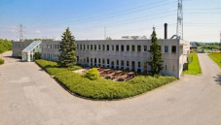
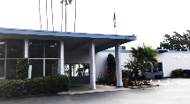
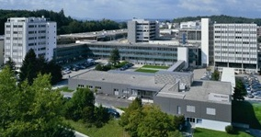
Energy Sensing & Controls footprint
MEGGITT
Piezoceramics
Kvistgaard (DK)
MEGGITT
Valves & Actuators
San Diego (USA)
Integrators / Distributors
MEGGITT
Condition Monitoring
Fribourg (CH)
Meggitt offices
Meggitt Energy Factories

Slide 5
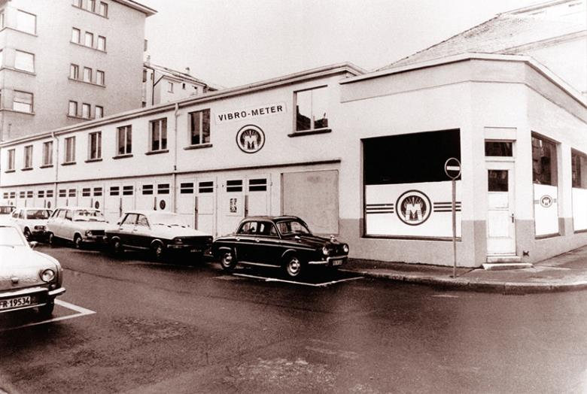

Legacy – Innovation – success story

Slide 6
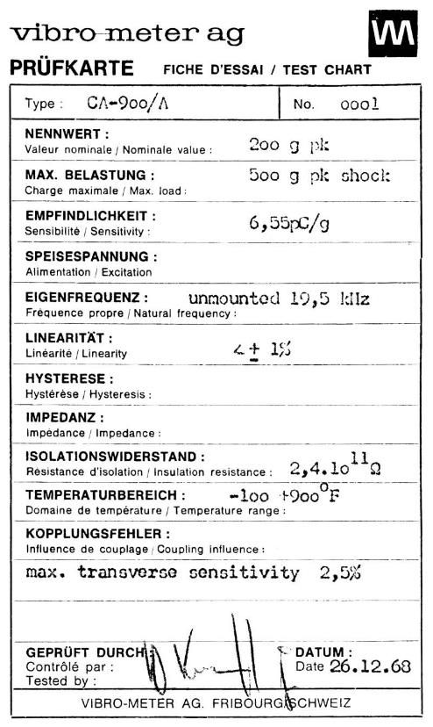
Legacy
100% predictability from sensors to decisions
In December 1968, vibro-meter launched the CA-900/A accelerometer and changed the world of vibration monitoring by reaching unprecedented temperature ranges (-196 to 700 ºC).
51 years later we have sold thousands of piezoelectric accelerometers for gas turbine monitoring and protection worldwide.

Slide 7

Continuous Innovation
100% predictability from sensors to decisions
First high temperature optical pressure sensor for turbines >500°C, Fabry-Pérot interferometer for extreme environments
Extended measurement capability full pressure measurement, extended bandwidth, improved stability and multiplexing
Improved sensitivity and accuracy positioning as close as possible to the measurement point
Intrinsic reliability insensitivity to electromagnetic interference and inherent compatibility with explosive atmospheres

Slide 8

Impactful Success story
100% predictability from sensors to decisions
20 % of all worldwide power turbines
Have our protection systems custom designed and installed
80% of all medium and large gas turbines worldwide
Uses our combustion monitoring solutions to monitor and protect
Assuring power for millions of people
Our protection and monitoring systems are installed on the majority of Switzerland’s and Canada’s hydro power plants.

Slide 9




OUR VISION
100% predictability from sensors to decisions – creating value to our customer beyond products
How we achieve it:
HPC culture
Competitive solutions
Customer focus
OUR KEY SEGMENTS
Power generation
Gas & Steam Turbines
Hydro turbines
Nuclear power
Adjacent markets
«High value asset» monitoring
Selected projects
OUR VISON
OUR KEY SEGMENTS
OEM
Partnering on specific solutions with long term revenue, global account management
End Users
Increasing visibility and trust to deliver high margin projects based on our existing hardware and software
OUR CUSTOMERS
New solutions Derived from existing products

Slide 10



Portfolio overview
3 Product Lines
Technical
Center of Excellence
4 regional
field service centers
Product portfolio performance, development and maintenance
Solutions offering, guaranteeing its full integration and value to our customers
Delivers and support our product and solutions portfolio incl. services
Our products, solutions and services enable our customers to reliably operate critical infrastructure without disruption
Notes:
Customer centric, small and agile,
We offer tailored made and competitive products, solutions and services to our customers,
We deliver differentiated protection and condition monitoring solutions with highly demanding requirements to the power generation industry and other adjacent markets

Slide 11

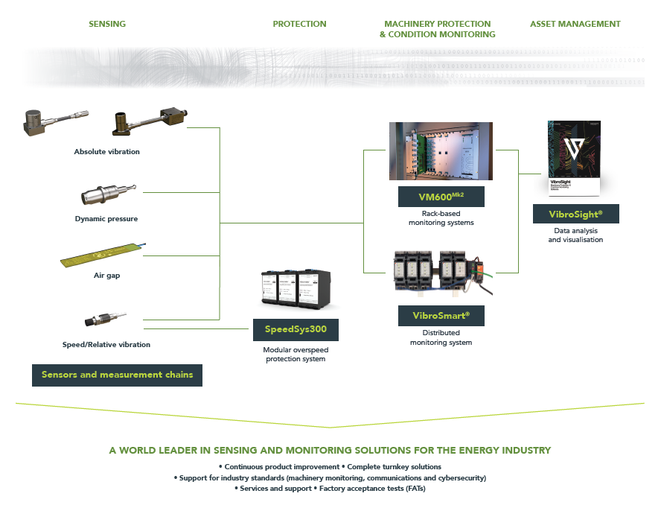
100% predictability from sensors to decisions

Slide 12
Sensors & conditioners
Vibration sensing systems to monitor critical plant and equipment

Slide 13
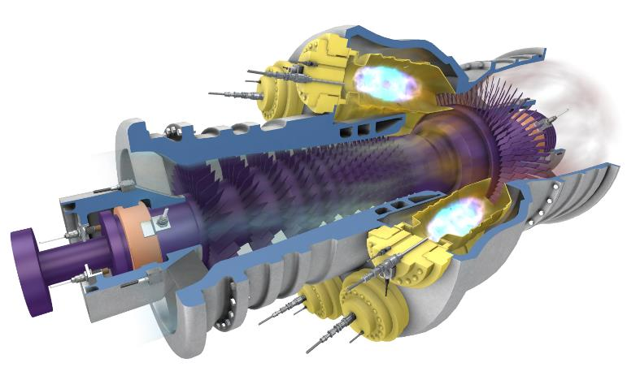
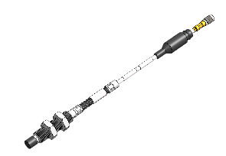
Sensing solutions for harsh environments
Industrial gas turbine
Absolute vibration
(accelerometers)
Displacement – Position - Speed
(proximity probes)
Combustion monitoring
(dynamic pressure)

Slide 14
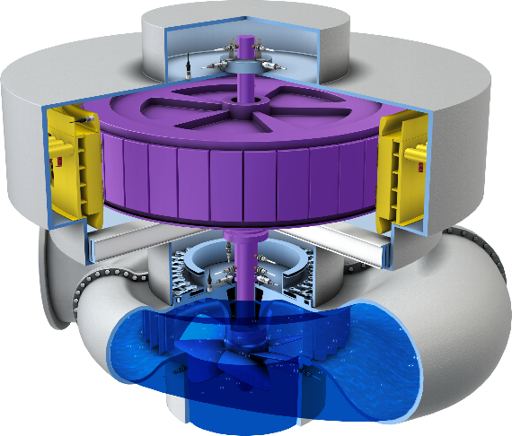


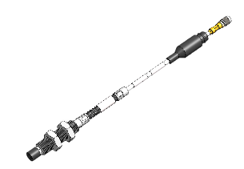
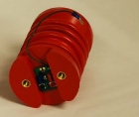
Sensing solutions
Hydro turbines
Absolute vibration
(accelerometers sensors)
Rotor-stator gap
(airgap sensors)
Vibration in velocity
(velocity sensors)
Displacement – Position - Speed
(proximity probes)
Winding current
(Partial Discharge)

Slide 15
Hardware
Protection and Monitoring system for critical rotating machinery

Slide 16
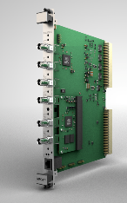
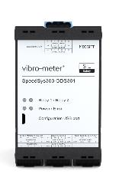
PORTFOLIO OVERVIEW advanced machinery protection, condition and performance monitoring for high value rotating machinery
VM600^{Mk2} rack-based advanced machinery protection and condition monitoring system.
* 1U and 6U format
Protection & condition monitoring
VibroSmart transmitter-based scalable system suitable for both smaller and larger rotating machinery
SpeedSys300 Scalable, robust and independent layer of protection to deliver fast and reliable protection for speed and acceleration.
Overspeed
protection system
Notes:
Product line logic
Add real examples of application (number of VM600 installed etc)

Slide 17
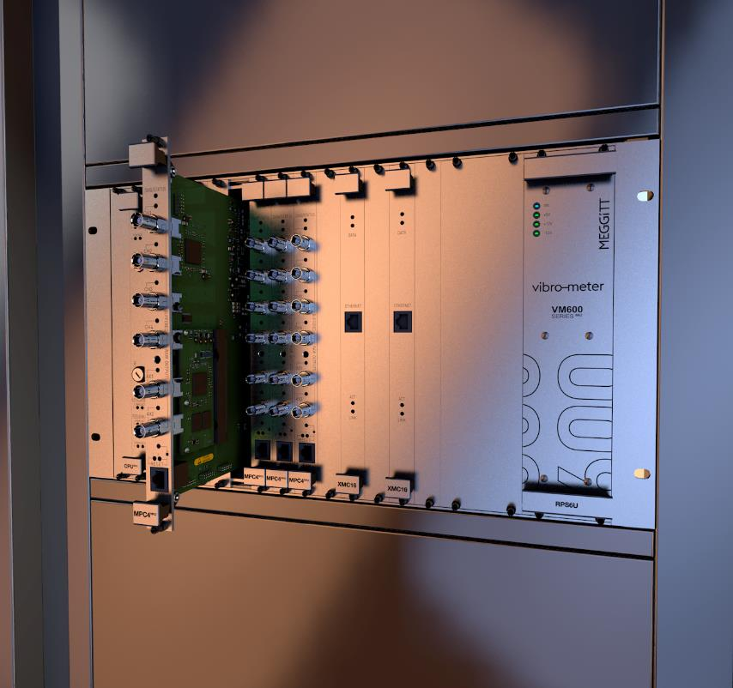
DESIGN CONCEPT
VM600^{Mk2}
Centralized system - designed to centrally process a wide range of dynamic inputs coming from a large variety of critical assets.
All measurements in one card - enables complex systems to be built with a minimum number of cards through the well thought modular structure and smart function combination.
MPC^{Mk2} protection module with integrated condition monitoring capabilities
Flexible network architecture - easy integration with VibroSmart distributed monitoring system for optimal and flexible network architecture in a condition monitoring system platform.
Industry standards
API 670 fully compliant
Cybersecurity certification per IEC62443
SIL 2

Slide 18



Our Legacy
VM600 success story
20 years of field experience: VM600 was introduced to market in 2001
Over 8’000 VM600 racks produced and installed worldwide
40’000 MPC4 machinery protection modules
5’500 CMC16/XMV16/XMC16 condition monitoring modules
Innovative drive: VM600^{Mk2} is vibro-meter latest rack-based system for protection and condition monitoring

Slide 19
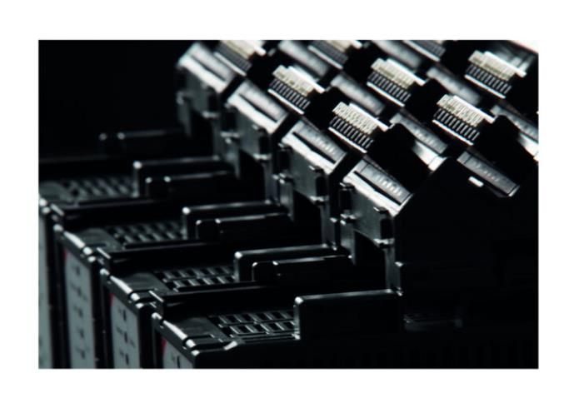
DESIGN CONCEPT
VibroSmart VSV301
Flexible Highly scalable and easy to extend
Wide range of applications From stand-alone unit on balance of plant equipment, up to several connected units for larger critical rotating machinery.
ATEX-certified (Zone 2)
Real time communication Via Ethernet or fieldbus
Lower installation cost Skid-mounting components near to machine

Slide 20
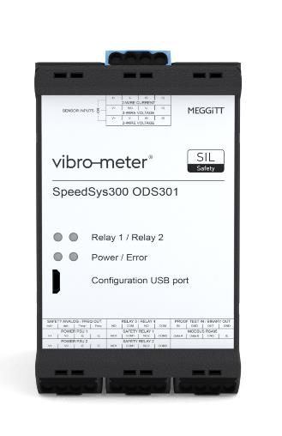
Design concept
SpeedSys300 ODS301
Advanced self-monitoring Continuous data validation process, ensuring an accurate operation and proof-test intervals of 10 years. Versatile modular architecture Design supports industry-standard speed sensors and uses external voting logic to ensure cost-effective solutions.
Low-impact retrofitting, Module and associated configuration software have also been designed for ease of use which makes it suitable to any critical application.
Driven by certification
API 670 compatible overspeed detection system (ODS).
SIL 3 IEC 61508
ATEX/IECEx Zone 0,1,2 (Ex ia) isolated inputs

Slide 21
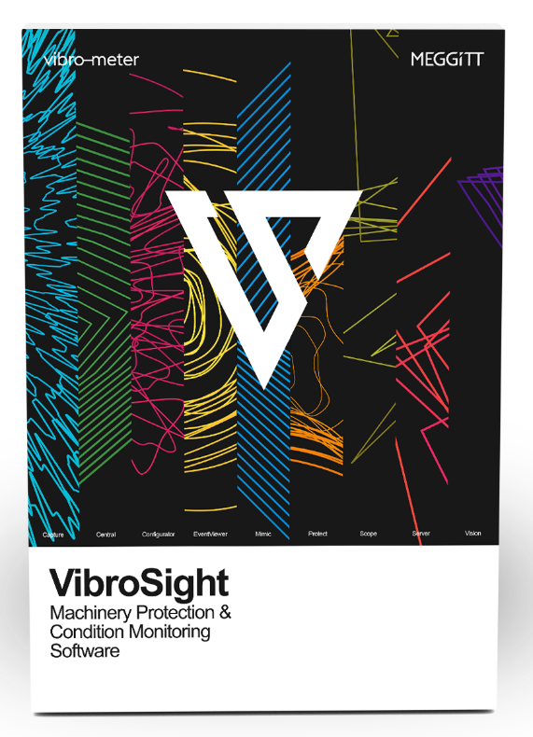
Software
Advanced machinery protection and condition monitoring software compatible with both VM600 and VibroSmart systems.

Slide 22
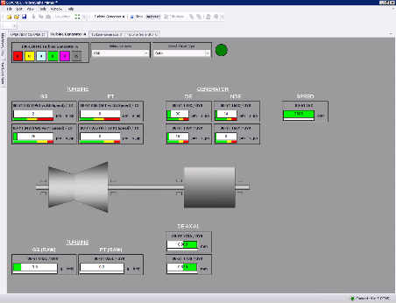
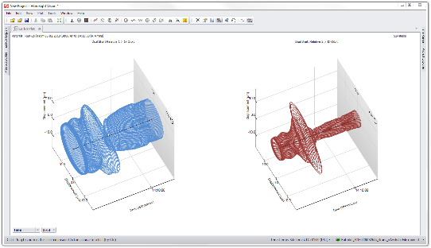
Protection & Monitoring systems
Software portfolio
Complete
Highly-integrated software suite that supports the effective monitoring of all rotating machinery.
User-friendly Use and navigation of the software is deliberately simple and straightforward in order to make tasks intuitive.
Fast installation configuration using VibroSight Protect can be done under 5 minutes
High performance.
VibroSight suite 9 software applications.
Notes:
Product line logic
Add real examples of application (number of VM600 installed etc)

Slide 23
Thank you

