Slide 1

Hardware Solutions
Presenter:
Title:
Date:

Slide 2
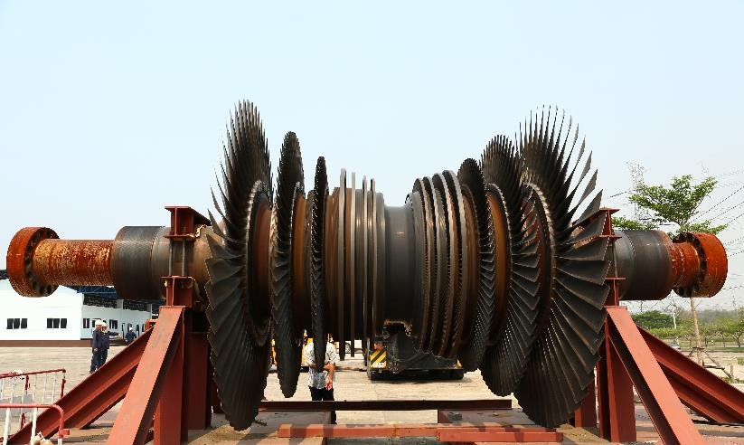
Advanced systems for machinery protection and condition monitoring specially designed for critical rotating machinery within the power generation, oil & gas, and process industries.
Notes:
Product line logic
Add real examples of application (number of VM600 installed etc)

Slide 3



Product lines overview
Sensors & Conditioners
Hardware
Software
Sensing solutions to monitor critical plant and equipment
Protection and Monitoring system for critical rotating machinery
Advanced machinery protection and condition monitoring software
Notes:
Customer centric, small and agile,
We offer tailored made and competitive products, solutions and services to our customers,
We deliver differentiated protection and condition monitoring solutions with highly demanding requirements to the power generation industry and other adjacent markets

Slide 4

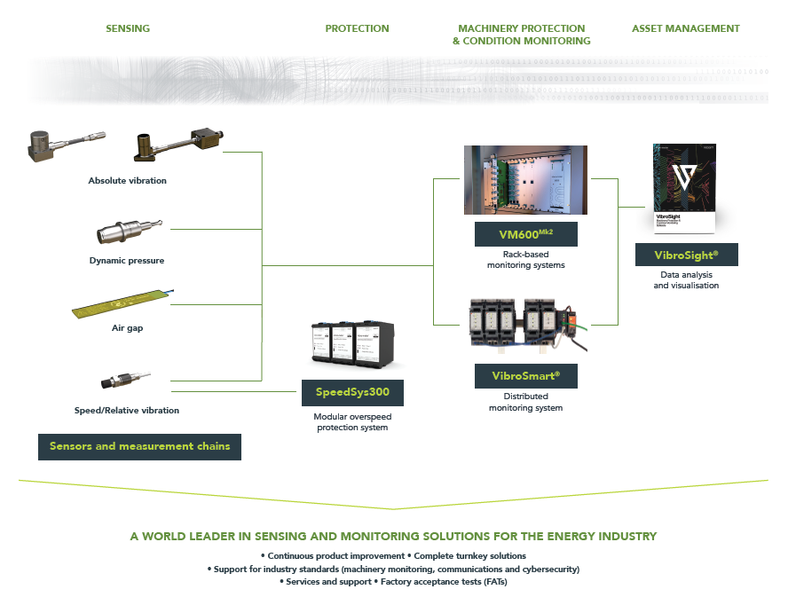
Portfolio overview

Slide 5
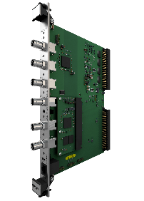
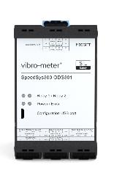
HARDWARE PORTFOLIO OVERVIEW advanced machinery protection, condition and performance monitoring for high value critical machinery
VM600^{Mk2} rack-based advanced machinery protection and condition monitoring system.
* 1U and 6U format
Protection & condition monitoring
VibroSmart transmitter-based scalable system suitable for both smaller and larger rotating machinery
SpeedSys300 Scalable, robust and independent layer of protection to deliver fast and reliable protection for speed and acceleration.
Overspeed
protection system
Notes:
Product line logic
Add real examples of application (number of VM600 installed etc)

Slide 6
Protection & condition monitoring
Rack-based solutions

Slide 7
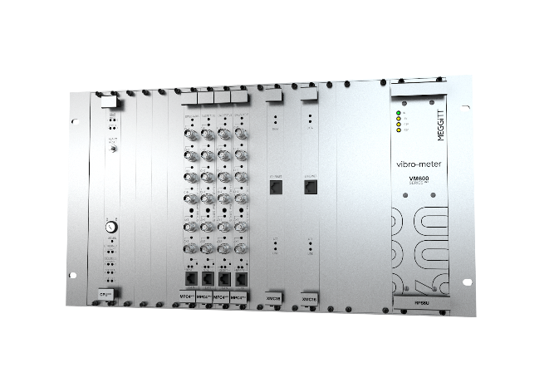
VM600^{Mk2}
6U
1U
Formats

Slide 8
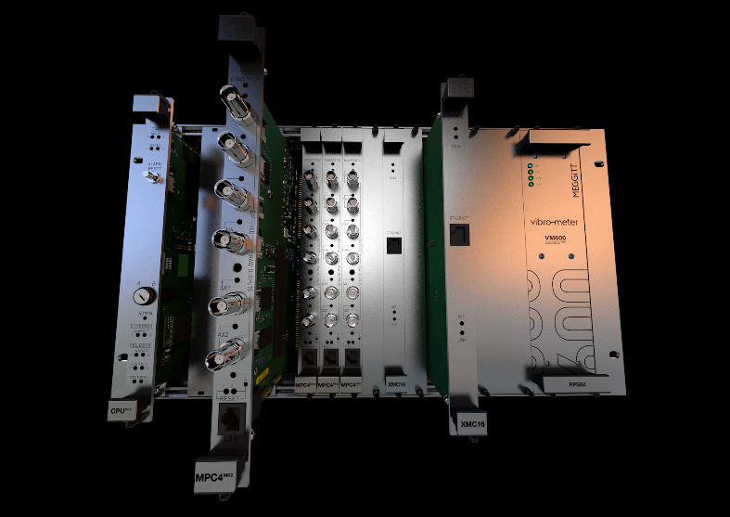
DESIGN CONCEPT
VM600^{Mk2}
Centralized system designed to centrally process a wide range of dynamic inputs coming from a large variety of critical assets.
All measurements in one card enables complex systems to be built with a minimum number of cards through the well thought modular structure and smart function combination.
MPC^{Mk2} protection module with integrated condition monitoring capabilities
Flexible network architecture easy integration with VibroSmart distributed monitoring system for optimal and flexible network architecture in a condition monitoring system platform.
Industry standards
API 670 fully compliant
Cybersecurity certification per IEC62443
SIL 2

Slide 9



VM600 success story
20 years of field experience: VM600 was introduced to market in 2001
Over 8’000 VM600 racks produced and installed worldwide
40’000 MPC4 machinery protection modules
5’500 CMC16/XMV16/XMC16 condition monitoring modules
Innovative drive: VM600^{Mk2} is vibro-meter latest rack-based system for protection and condition monitoring

Slide 10
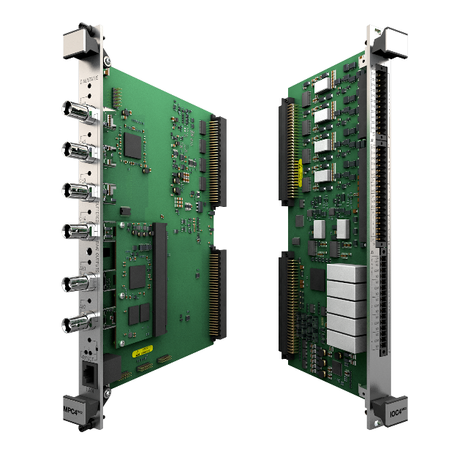
MPC4^{Mk2} + IOC4^{Mk2}
VM600^{Mk2} Machinery protection system
4 dynamic input channels + 2 tacho/aux input channels
4 configurable relays + 1 card fault relay
6 BNC raw outputs
4 analogue outputs (current/voltage)
2 front panel buttons for:
Card lock
Card reboot
Firmware recovery
Ethernet port for communication with VibroSight
Configuration
Data visualization
VME bus communication with CPU card

Slide 11

New approach with enhanced monitoring capabilities
VM600^{Mk2} Machinery projection system
Permanent Ethernet communication link
Condition monitoring
XMV16
VibroSight condition monitoring software
Machinery protection configuration software
MPC4
Machinery protection
VM600 rack
Sensors
Visibility of relay status, protection alarms and processing results from the monitoring software
Enhanced monitoring capabilities
Change of machinery protection setup requires phisical access to the VM600 rack
Cyber Secure

Slide 12
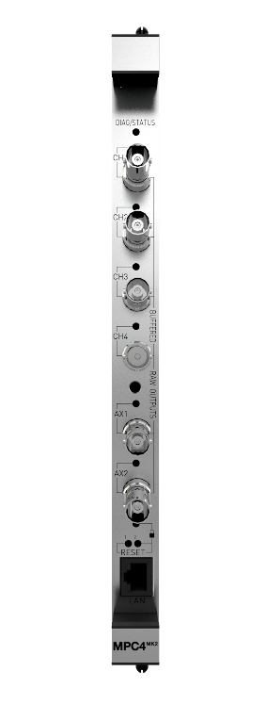

MPC4^{Mk2} comparison against Mk1
VM600^{Mk2} Machinery projection system
MPC4^{Mk2} comparison against Mk1 | MPC4 Mk2 | MPC4 Mk1
ADC resolution | 24 bits | 12 bits
Bandwidth | 20 kHz | 10 kHz
Measurement outputs per channel | Up to 5 | Up to 2
Waveforms and spectra for troubleshooting | Yes | No
Epoxy sealed relays with all contacts available | Yes (4 + 1) | No (4)
NO/NC contact and Normally Energized or NDE without jumper configuration | Yes | No
Physical card lock for cyber security | Yes | No
Condition monitoring | Yes (Q3 2021) | No
SIL2 | Yes, by design (2022) | Yes, by experience

Slide 13
Single channel procession functions
VM600^{Mk2} Machinery projection system
MPS SW processing name | VibroSight Protect® equivalent
(BBAB) Broad Band Absolute Bearing Vibration | Bearing absolute vibration
(NB) Narrow Band (Tracking) Vibration | Bearing absolute vibration or Shaft Relative Vibration
(RS) Relative Shaft Vibration | Shaft Relative Vibration
(PS) Position | Position Shaft axial position (collar) Shaft axial position (shaft end) | Rotor position (collar) Differential expansion (collar) Rotor expansion (collar)
(EC) Eccentricity | Shaft eccentricity
(HE) Absolute Housing Expansion | Housing expansion
(SEP) Relative Shaft Expansion With Pendulum | Differential expansion (pendulum) or Rotor expansion (pendulum)
(BBP) Broad Band Pressure | Broad band pressure
(QSP) Quasi-static Pressure | Quasi-static pressure
(QST) Quasi-static Temperature | Quasi-static temperature
(NBFS) Narrow Band Fixed Frequency | Bearing absolute vibration or Shaft Relative Vibration
Speed | Speed

Slide 14
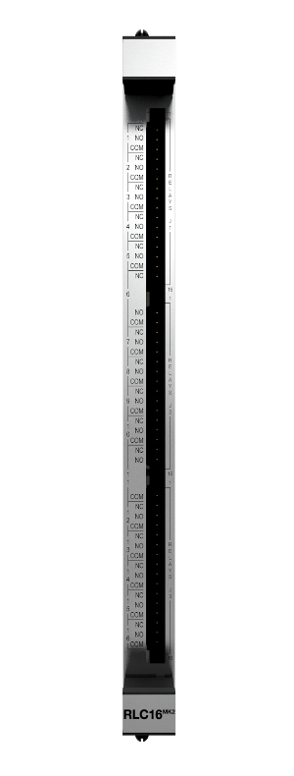
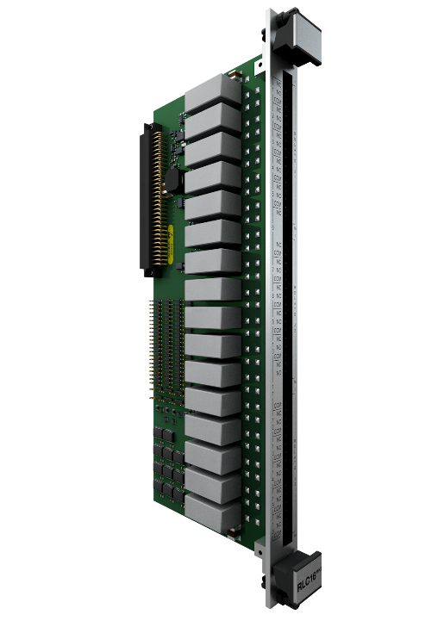
RLC16^{Mk2} for additional relays
VM600^{Mk2} Machinery projection system
RLC16 Mk2 comparison against Mk1 | RLC16 Mk2 | RLC16 Mk1
Machinery protection relays | 16 | 16
Epoxy sealed relays with all contacts available | Yes | No
NO/NC contact and Normally Energized or NDE without jumper configuration | Yes | No
Card OK raw bus output line | Yes | No
Switch all relays to safe state when a module failure is detected | Yes | No
SIL2 | Yes, by design (2022) | Yes, by experience

Slide 15
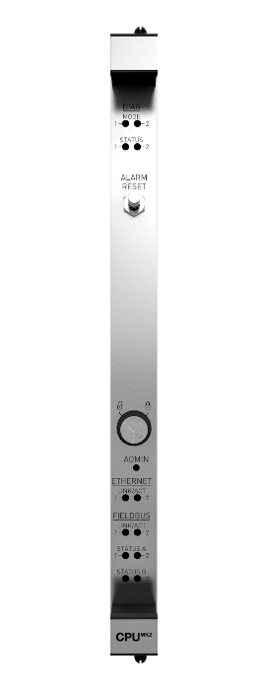
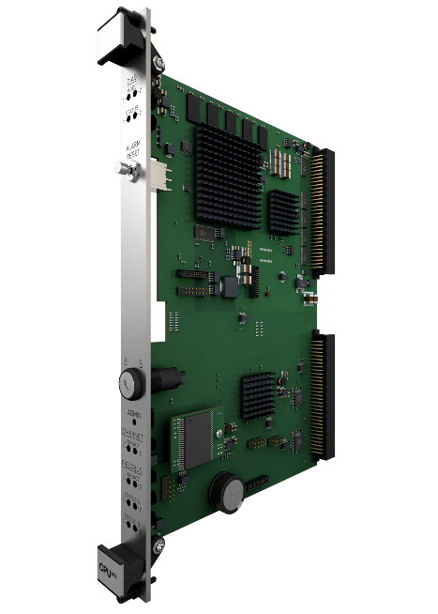
CPU^{Mk2} + IOC^{Mk2} central processing unit
VM600^{Mk2} Machinery protection system
Communication with MPC4^{Mk2}
Profibus DP and Modbus TCP interfaces (Modbus RTU not available currently)
Future Profinet communication protocol will be supported
Configuration via VibroSight Protect software
Designed for combustion monitoring applications
Can disable VME bus communication for collocation of more than 1 card in rack
Notes:
Start selling more of the CPUR and CPUR2 cards as an alternative to CPUM

Slide 16

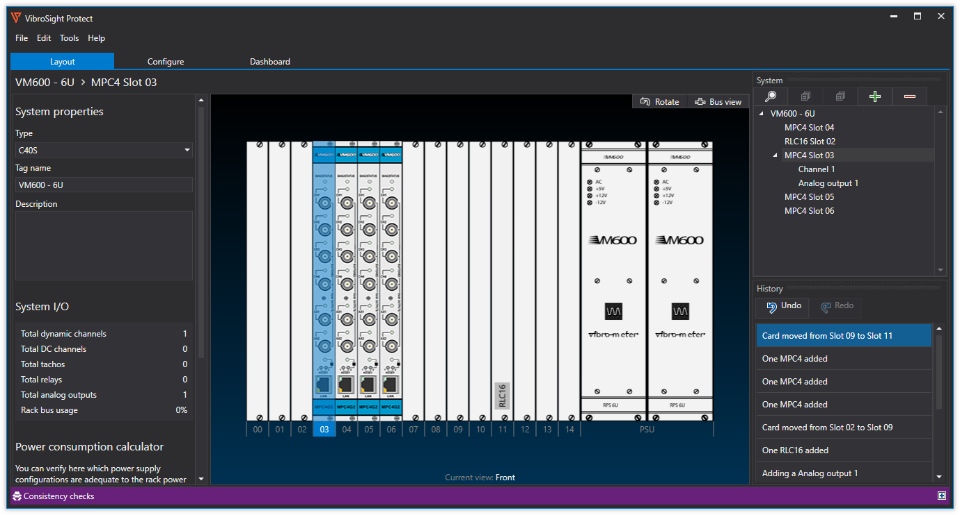
VibroSight Protect Software
Machinery protection configuration software
New easy to use and intuitive user interface
Fast configuration
Checks overall rack configuration consistency (as opposed to one-by-one card configuration)

Slide 17
Dual channel procession functions
VM600^{Mk2} Machinery projection system
MPS SW processing name | VibroSight Protect® equivalent
(SMAX) Smax | X-Y shaft relative vibration
(DHE) Differential Housing Expansion | Differential housing expansion
(RST) Relative Shaft Expansion (shaft taper) | Rotor expansion (single taper) Rotor expansion (dual taper) Differential expansion (single taper) Differential expansion (dual taper)
(RSC) Relative Shaft Expansion (shaft collar) | Shaft axial position (collar) Shaft axial position (shaft end) Rotor expansion (collar) Differential expansion (collar)
(DMF) Dual Mathematical Function | Mathematical function
(DQSP) Delta Quasi-static Pressure | Delta Quasi-static Pressure
(DQST) Delta Quasi-static Temperature | Delta Quasi-static Temperature
(AS) Absolute Shaft Vibration | Shaft absolute vibration

Slide 18
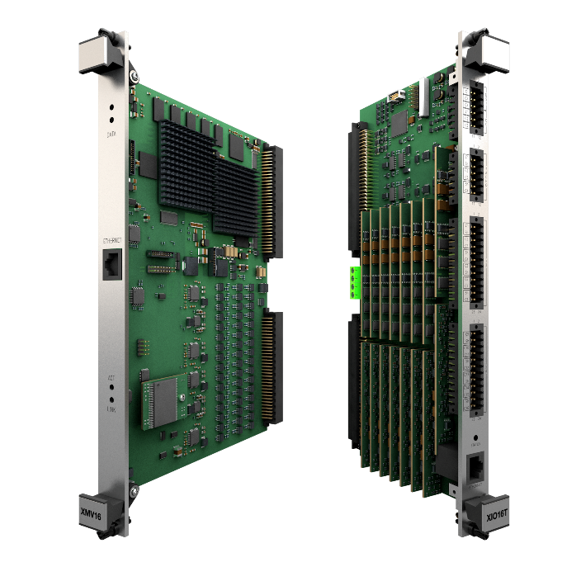
Extended condition monitoring module XMV16 + XIO16
VM600^{Mk2} condition monitoring system
Highly suitable for vibration monitoring for critical and large industrial applications.
For vibration condition monitoring
16 dynamic channels and 4 tachometer (speed) channels, all of which are independently configurable.
Synchronous and seamless data acquisition on all channels
Up to 20 signal extractions per channel
High-resolution FFT up to 6400 lines every 500ms (100ms updater rate possible with lower spectral resolution)
Order Tracking
Direct gigabit Ethernet communication » Hardware is fully software configurable

Slide 19

Condition monitoring modules XMC16 + XIO16
VM600^{Mk2} condition monitoring system
For combustion and vibration monitoring
Specific FFT windows options
Proprietary algorithm included (OEM application)
Provides 16 dynamic channels and 4 tachometer (speed) channels, all of which are independently configurable.
Synchronous and seamless data acquisition on all channels
Up to 20 signal extractions per channel (Band-Peak extraction for Combustion Monitoring)
High-resolution FFT up to 6400 lines every 500ms (100ms updater rate possible with lower spectral resolution)
Order Tracking (New feature !!!)
Direct gigabit Ethernet communication » Hardware is fully software configurable

Slide 20
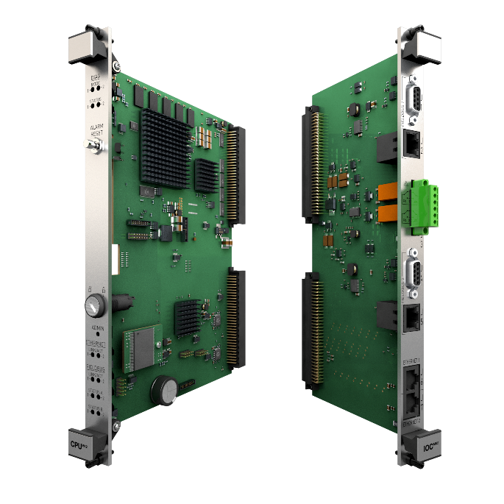
Rack controller and communication interface module CPU^{Mk2} + IOC^{Mk2}
VM600^{Mk2} condition monitoring system
System controller and data communication gateway for VM600^{Mk2} systems.
Industry standard fieldbus communications interfaces: Modbus TCP and PROFIBUS DP.
Mathematical operations on fieldbus data.
System status (health) information available via fieldbus.
Front-panel alarm reset (AR) button.
VM600 rack (CPU^{Mk2}) security with a removable key.
Available modules
CPU^{Mk2} + IOC^{Mk2} module for Modbus RTU/TCP

Slide 21
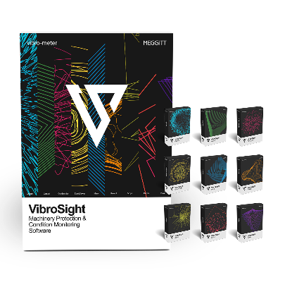
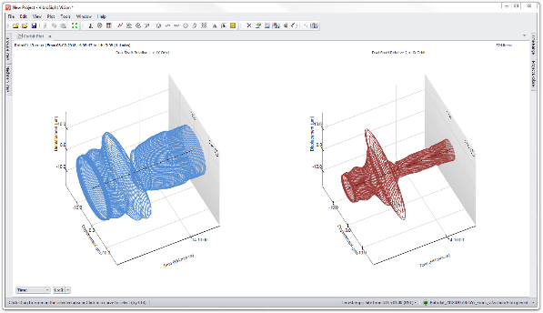
VibroSight suite
VM600^{Mk2} condition monitoring system
Key Features
User-friendly advanced vibration monitoring and analysis
Allows to efficiently handle large numbers of measurement points and extensive volumes of data
Easy collection of data from multiple different systems is supported in cyber secure environments
Modular, flexible and comprehensive machinery protection and condition monitoring solutions for a wide range of applications within the power generation, oil & gas, and process industries.

Slide 22
Distributed monitoring system
VibroSmart VSV301

Slide 23
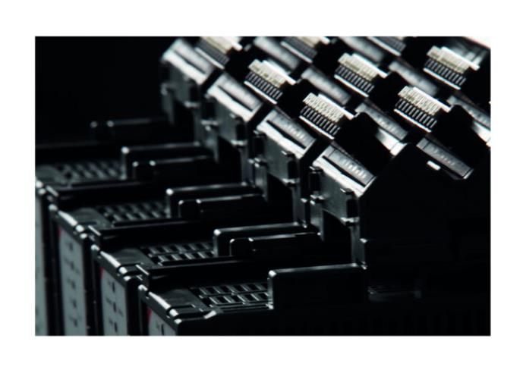
DESIGN CONCEPT
VibroSmart VSV301
Flexible Highly scalable and easy to extend
Wide range of applications From stand-alone unit on balance of plant equipment, up to several connected units for larger critical rotating machinery.
ATEX-certified (Zone 2)
Real time communication Via Ethernet or fieldbus
Lower installation cost Skid-mounting components near to machine
Industry standards
API 670 fully compliant
Cybersecurity certification per IEC62443
SIL 2

Slide 24
SYSTEM FEATURES
VibroSmart
ATEX-certified (Zone 2)
Directly mounted to the machine (DIN-rail)
Measurement chain: suitable for accelerometers, proximity (eddy current) and velocity sensors.
VibroSight: compatible with vibro-meter’s analysis and data processing software
2 dynamic channels and 1 analog input
Auxiliary input channel for tachometer
4 basic and 2 advanced logic functions to drive the module’s relays
Ethernet communications

Slide 25
Overspeed protection system
Modular solution

Slide 26
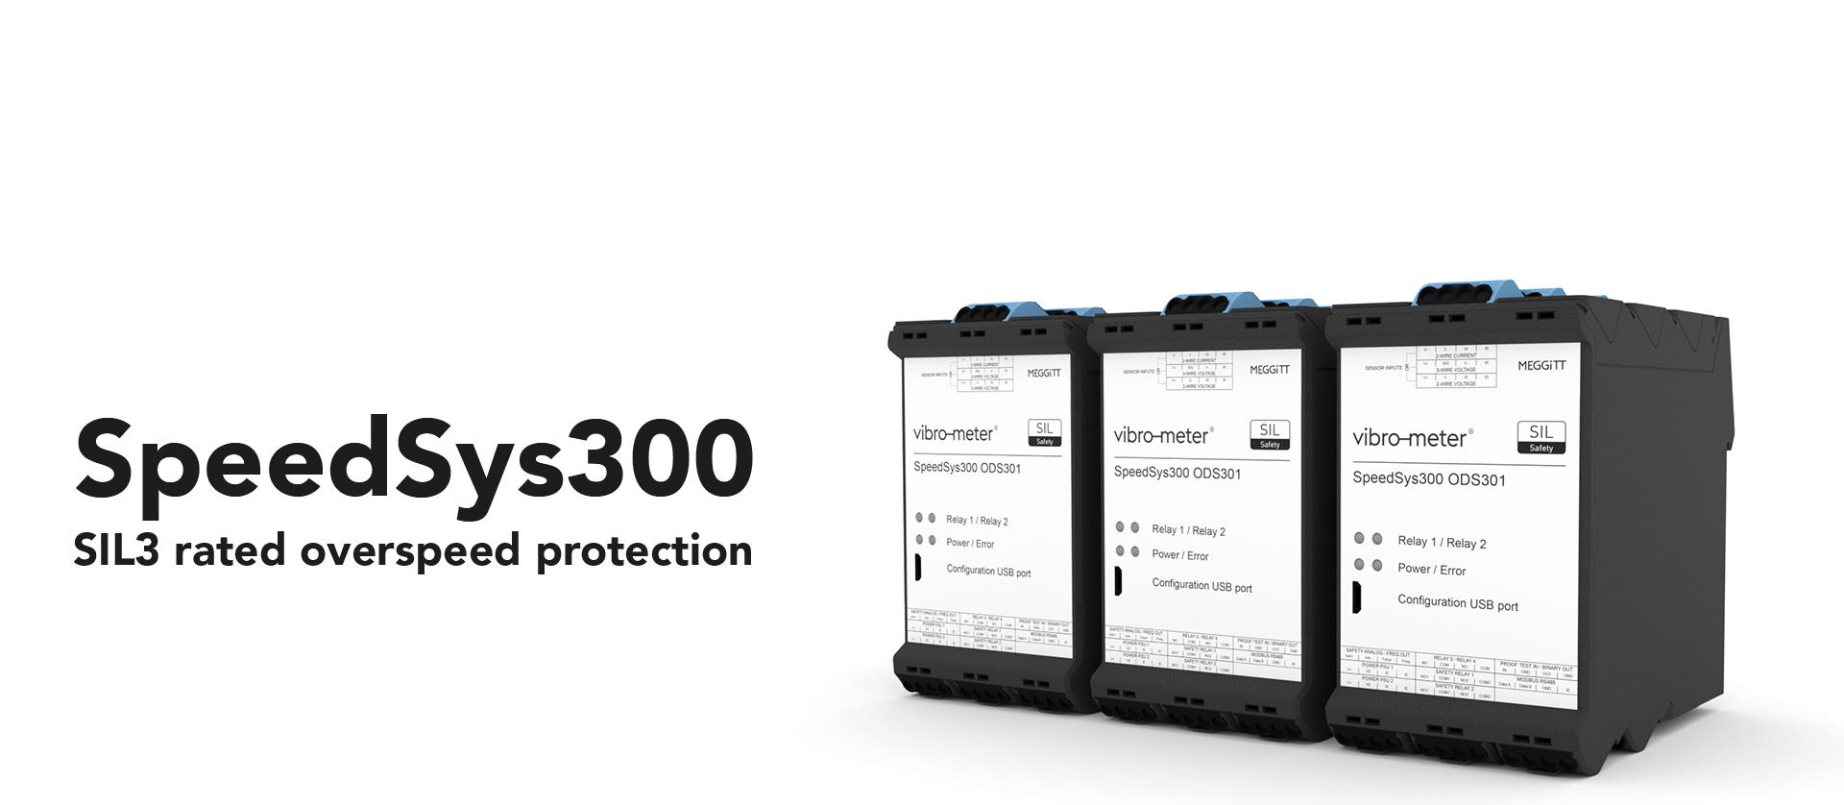

Slide 27
Design concept
SpeedSys300 is designed as an independent layer of protection; to be fundamentally simple and robust. It delivers fast and reliable protection for speed and acceleration and complies to all industry standards including SIL and ATEX.

Slide 28
SpeedSys300 ODS301
Key Benefits
Safety by design
Scalable
API 670 Compliant
SIL certified «by design», for SIL2 and SIL3
10+ Years PTI
Built-in diagnostics
Modular
Suitable for Ex-areas
Compatible with industry standard speed sensors
Overspeed dedicated system (segregation)
Fast response time
Voting logic

Slide 29
Key features
SpeedSys300
SpeedSys300 module key features
Sensor compatibility | Proximity (eddy current), electronic (Hall-effect) or magnetic (variable reluctance) speed measurement chains
Signal processing | The ODS301 counts measurement chain pulses and converts them to rotational speed and acceleration measurements, which are compared against configured alarm limits. Safety outputs are activated for critical alarms while non-safety outputs are used for other alarms/status information
Frequency range | 0.025 Hz to 35 kHz
Response time | 10 ms (typical)
Safety outputs | 2 × double-pole single-throw (DPST) safety relays and 1 × analogue 4 to 20mA current loop – certified for SIL safety loops
Non-safety outputs | 2 × single-pole single-throw (SPST) relays, 1 × frequency (speed) output, 1 × binary (status) output and 1 ×Modbus RTU serial interface (read only)
Diagnostics technology | Advanced self-monitoring and diagnostics (that is, built-in self-test (BIST)) monitors and reports the health/status of the complete system
Proof test interval | 10 years (typical)

Slide 30
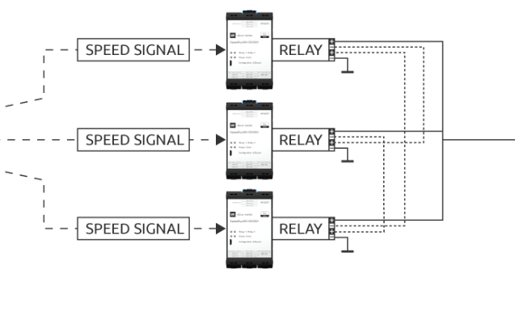


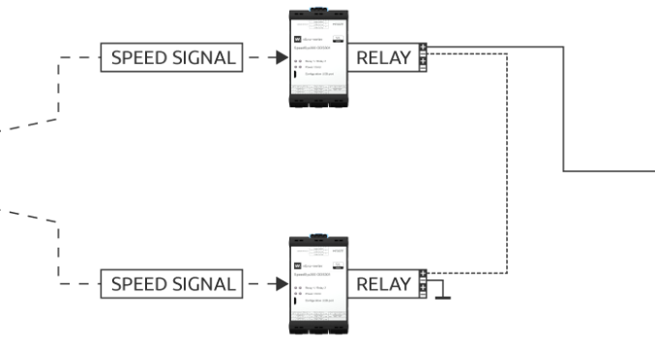

SIL 3 configurations
SpeedSys300
SPEED SIGNAL
SPEED SIGNAL
PCS/ACTUATOR
SPEED SIGNAL
SPEED SIGNAL
PCS/ACTUATOR
SPEED SIGNAL

Slide 31
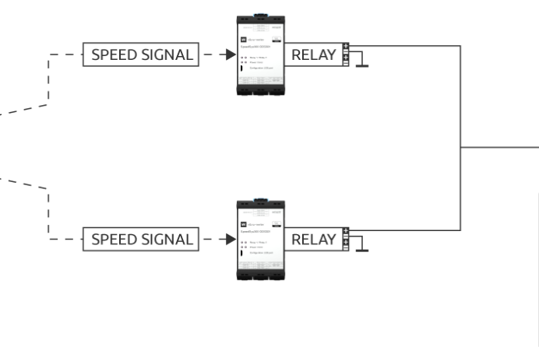

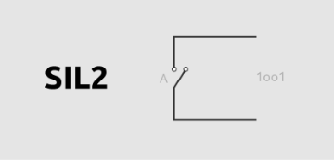
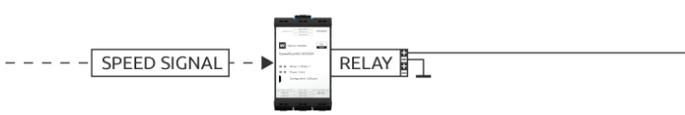

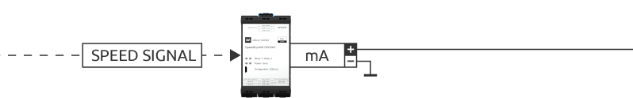
SIL 2 and analog configurations
SpeedSys300
SPEED SIGNAL
PCS/ACTUATOR
SPEED SIGNAL
SPEED SIGNAL
PCS/ACTUATOR
SPEED SIGNAL
PCS/ACTUATOR

Slide 32
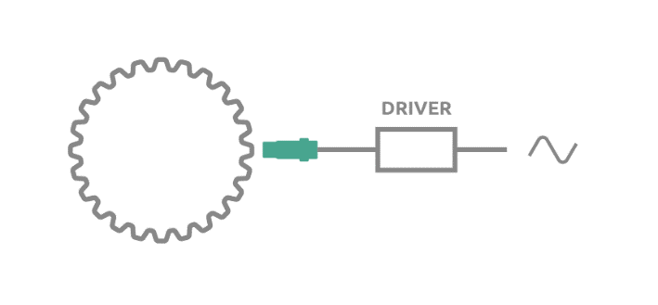
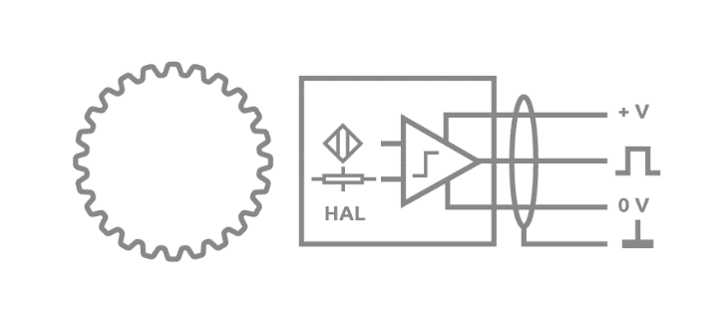
SpeedSys300 ODS301
Sensor input compatibility
Eddy-current
Electronic hall effect
Electromagnetic
(2-wire with self-monitoring technology), e.g. Meggitt IQS 450 and TQ40x type →more info here
Wide speed range
Long distance signal transmission (1000 meters)
Operation up to 180°C
Preferred solution for a wide range of applications
(3-wire)
Easily transmittable and processable digital output
Less vulnerable to EMI
Preferred for low rpm / zero speed
(2-wire)
Suitable for high temperature applications (300°C)
Self-powered
Preferred for high rpm

Slide 33
Thank you

