Slide 1

Sensors & measurement chains
for turbomachinery & essential rotating equipment
  Presenter:
Title:
Date:

Slide 2

  Our comprehensive sensors portfolio include complete measurement chains types for absolute and relative vibrations such as acceleration, velocity, displacement or gaps.
  We provide more accurate, reliable and safer solutions for extreme environments and critical applications such as bearing and relative shaft vibration protection of rotating equipment, gas turbine online combustion tuning, generator air gap monitoring, ice detection etc.
Notes:
Product line logic
Add real examples of application (number of VM600 installed etc)

Slide 3



Product lines overview
Sensors & Conditioners
Hardware
Software
Sensing solutions to monitor critical plant and equipment
  Protection and Monitoring system for critical rotating machinery
  Advanced machinery protection and condition monitoring software

Slide 4

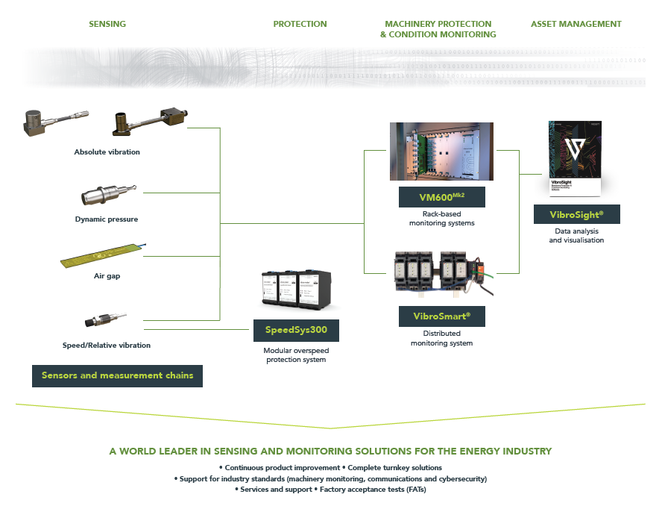
Portfolio overview

Slide 5
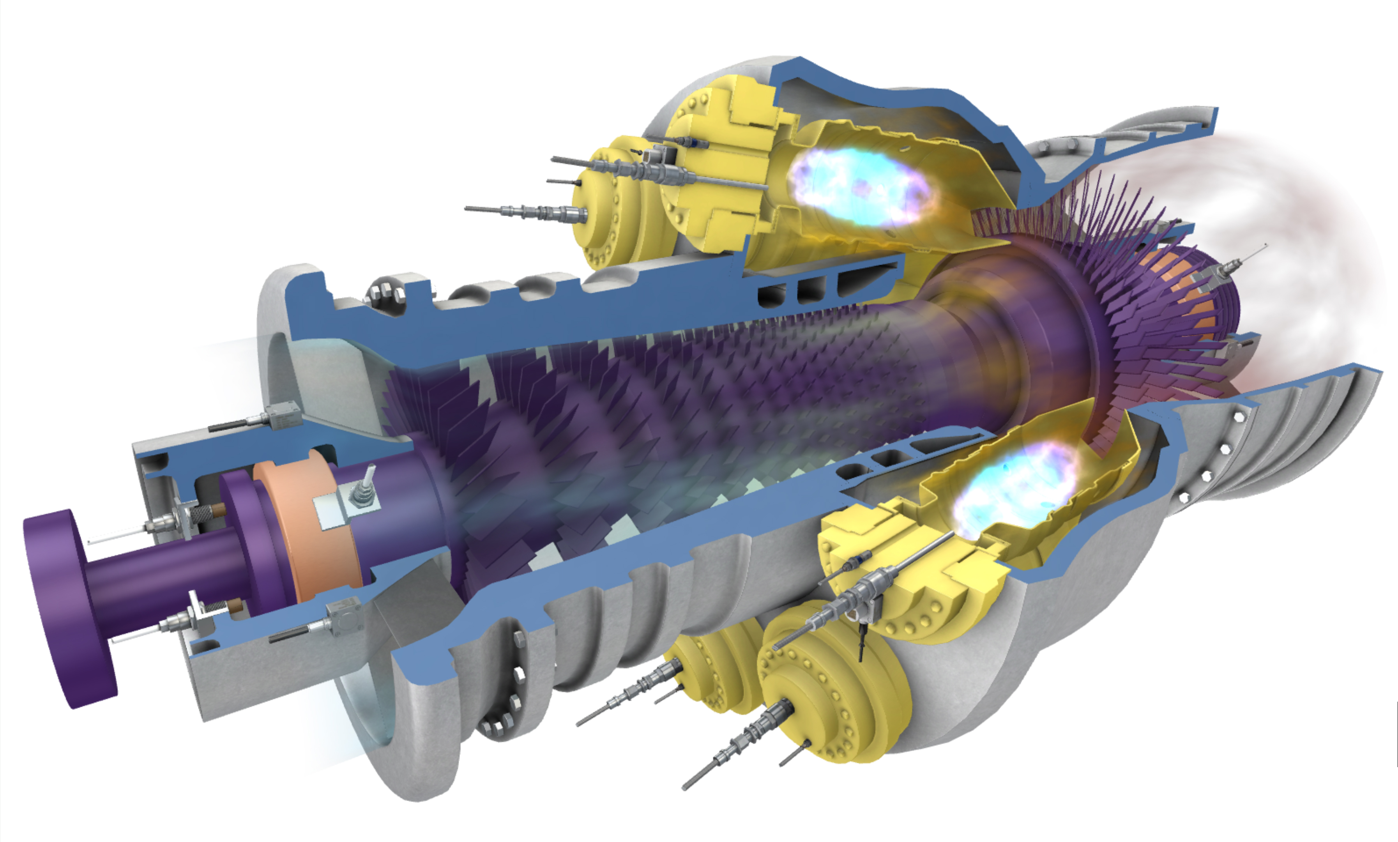
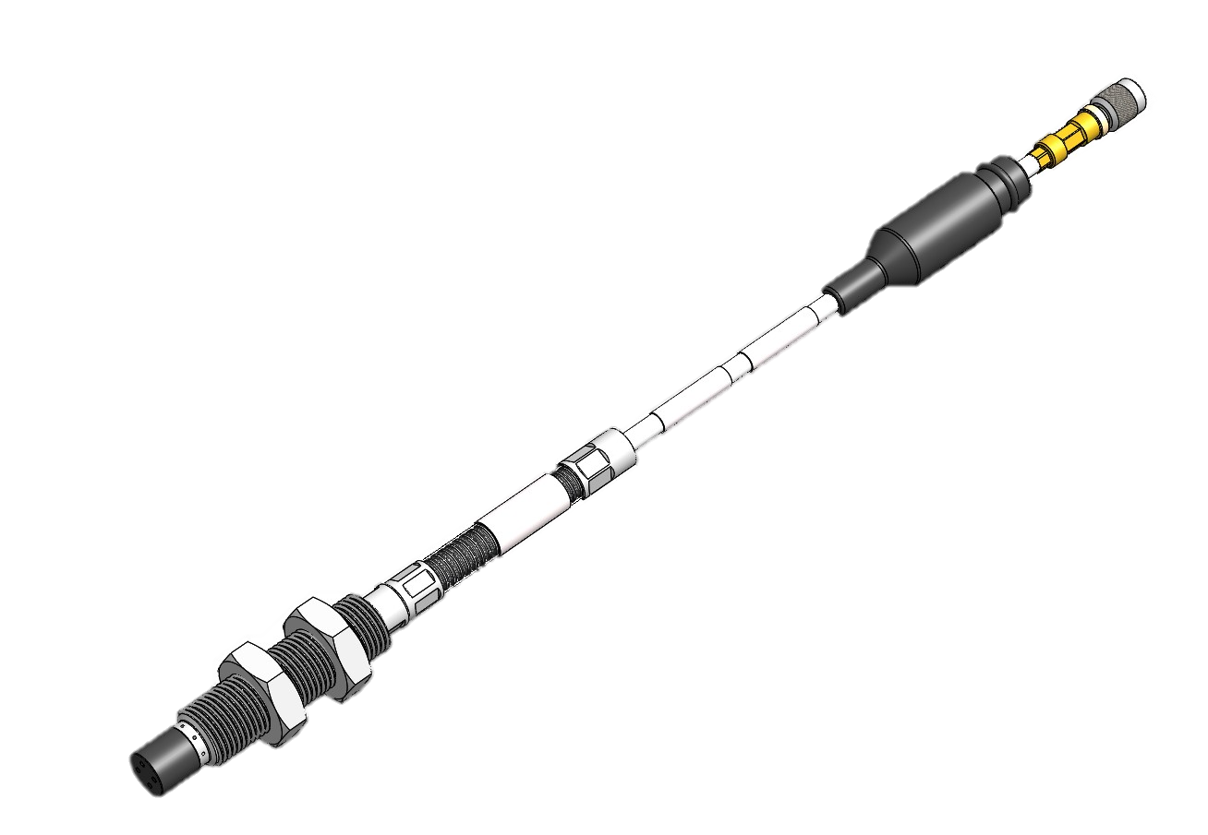
Sensing solutions for harsh environments
Industrial gas turbine
Absolute vibration
(accelerometers)
Displacement – Position - Speed
(proximity probes)
Combustion monitoring
(dynamic pressure)

Slide 6
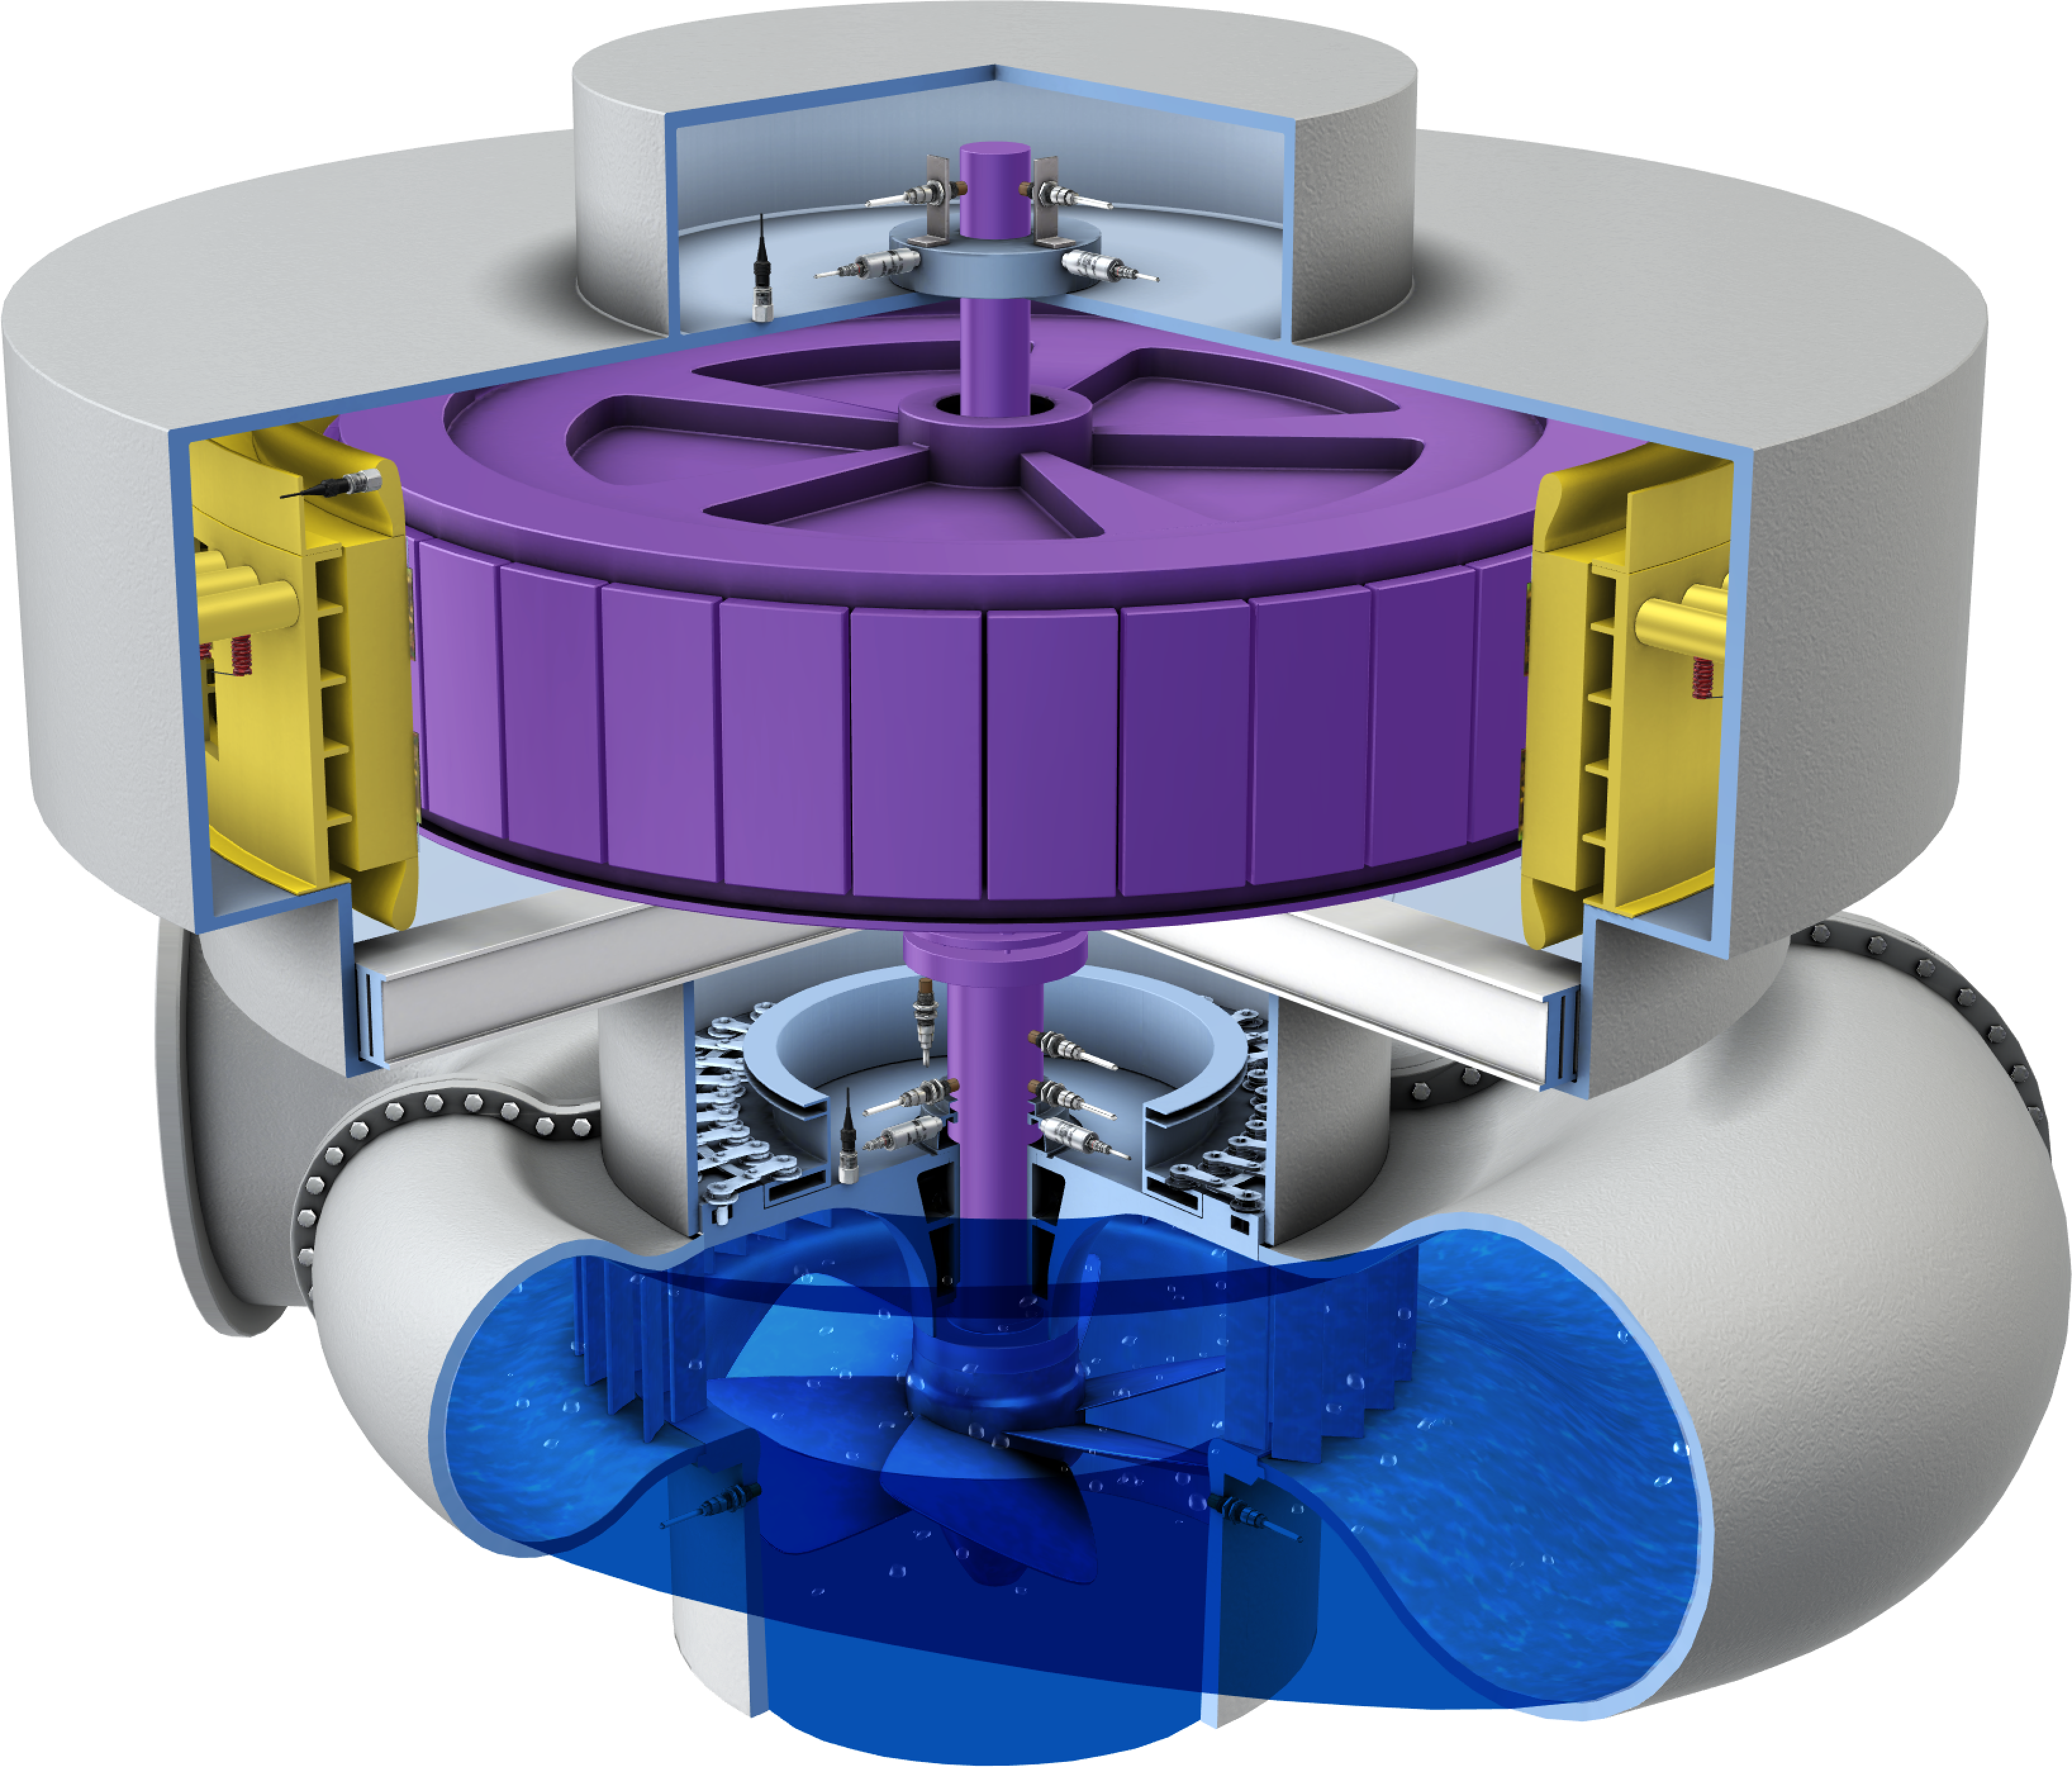

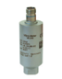
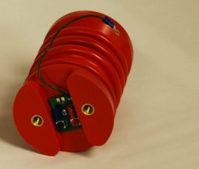
Sensing solutions
Hydro turbines
Absolute vibration
(accelerometers sensors)
Rotor-stator gap
(airgap sensors)
Vibration in velocity
(velocity sensors)
Displacement – Position - Speed
(proximity probes)
Winding current
(Partial Discharge)

Slide 7
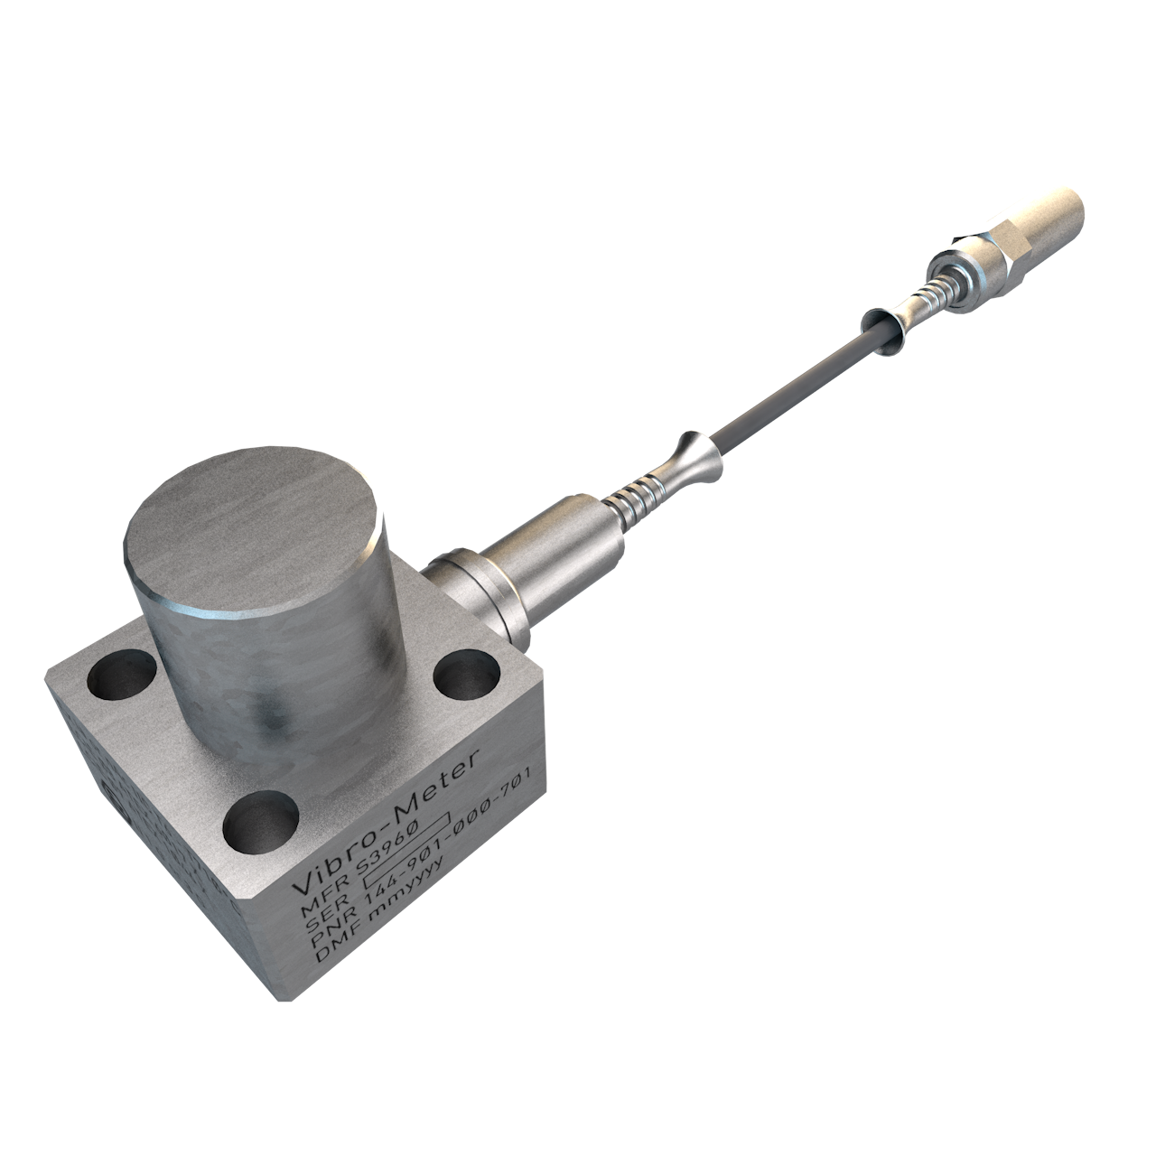
Absolute vibration
Systems

Slide 8

High-temperature piezoelectric sensors with external electronics
The CA series
Features & Benefits
Safety standards | API 760 compliant Ex certified SIL 2
Operating temperatures (up to) | 700 °C for sensors & 85 °C for signal conditioner
Sensitivities | From 10 to 100 pC/g
Measurement ranges | Dynamic - from 0.001 to 500 g Overload – up to 1000 g
Frequency responses | From 0.5 to 10’000 Hz
Signal conditioner IPC707 | With diagnostics & built-in test equipment (BITE)
Typical linearity Transverse sensitivity Sensitivity tolerance | ± 1% < 5% ± 5%
Piezoelectric-based sensors designed for the long-term measurement and monitoring of absolute vibration in the most severe of environments.

Slide 9
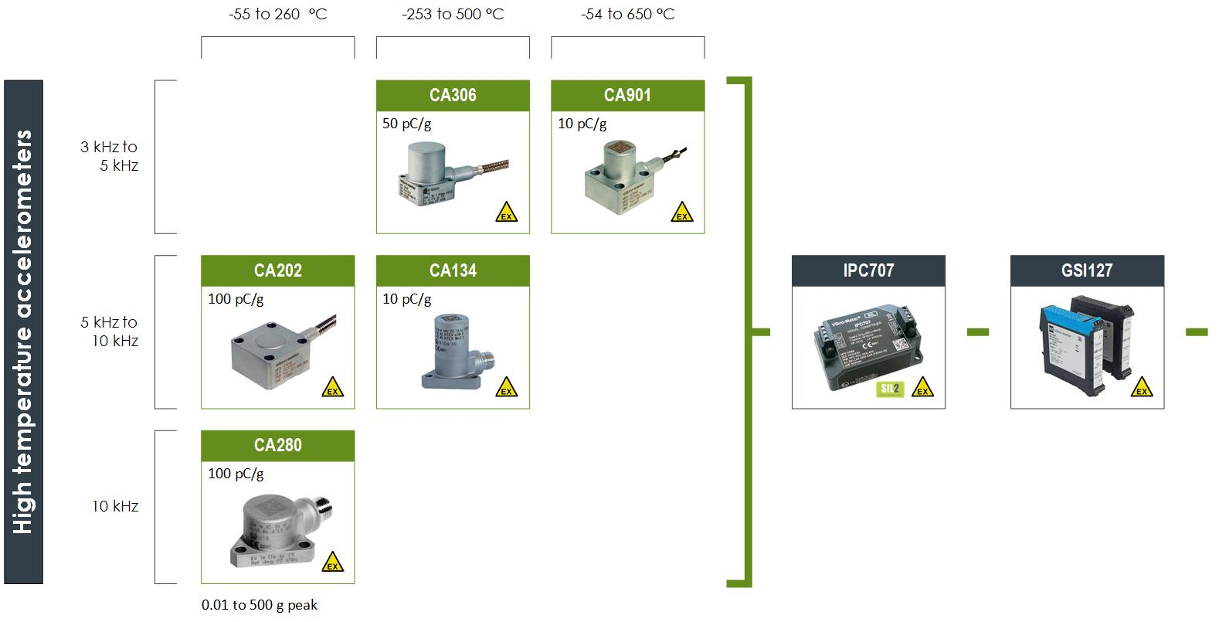
CA series overview
More than 10 000 CA measurement chains installed yearly by OEMs and end users worldwide.

Slide 10
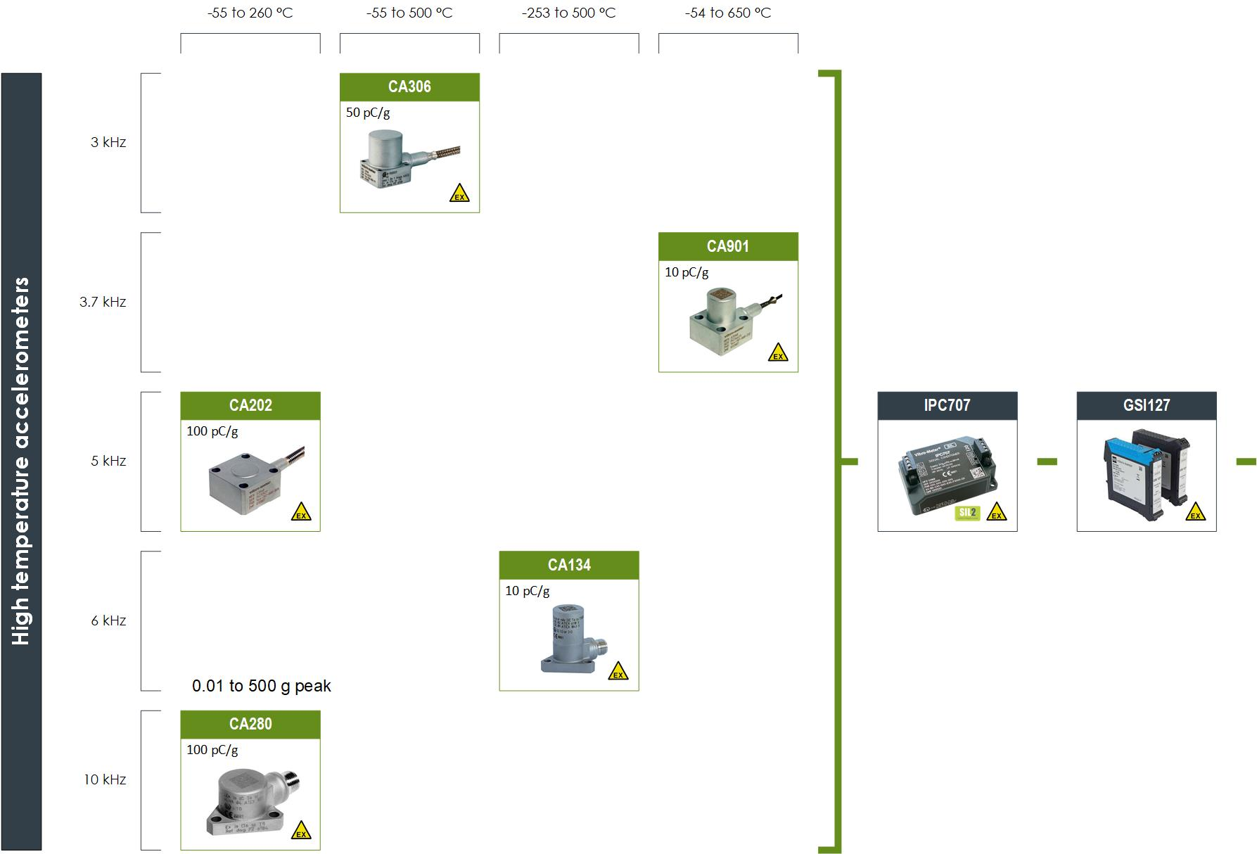
CA series overview
Signal conditioner
Galvanic separator
More than 10 000 CA measurement chains installed yearly by OEMs and end users worldwide.

Slide 11

Accelerometers and Velocimeters
With attached or integrated electronics
Features & Benefits
 | With attached electronics | With integrated electronics
Safety standards | API 760 compliant Ex certified SIL 2 | API 760 compliant Ex certified SIL 2
Operating temperatures | Up to 350 °C | Up to 140 °C
Sensitivities | From 5 to 50 μA /g | From 50 to 500 mV/g (CE6xx), From 4 mV/mm /s (PV660)
Measurement ranges | Dynamic - from 0.001 to 400 g Overload – up to 2000 g | Up to 80 g (CE6xx) Up to 100 mm /s RMS (PV6xx)
Frequency responses | From 2 to 10’000 Hz | From 2 to 10’000 Hz
Signal conditioning: | Attached or integrated. Note: No external signal conditioner, so no connectors close to the machinery being monitored and easier to install.
For applications that do not require the temperature capabilities of a CA sensor, this series provides a more cost-effective and easier to install solution.

Slide 12
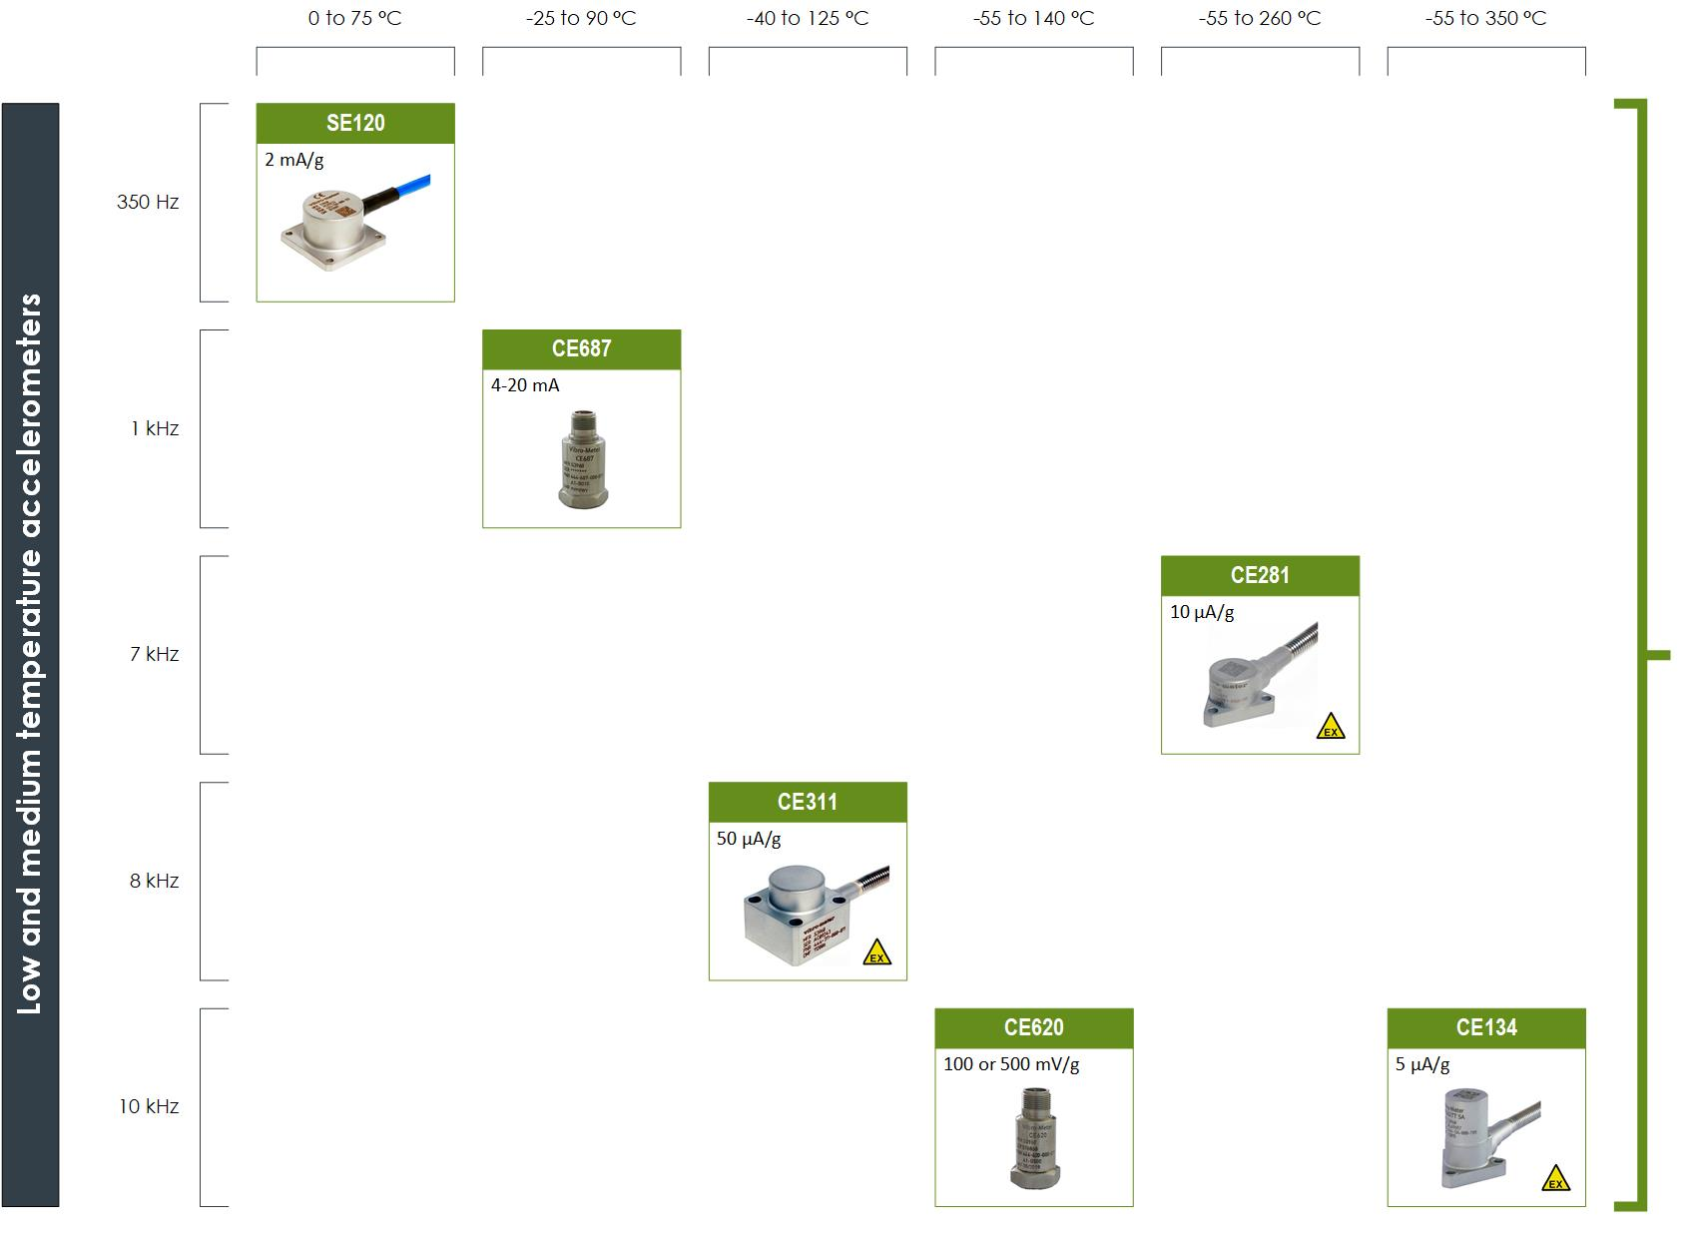
Accelerometers and Velocimeters
With attached or integrated electronics

Slide 13
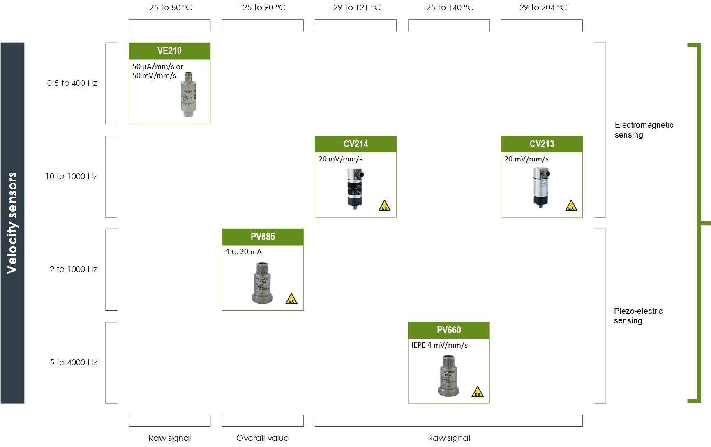
Low and medium temperature accelerometers
With attached or integrated electronics

Slide 14
Dynamic pressure
Solutions

Slide 15

CP series
Dynamic pressure sensor measurement chains
Features & Benefits
Safety standards | API 760 compliant Ex certified SIL 1 and SIL 2
Operating temperatures | Up to 700 °C for sensors Up to 85 °C for signal conditioner
Sensitivities | From 25 to 750 pC/bar
Measurement ranges | Dynamic - from 0.00005 to 250 bar Overload – up to 350 g
Frequency responses | From 2 to 15’000 Hz
Typical linearity | ±1%, low acceleration sensitivities
Piezoelectric-based sensors designed for the long-term measurement and monitoring of combustion in gas turbines: combustor pulsations and combustion dynamics.

Slide 16
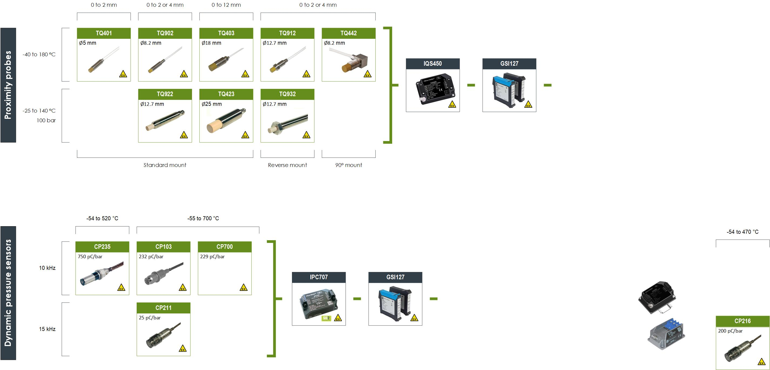
CP series
Dynamic pressure sensor measurement chains
Patented acceleration-compensated designs with the highest temperatures and pressure sensitivities in the industry.

Slide 17
Relative vibration

Slide 18

Proximity probes measurement chains
Features & Benefits
Safety standards | API 760 compliant (TQ9xx, EA90x and IQS900 ) Ex certified SIL 1 and SIL 2
Operating temperatures | -40 °C to 180 °C for sensors -35 °C to 85 °C for signal conditioner
Signal transmission | Up to 1000m
Measurement ranges | 2 mm range with 8 mV/μm or 2.5 μA/μm sensitivity and Ø 5.1 mm tip 4 mm range with 8 or 4 mV/μm or 2.5 or 1.25 μA/μm sensitivity and Ø 8.2 mm tip 12 mm range with 1.33 mV/μm or 0.417 μA/μm sensitivity and Ø 18 mm tip
Frequency responses | DC to 20’000 Hz
Mount | Standard, reverse and right-angle (90°)
Non-contact measurement | Based on eddy current principle
Eddy-current based sensors designed for the contactless measurement of the relative displacement of moving machine elements.

Slide 19
Proximity probes series overview
Comprehensive radial vibration, axial position, rotational speed and phase reference
(1/ REV pulse) measurement solutions

Slide 20
Air gap

Slide 21
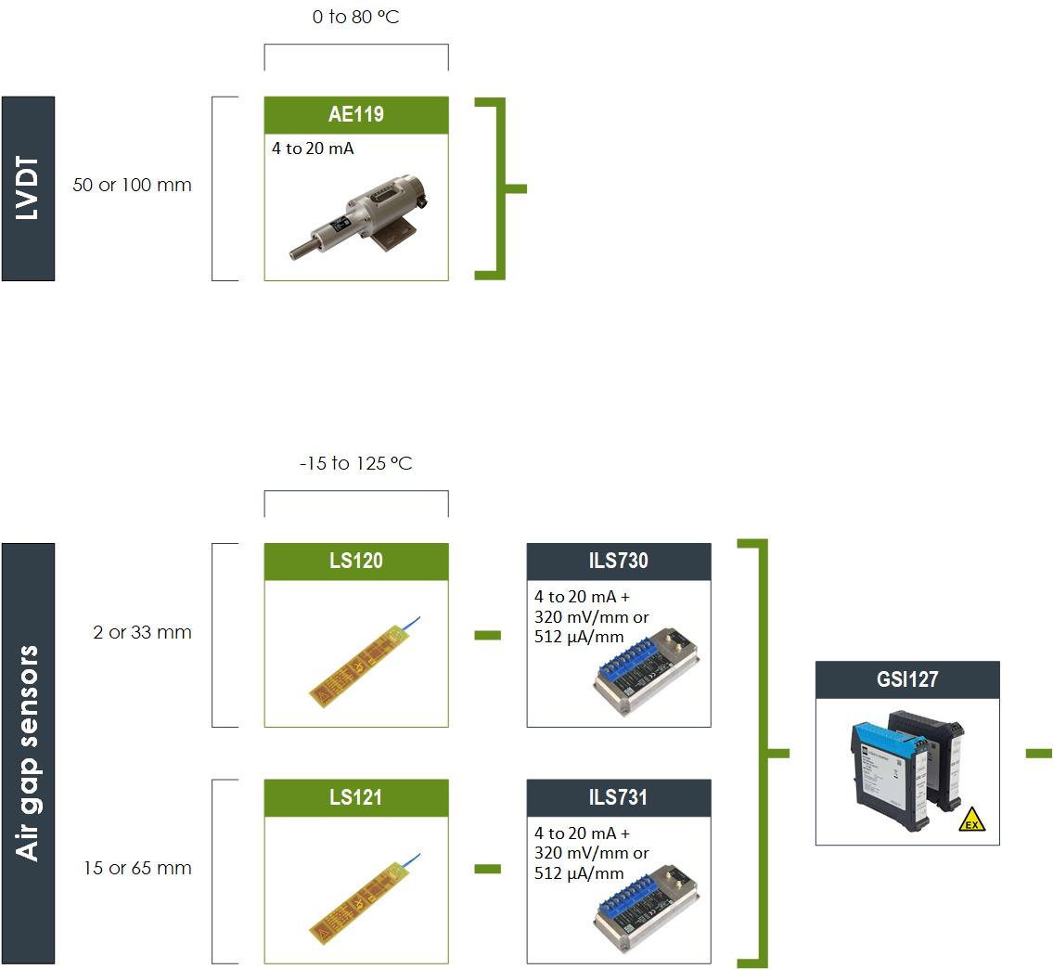
Air gap measurement chains
For contactless measurements of generator air gaps between rotor and stator using an electric field (capacitance) technology.
Key features
Three output signals: Pole profile, rotor profile and min gap
Contactless measurement – no wear-out
Three voltage + one 4 to 20mA output signals
Enhanced filtering of noise and spikes
induced by high excitation currents

Slide 22
Housing expansion probes

Slide 23
Housing expansion probes
For absolute housing expansion monitoring on medium to large thermal machines like gas and steam using eddy current technology.
Key features:
Integrated electronics delivering 4-20mA output signal
Splash proof: IP54 protection rating

Slide 24
Thank you

