Slide 1
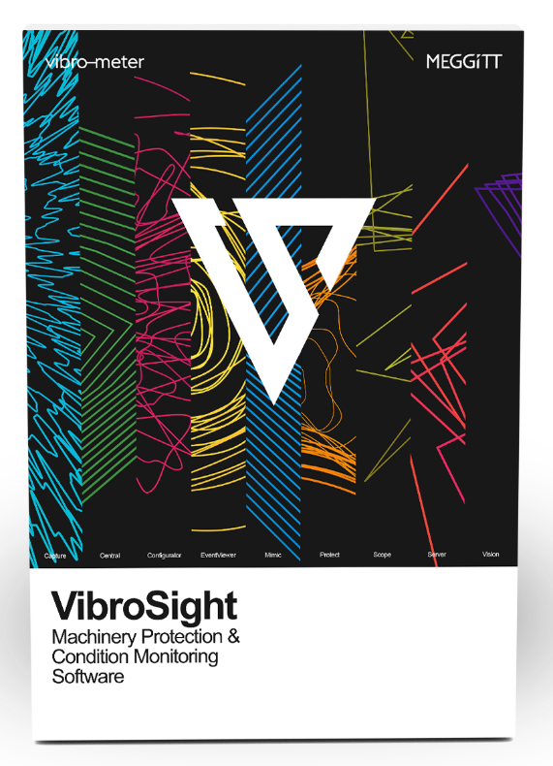
VIBROSIGHT
Advanced machinery protection and condition monitoring software
Presenter:
Title:
Date:

Slide 2

VibroSight enables modular, flexible and comprehensive machinery protection and condition monitoring solutions for a wide range of applications within the power generation, oil & gas, and process industries.
Notes:
Product line logic
Add real examples of application (number of VM600 installed etc)

Slide 3

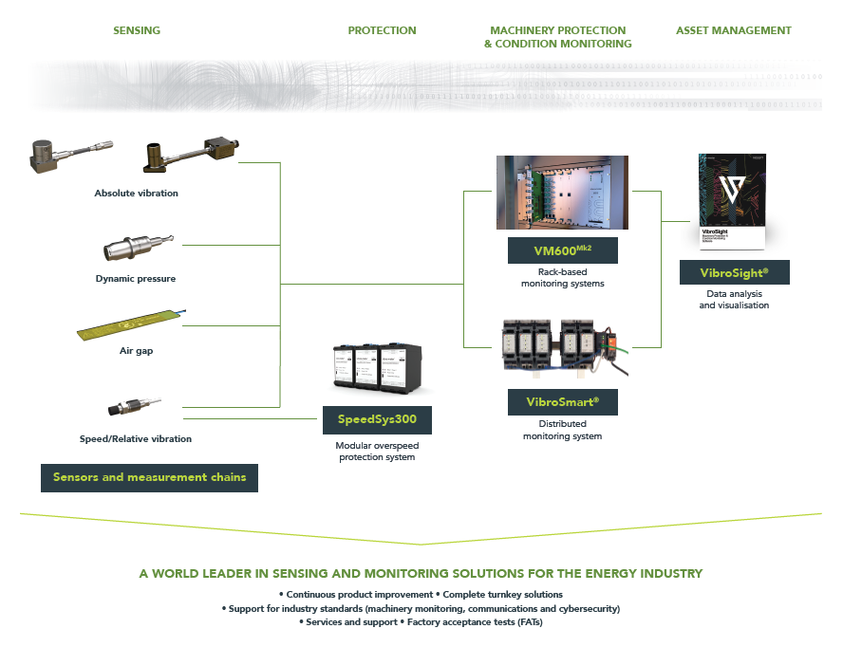
Portfolio overview

Slide 4






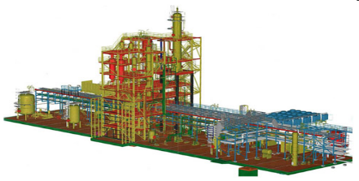
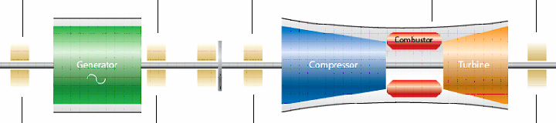
System Architecture
VibroSight System
Data display workstations
Offline analysis
Database
Ethernet plant data highway
Configuration and local data display
VM600^{Mk2} System
VibroSmart
System
Digital Control System
Process parameters
Vibration – speed – pressure - temperature, etc.

Slide 5



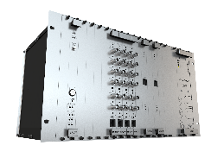


System architecture
VibroSight System
MONITORING SYSTEM DEVICES
Database
INDUSTRIAL MACHINERY

Slide 6
VibroSight demo

Slide 7
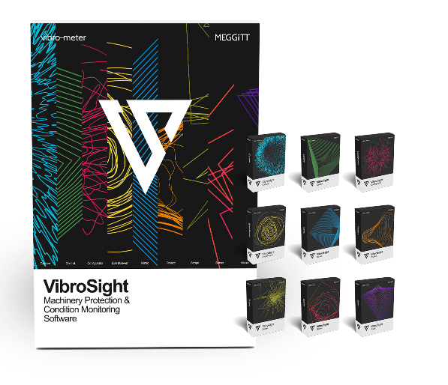
Software Suite
VibroSight has a modular client-server architecture composed of system configuration, monitoring and management applications

Slide 8

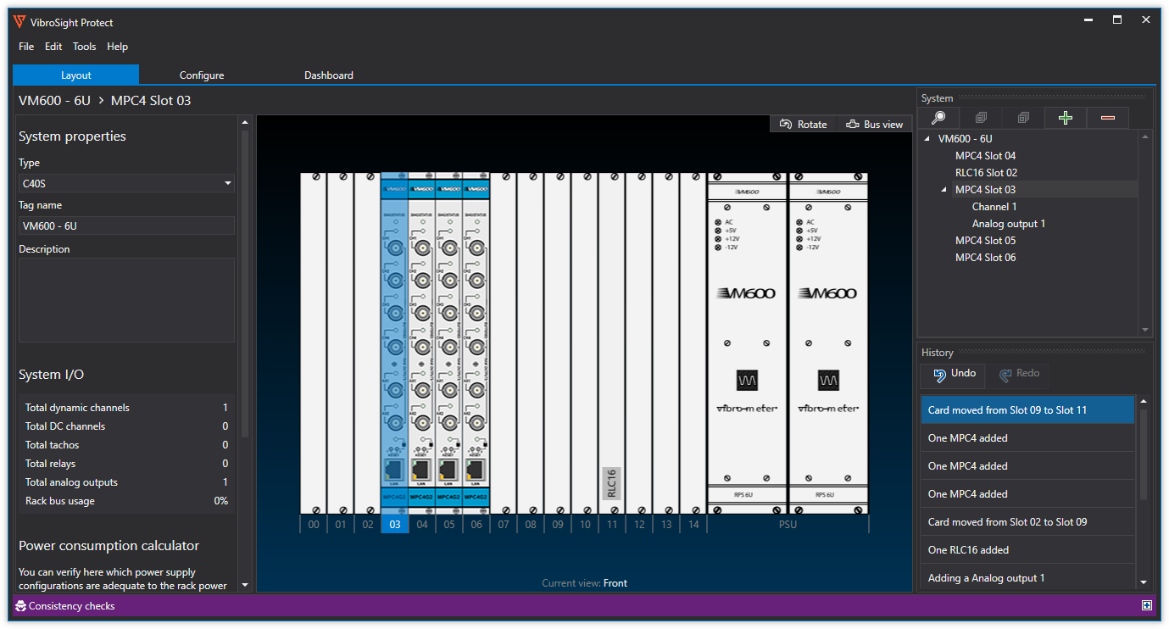
MACHINERY PROTECTION CONFIGURATOR
For the configuration of machinery protection functionality for VM600^{Mk2} systems.

Slide 9
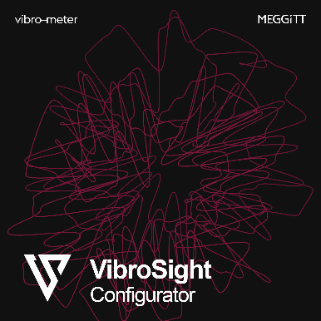
MONITORING SYSTEM HARDWARE CONFIGURATOR
Application software used to configure VM600 or VibroSmart monitoring systems.
Configurator can also be used to configure the external interfaces with third-party devices using industry-standard protocols such as Modbus and OPC.

Slide 10

CONDITION MONITORING CONFIGURATOR
For the configuration of condition monitoring functionality for VM600^{Mk2} systems.

Slide 11

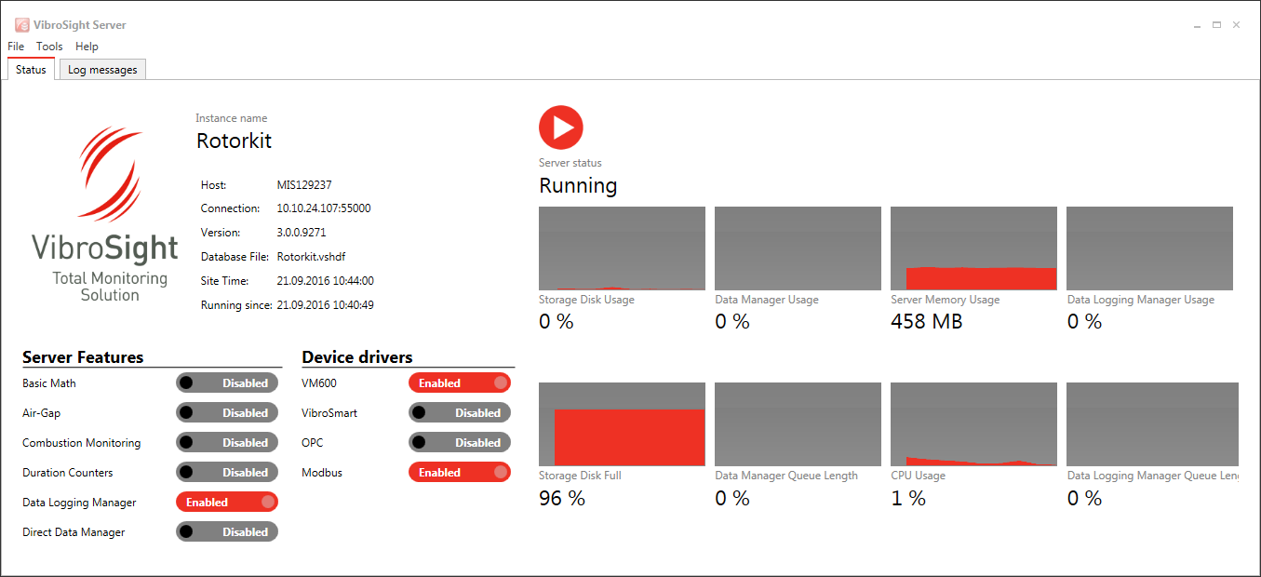
Data Management The core server software module that interacts with all other parts of the machinery monitoring system and manages the online database.

Slide 12

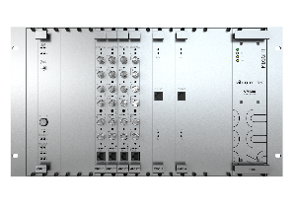


Integrated database management
VibroSight – Server
Simplifies operation of the database backup, database purge and management of offline data files
Backup
Incremental backup
Data logging
Data Base
Data purge
Trash bin
Monitoring system
Data copy
Historical data files

Slide 13

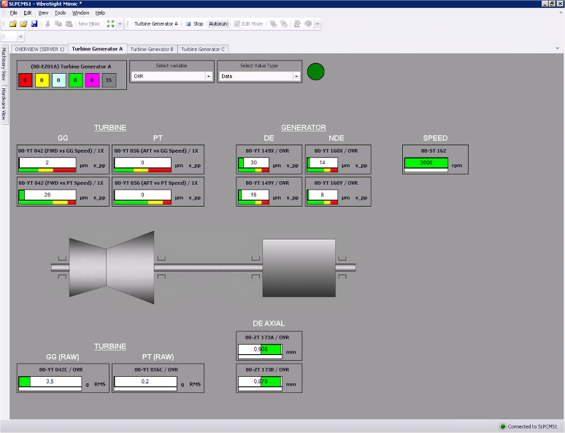
MACHINE OPERATOR INTERFACE Provides an overview of the machinery being monitored using live measurement data. Mimic uses shortcuts that allow static and dynamic measurements of interest to automatically open the Vision software module and be displayed in more detail.

Slide 14

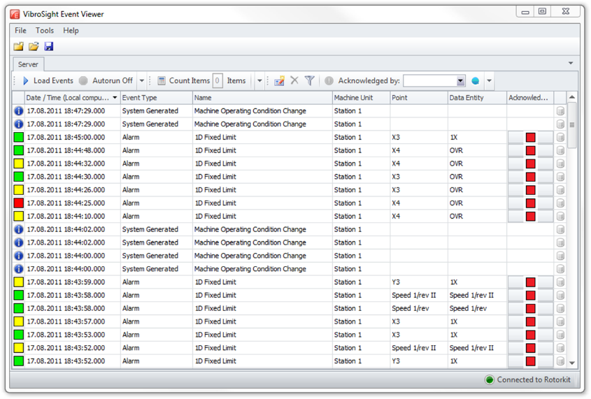
MONITORING OF ALARMS AND SYSTEM EVENTS
Allows the monitoring of alarms and system events from monitoring systems or stored in VibroSight databases.
Event Viewer provides a comprehensive overview of alarms (severity states), which may have been triggered by factors such as excessive vibration levels in the machinery being monitored.

Slide 15

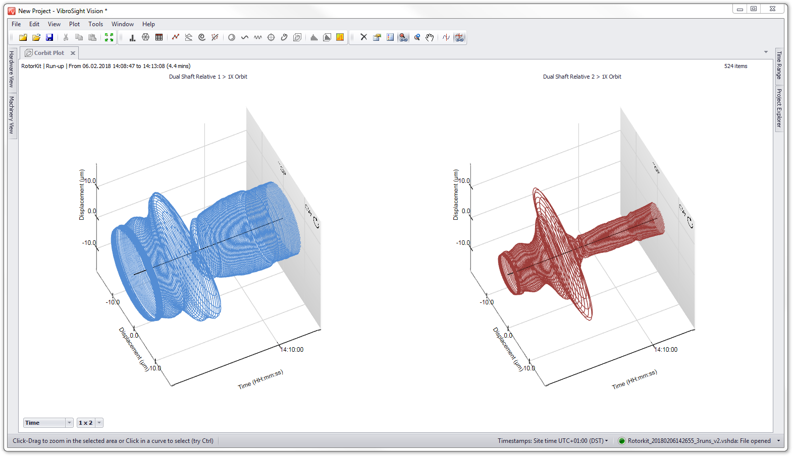
DATA VISUALIZATION & ANALYSIS Features a comprehensive plot catalogue to display and analyse live or historical data from monitoring systems or stored in VibroSight databases.
Plot catalogue: Corbit, Orbit, Polar, Shaft certer line, Spectogram, Spectrum, Waterfall cascade, trend and table

Slide 16
Features & Benefits

Slide 17

Easy to use
Use and navigation of the software is deliberately simple and straightforward in order to make tasks intuitive
Fast installation and configuration from a single setup file.
Tightly-integrated and automated database management.
Fast data analysis and machinery diagnosis using a comprehensive plot catalogue, featuring cursor and zoom synchronisation.
Fully customisable machine states including run-ups and run-downs.

Slide 18

Complete
Modular, flexible and comprehensive solutions for a wide range of applications
Machinery protection and condition monitoring applications.
Compatible with VM600 and VibroSmart monitoring systems to support a wide range of input signals such as vibration, combustion, air gap, magnetic flux, temperature, etc.
More than 15 different plot types including corbit (cascaded orbit), long waveform and spectrogram plots for detailed data visualisation and analysis.
Additional modules for improved machine analysis and diagnostics Possibility to add special combustion monitoring and generator air gaps analysis modules, or add a mathematical module with one own’s rules.

Slide 19

High performance
Allows to efficiently handle large numbers of measurement points and huge volumes of data
Highly-optimised, proprietary databases that are much faster than standard databases (off the shelf solutions?).
Flexible data storage including an online database for data logging and stand-alone historical data archive files for offline data analysis and/or data sharing.
Effortlessly fast data retrieval
Data logging of very large systems including more than 700 measurements point per system.

Slide 20

Cyber security & IoT
Easy correlation of data from multiple different systems is supported in cybersecure environments
Support for remote monitoring and diagnostics using mirrored (replica) servers
Support for industry-standard communication protocols to allow data exchange with other systems, including OPC Classic and UA, Modbus TCP and RTU, PROFIBUS DP, CSV files and Python.
Centralised diagnostic centers and decision making with seamless data display across multiple devices, databases or historical data archive files.

Slide 21

VibroSight current status
Ready for cyber security environments
Import of VibroSight HDA files into the VibroSight database
Historical data files
Firewall
Historical data files
Monitoring system
Mirrored database
Database
Local
Remote
Notes:
Import of VibroSight HDA files into the VibroSight database
For the creation of a replica/mirror of a remote database in a central diagnostics centre.
The synchronization of the original and replica database servers is done via the transfer for VibroSight data files.
Useful when the original database is located:
Behind a network data diode
Behind a firewall
In a remote location connected via an unreliable network.

Slide 22
communication interfaces

Slide 23

Data export capabilities
Communication interfaces
Modbus serial
OPC classic
Modbus TCP
OPC UA
Database
Ethernet plant data highway
Profibus
Profibus
Profinet
VM600^{Mk2} System
VibroSmart
System
Modbus serial
Modbus serial
Modbus TCP
Modbus TCP
IEC61850

Slide 24


Data import capabilities
Communication interfaces
Modbus serial
CSV files
Modbus TCP
VSHDA files
OPC classic
Database
Ethernet plant data highway
VM600^{Mk2} System
VibroSmart
System

Slide 25
Thank you

