Slide 1
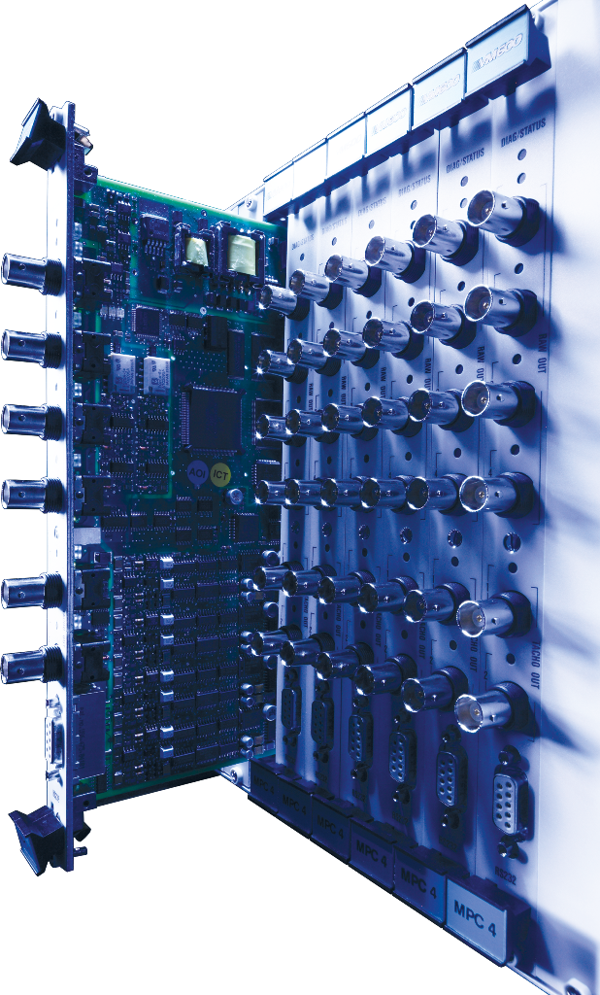

VM600^{Mk2}
Product Introduction

Slide 2
VM600
Evolution through time
VM600^{Mk1} Launch
VM600^{Mk2}
Basic MPS:
- MPC4,
- CPUM,
- RLC16
IRC4
CPUR
XMV16 & XMC16
VibroSight CMS Software
SIL2 certification
Per IEC61508 (PiU)
CMS S/W
CMC16
AMC8
CPUR2
MPC4 SIL1version
2000
2005
2010
2015
2021
As of today:
More than 8000 systems sold worldwide, protecting and monitoring critical assets 24/7
40’000 MPC4/IOC4 machinery protection modules
5’500 CMC16/XMV16/XMC16 condition monitoring modules

Slide 3
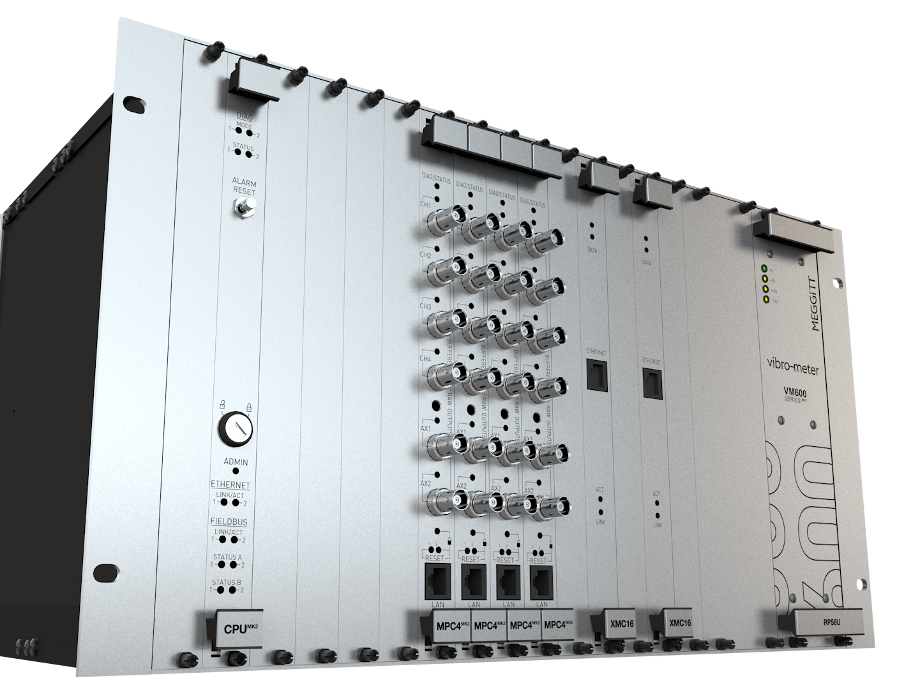
Why VM600^{Mk2} ?
Technical evolution
Next generation rack-based system for advanced machinery protection and condition monitoring
Component obsolescence issues
Benefit from state-of-the-art hardware and software technologies
Improved performances
Address new requirements and markets needs

Slide 4
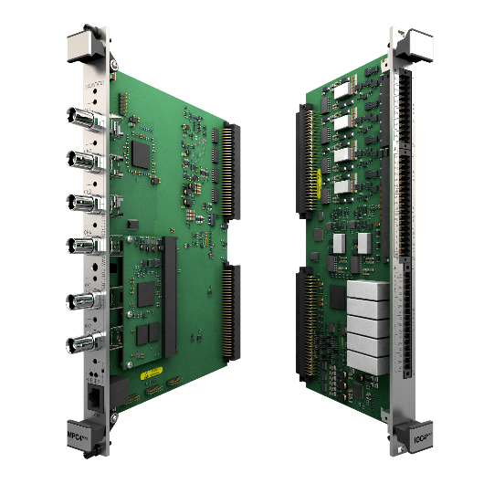
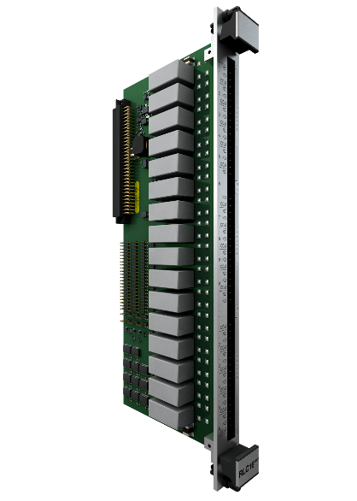
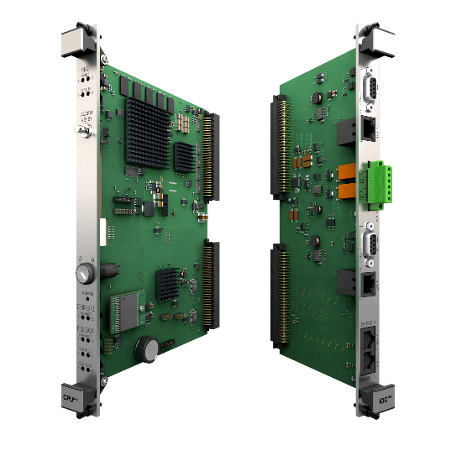
Key features: VM600^{Mk2} hardware
New hardware for Machinery Protection
Machinery Protection Module MPC4^{Mk2} + IOC4^{Mk2}
Available modules:
MPC4Mk2 + IOC4Mk2 (Q1 2021)
MPC4Mk2 + IOC4Mk2 with CMS capability (Q3 2021)
MPC4Mk2 + IOC4Mk2 SIL2 (Q1 2022)
MPC4^{Mk2} + IOC4^{Mk2} , RLC16^{Mk2}, CPU^{Mk2}
Enhanced features
24bits ADC resolution
20kHz bandwidth
Up to 5 processed output’s per channel
Added capabilities
Integrated CMS in MPC4^{Mk2}, in-situ upgrade
Cybersecurity certification per IEC62443
SIL 2 by design per IEC61508 (H1-2022)
Full API670 compliance
Machinery Protection Relays RLC16^{Mk2}
Available modules:
RLC16Mk2 (Q1 2021)
RLC16Mk2 SIL 2 (Q1 2022)
System controller and data communication gateway CPU^{Mk2}
Available modules:
CPUMk2 + IOCMk2 module for Modbus RTU/TCP
CPURMk2 + IOCRMk2 redundant module with mathematical processing of fieldbus data and support for Modbus TCP and PROFIBUS DP

Slide 5
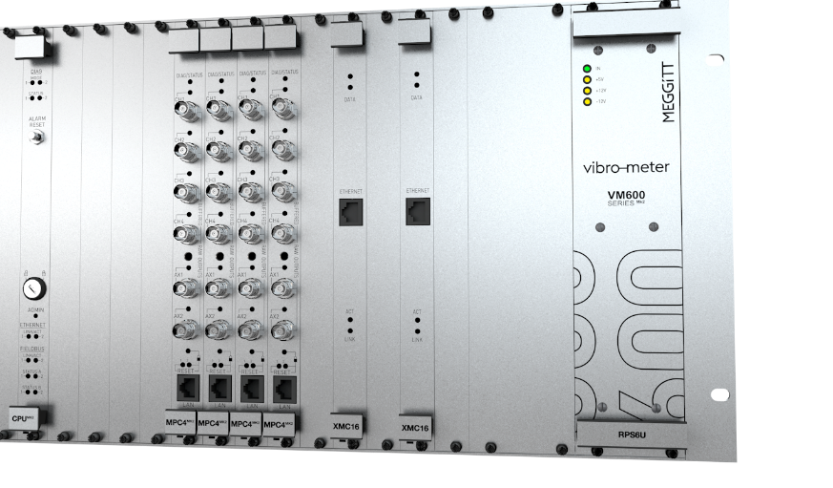
VM600^{Mk2}
Design Concept Enhancement
MPC4^{Mk2} With Condition Monitoring Capabilities
Covers most of energy industry CMS needs
Completely segregated per API 670 5th Edition
Comprehensive view on machinery behavior: MPS data can be logged and displayed on the Condition monitoring system
Easy And Fast Configuration
NEW VibroSight Protect
User-friendly interface visually guides measurement channel configuration based on the sensor family and the type of processing required.
MPS and CMS distinct configuration software applications ensure complete segregation

Slide 6


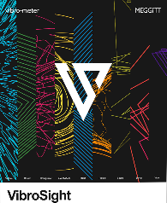
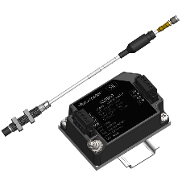
VM600^{Mk2}
Increased safety and security
Locked operational mode for improved safety and security
physical access to VM600 rack required to change the machinery protection system configuration
Segregation of protection and condition monitoring
in accordance with API 670 5th edition
Permanent link to VibroSight server for CMS features
Temporary link to Protect® for MPS configuration
Temporary link
Permanent link
Condition Monitoring
XMV16
MPC4^{Mk2}
Machinery Protection
Machinery Protection configuration software
Condition Monitoring software
VM600^{Mk2} Rack

Slide 7
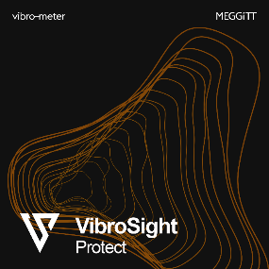
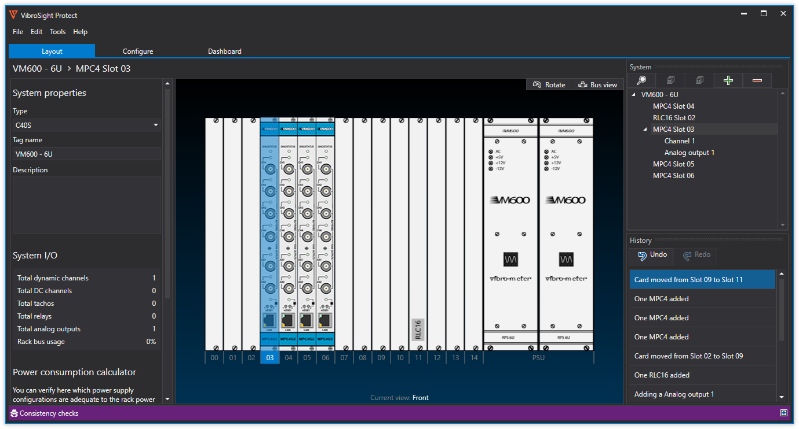
Key features: VM600^{Mk2} software
Machinery protection system
New machinery protection configuration software
Intuitive user interface
Fast configuration
More than 2x faster than MPS1 Software
Checks overall rack configuration consistency
As opposed to one-by-one card configuration

Slide 8
VM600^{Mk2}
Advanced machinery protection and condition monitoring designed for critical rotating machinery
What do we offer?
The most reliable condition and monitoring system for critical machinery assets.
Key benefits
Evolution of a proven and reliable platform
New simplified and intuitive interface
Modular design
Centralized system
Designed to Centrally process a wide range of dynamic inputs coming from a variety of critical assets
VM600^{Mk2}
Market category
Critical rotating machinery
Key differentiators
All measurements in one card
Enables complex systems to be built with a minimum number of cards
Limits spare parts inventory
100% API670 compliance
SIL2 by design
Cybersecurity compliance Per IEC62443
Integrated high-end CMS
Applications
Power Generation: gas, steam, hydro and nuclear
Oil & Gas
Other critical industrial applications

Slide 9
VM600^{Mk2}
Launch Roadmap
Launch
VM600^{Mk2} Machinery Protection
MPC4^{MK2}, RLC16^{MK2}, CPU^{MK2}
Vibrosight Protect
Launch
VM600^{Mk2} Integrated CMS Solution
- MPC4^{MK2} CMS Version
- AMC8^{Mk2}
- Vibrosight 6.0
VM600^{Mk2} MPS available to quote
(ongoing early adopters test)
VM600^{Mk2} MPS with integrated CMS solution available to quote
(early adopters)
VM600^{MK2} Program Normalized
VM600^{MK1} platform obsolete
(Spares & upgrades support only)
Q4-2020
Q1-2021
Q2-2021
Q3-2021
Q4-2021
H1-2022
H2-2022
Features & certification
Cybersecurity certification Per IEC62443 (SL2)
CSA Approvals
Features & certification
SIL2 certification
Add-on capabilities per market**

Slide 10
VM600^{Mk2}
Useful Links
Website Product Landing page:
https://meggittsensing.com/energy/vm600mk2/
Datasheets (pdf download):
https://meggittsensing.com/wp-content/uploads/DS_VM600_Mk2_MPC4_Mk2_IOC4_Mk2-en-1.pdf
https://meggittsensing.com/wp-content/uploads/DS_VM600_Mk2_RLC16_Mk2-en-1.pdf
https://meggittsensing.com/wp-content/uploads/DS_VM600_Mk2_CPU_Mk2_IOC_Mk2-en.pdf
Meggitt – vibro-meter® website:
https://meggittsensing.com/energy/
vibro-meter® Products catalog
https://catalogue.meggittsensing.com/

Slide 11
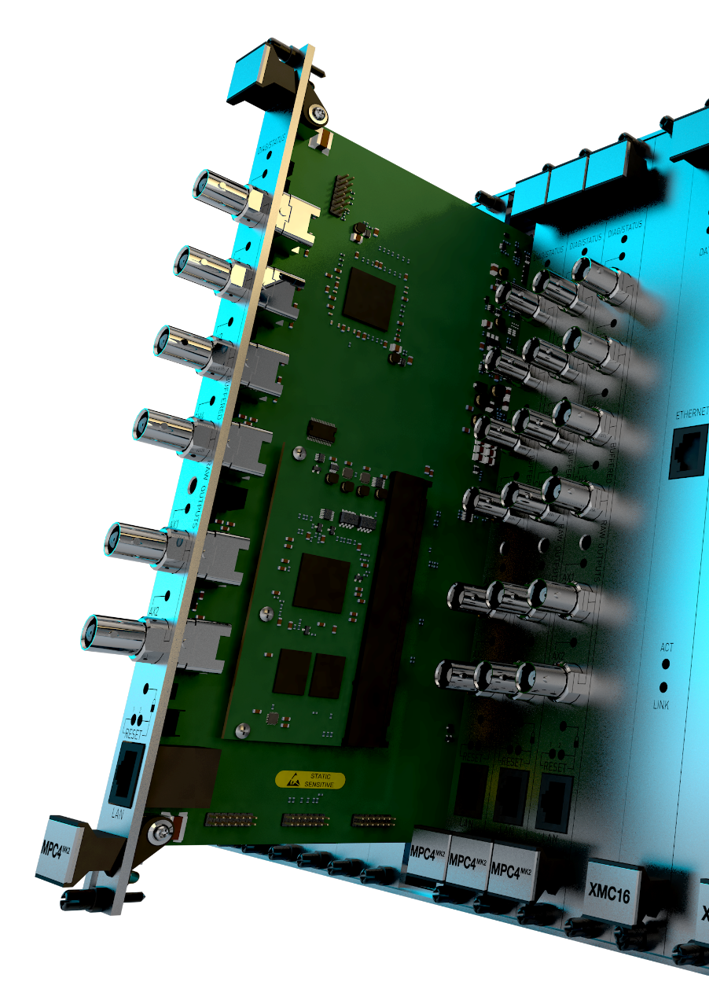
Thank you!
For more information regarding our VM600^{Mk2} protection and monitoring system or our portfolio in general, please contact your local Meggitt representative or visit our website at https://meggittsensing.com/energy/

Slide 12
Disclaimer
Business legal entity. Business address.
Legal entity registration information as appropriate.
Information contained in this document may be subject to export control regulations of the United Kingdom, European Union, United States or other national jurisdictions, including the US International Traffic in Arms Regulations and/or Export Administration Regulations.
Each recipient of this document is responsible for ensuring that transfer or use of any information contained herein complies with all relevant Export Control Regulations.
© Meggitt 2021. All rights reserved.

